Slide 1
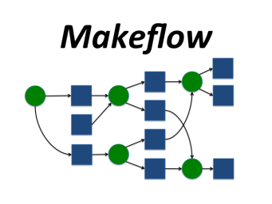
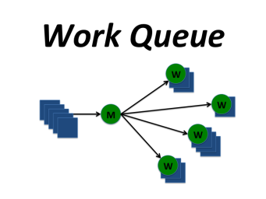

Introduction to
Makeflow and Work Queue
Prof. Douglas Thain, University of Notre Dame
http://www.nd.edu/~dthain
dthain@nd.edu
@ProfThain

Slide 2
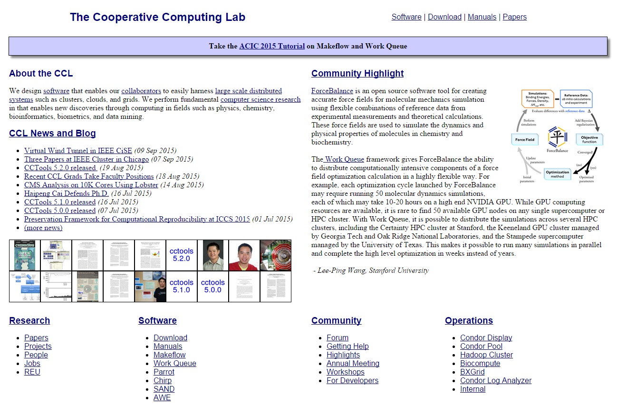
Go to http://ccl.cse.nd.edu and click on ACIC Tutorial.

Slide 3
The Cooperative Computing Lab
We collaborate with people who have large scale computing problems in science, engineering, and other fields.
We operate computer systems on the O(10,000) cores: clusters, clouds, grids.
We conduct computer science research in the context of real people and problems.
We develop open source software for large scale distributed computing.
http://www.nd.edu/~ccl

Slide 4
Outline
Thinking Opportunistically
Overview of the Cooperative Computing Tools
Makeflow
Makeflow + Work Queue
Makeflow + Work Queue + Containers
Work Queue Native Code
Hands-On Tutorial

Slide 5
Thinking Opportunistically

Slide 6
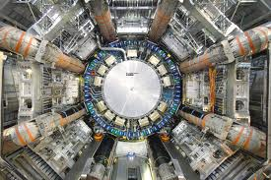
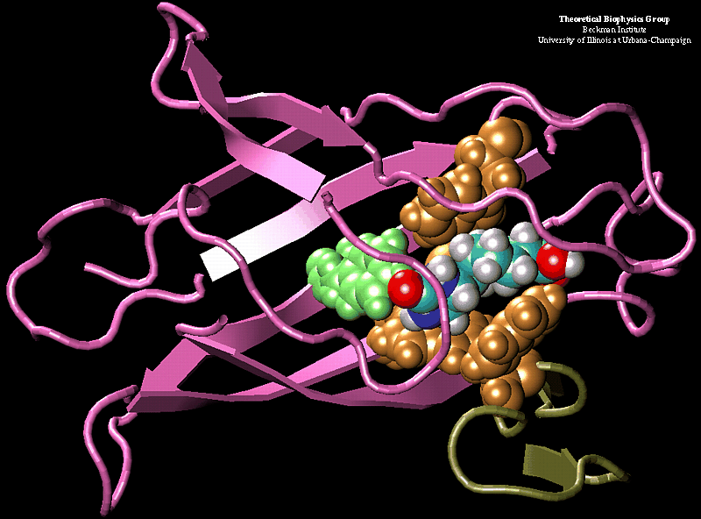
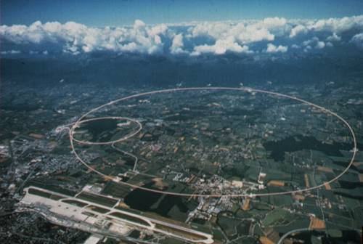
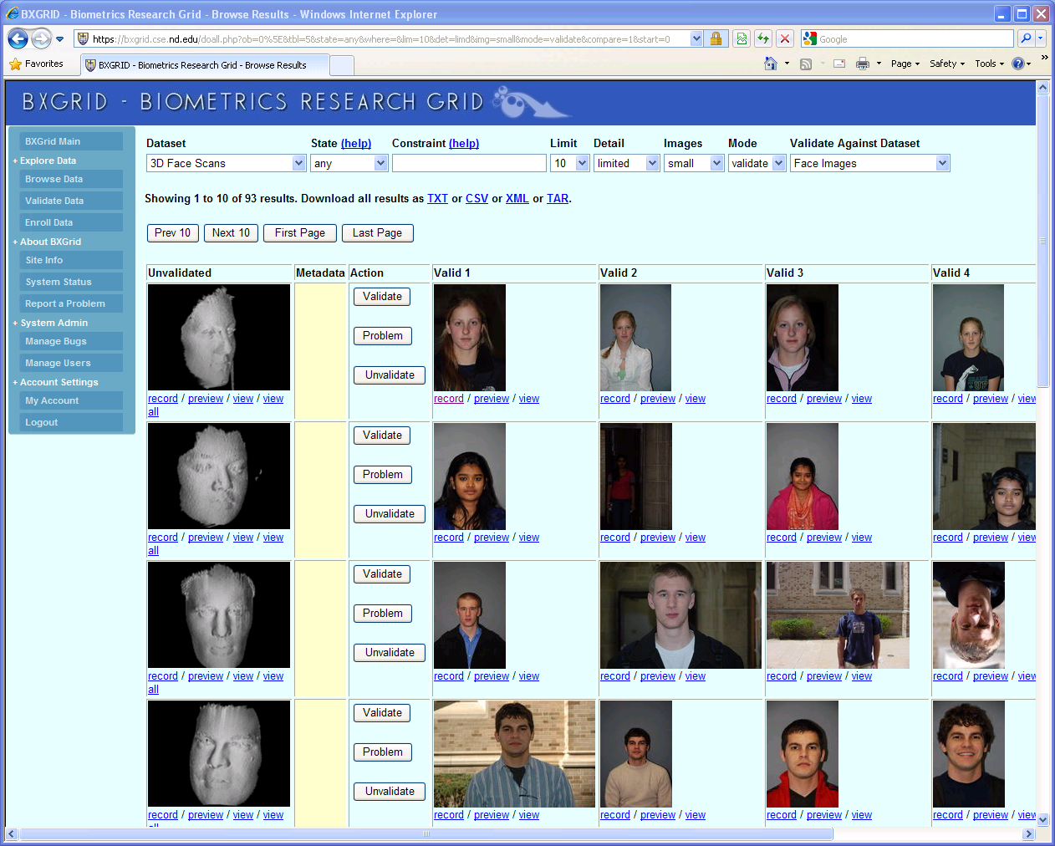
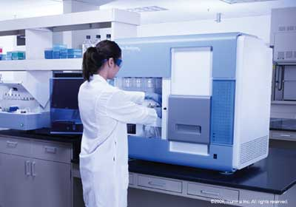

Science Depends on Computing!
AGTCCGTACGATGCTATTAGCGAGCGTGA…

Slide 7
Opportunistic Computing
Much of scientific computing is done in conventional computing centers with a fixed operating environment with professional sysadmins.
But, there exists a large amount of computing power available to end users that is not prepared or tailored to your specific application:
  National HPC facility
  Campus-level cluster and batch system.
  Volunteer computing systems: Condor, BOINC, etc.
  Cloud services.
Can we effectively use these systems for “long tail” scientific computing?

Slide 8
Opportunistic Challenges
When borrowing someone else’s machines, you cannot change the OS distribution, update RPMs, patch kernels, run as root…
This can often put important technology just barely out of reach of the end user, e.g.:
  FUSE might be installed, but without setuid binary.
  Docker might be available, but you aren’t a member of the required Unix group.
The resource management policies of the hosting system may work against you:
  Preemption due to submission by higher priority users.
  Limitations on execution time and disk space.
  Firewalls only allow certain kinds of network connections.

Slide 9
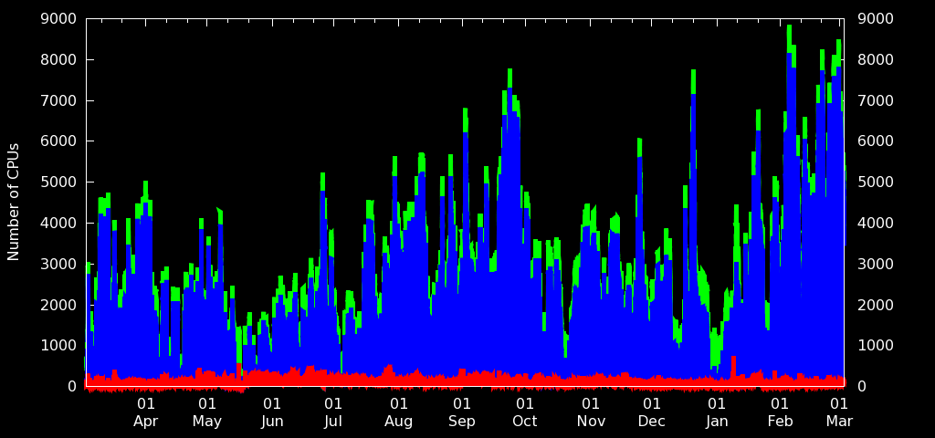
Backfilling HPC with Condor at Notre Dame

Slide 10
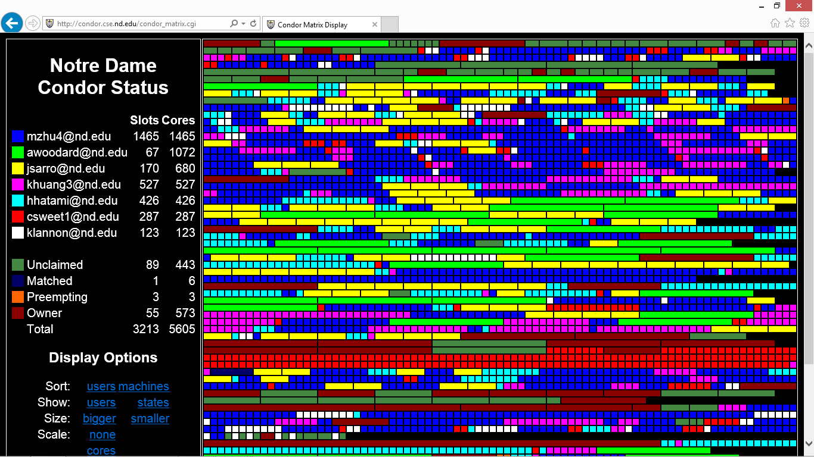
Users of Opportunistic Cycles

Slide 11
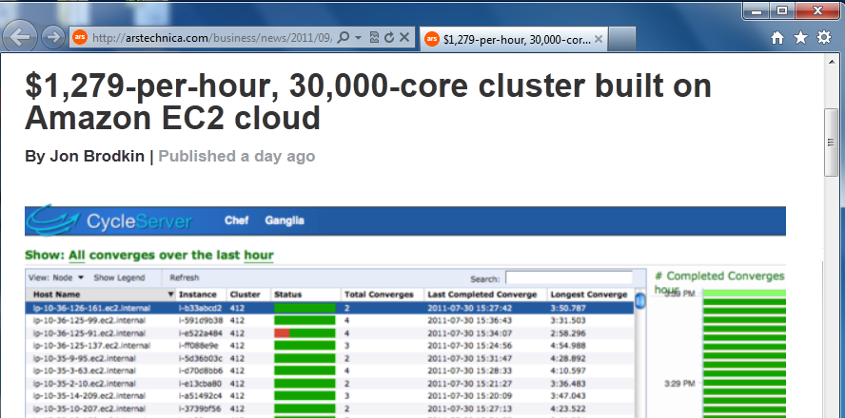
Superclusters by the Hour
http://arstechnica.com/business/news/2011/09/30000-core-cluster-built-on-amazon-ec2-cloud.ars

Slide 12
I can get as many machines on the cloud/grid as I want!
How do I organize my application to run on those machines?

Slide 13
The Cooperative Computing Tools

Slide 14
Our Philosophy:
Harness all the resources that are available: desktops, clusters, clouds, and grids.
Make it easy to scale up from one desktop to national scale infrastructure.
Provide familiar interfaces that make it easy to connect existing apps together.
Allow portability across operating systems, storage systems, middleware…
Make simple things easy, and complex things possible.
No special privileges required.

Slide 15
A Quick Tour of the CCTools
Open source, GNU General Public License.
Compiles in 1-2 minutes, installs in $HOME.
Runs on Linux, Solaris, MacOS, Cygwin, FreeBSD, …
Interoperates with many distributed computing systems.
  Condor, SGE, Torque, Globus, iRODS, Hadoop…
Components:
  Makeflow – A portable workflow manager.
  Work Queue – A lightweight distributed execution system.
  All-Pairs / Wavefront / SAND – Specialized execution engines.
  Parrot – A personal user-level virtual file system.
  Chirp – A user-level distributed filesystem.
http://ccl.cse.nd.edu/software

Slide 16
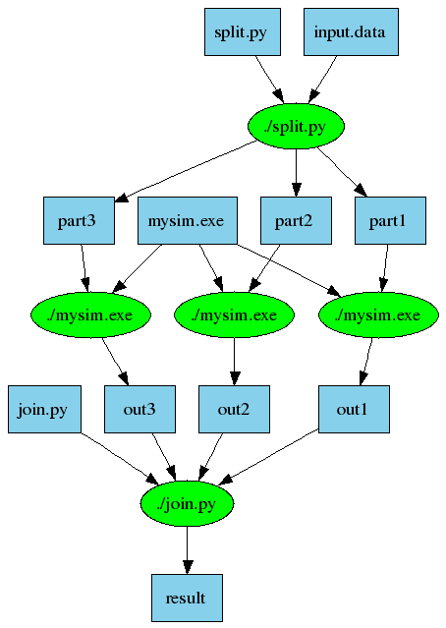
Makeflow = Make + Workflow
Provides portability across batch systems.
Enable parallelism (but not too much!)
Fault tolerance at multiple scales.
Data and resource management.
Makeflow
Local
Condor
SGE
Work
Queue
http://ccl.cse.nd.edu/software/makeflow

Slide 17
Work Queue Library
#include “work_queue.h”
while( not done ) {
while (more work ready) {
task = work_queue_task_create();
// add some details to the task
work_queue_submit(queue, task);
}
task = work_queue_wait(queue);
// process the completed task
}
http://ccl.cse.nd.edu/software/workqueue

Slide 18
Parrot Virtual File System
Unix
Appl
Custom Namespace
/home = /chirp/server/myhome
/software = /cvmfs/cms.cern.ch/cmssoft
Capture System
Calls via ptrace
Parrot Virtual File System
File Access Tracing
Sandboxing
User ID Mapping
. . .
Local
iRODS
Chirp
HTTP
CVMFS
http://ccl.cse.nd.edu/software/parrot

Slide 19
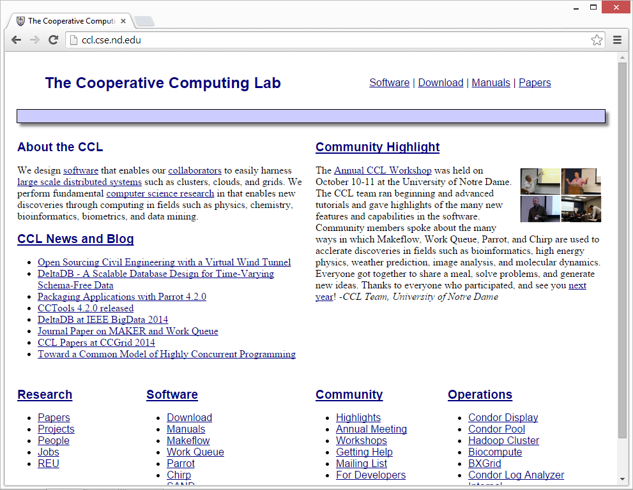
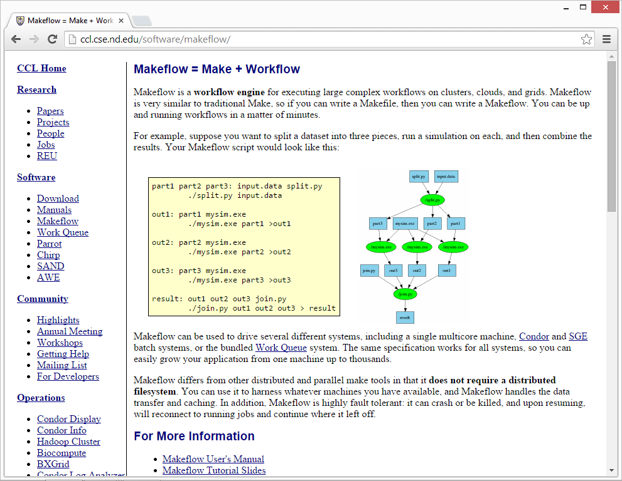
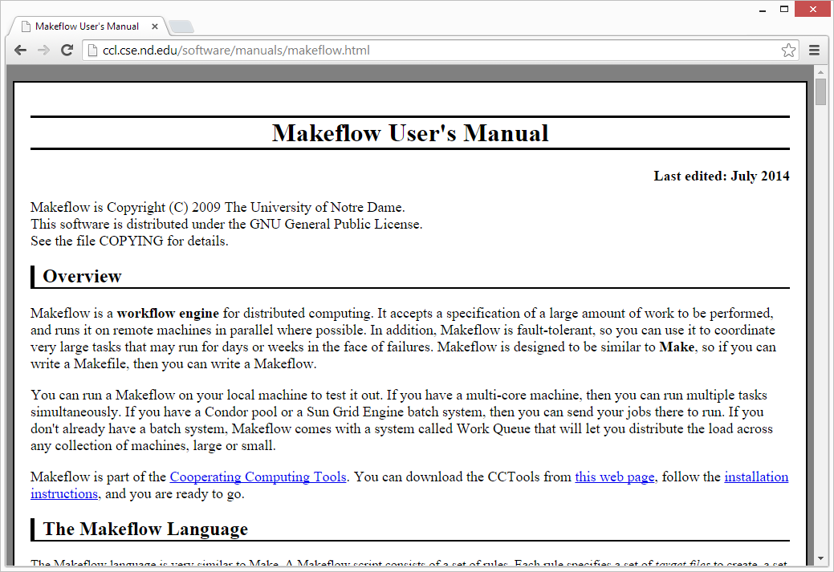
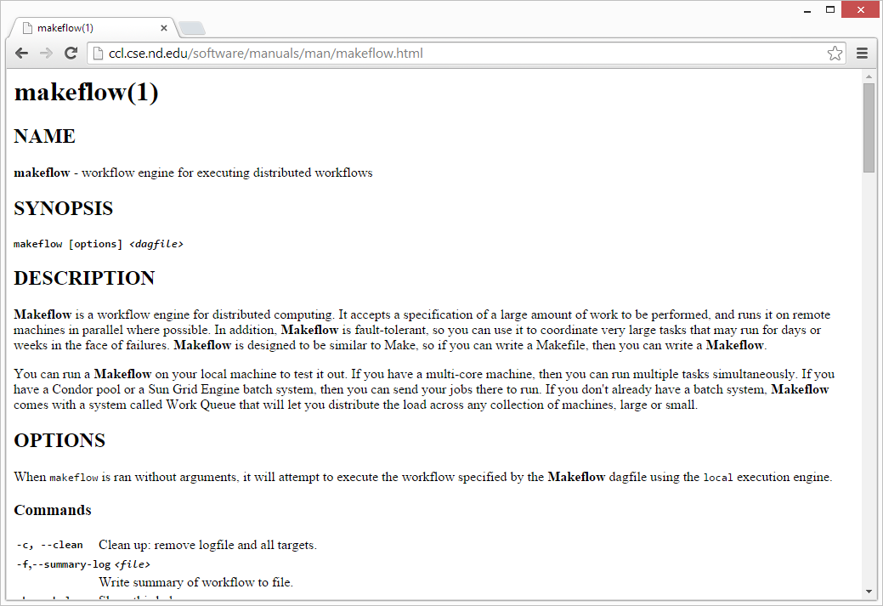
http://ccl.cse.nd.edu
Lots of Documentation

Slide 20
Makeflow:
A Portable Workflow System

Slide 21
An Old Idea: Makefiles
part1 part2 part3: input.data split.py
./split.py input.data
out1: part1 mysim.exe
./mysim.exe part1 >out1
out2: part2 mysim.exe
./mysim.exe part2 >out2
out3: part3 mysim.exe
./mysim.exe part3 >out3
result: out1 out2 out3 join.py
./join.py out1 out2 out3 > result

Slide 22
Makeflow = Make + Workflow
Provides portability across batch systems.
Enable parallelism (but not too much!)
Trickle out work to batch system.
Fault tolerance at multiple scales.
Data and resource management.
Makeflow
Local
Condor
Torque
Work
Queue
http://ccl.cse.nd.edu/software/makeflow

Slide 23
Makeflow Syntax
[output files] : [input files]
[command to run]
One Rule
calib.dat
sim.exe
out.txt
in.dat
sim.exe in.dat –p 50 > out.txt
out.txt : in.dat
sim.exe –p 50 in.data > out.txt
out.txt : in.dat calib.dat sim.exe
sim.exe –p 50 in.data > out.txt
Not Quite Right!

Slide 24
You must state all the files needed by the command.

Slide 25
sims.mf
out.10 : in.dat calib.dat sim.exe
sim.exe –p 10 in.data > out.10
out.20 : in.dat calib.dat sim.exe
sim.exe –p 20 in.data > out.20
out.30 : in.dat calib.dat sim.exe
sim.exe –p 30 in.data > out.30

Slide 26
How to run a Makeflow
Run a workflow locally (multicore?)
  makeflow -T local sims.mf
Clean up the workflow outputs:
  makeflow –c sims.mf
Run the workflow on Torque:
  makeflow –T torque sims.mf
Run the workflow on Condor:
  makeflow –T condor sims.mf

Slide 27
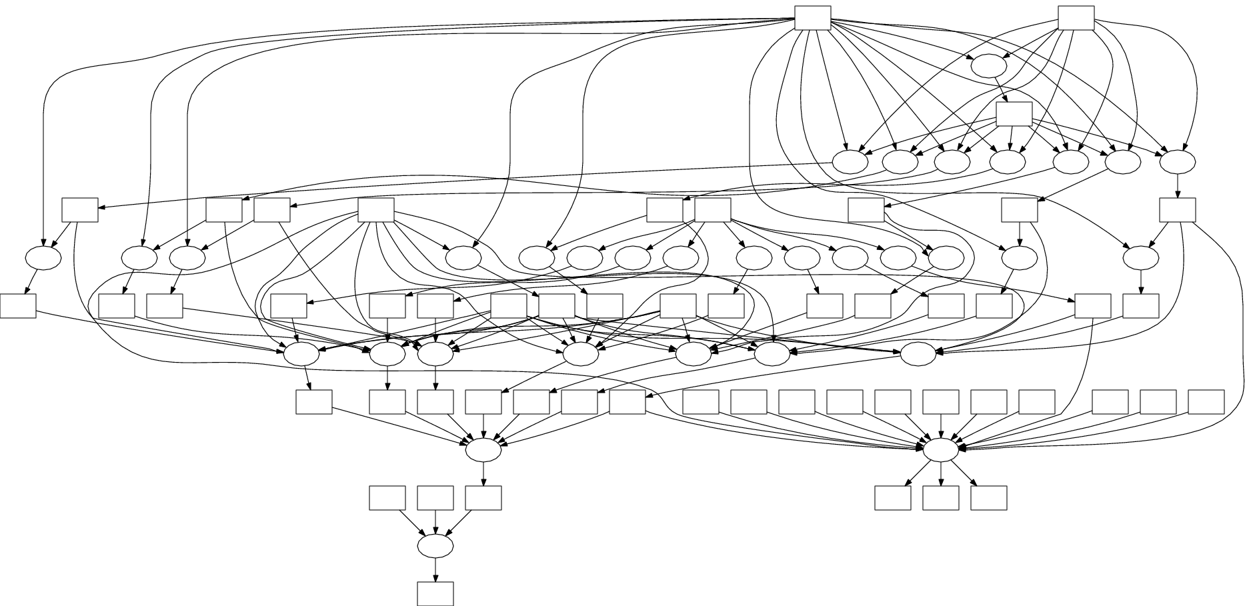
Visualization with DOT
makeflow_viz –D example.mf > example.dot
dot –T gif < example.dot > example.gif
DOT and related tools:
http://www.graphviz.org

Slide 28
Makeflow Shapes a Workflow
Concurrency
Control
Millions of Tasks
Thousands of Nodes
Batch
System
T
Make
Flow
T
T
T
Precise
Cleanup
Transaction Log
Performance
Monitoring

Slide 29
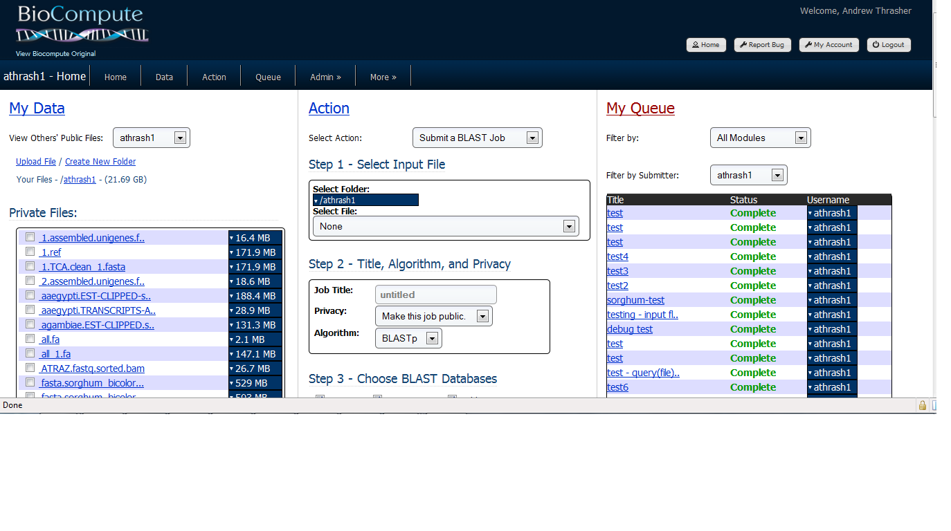

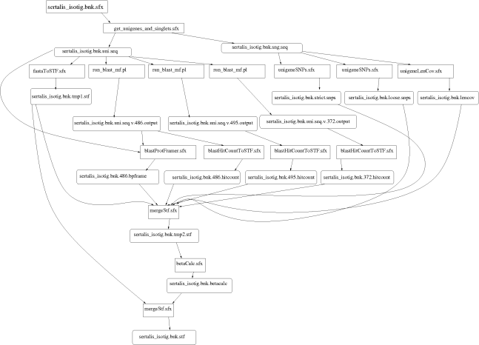
Example: Biocompute Portal
BLAST
SSAHA
SHRIMP
EST
MAKER
…
Progress
Bar
Generate Makefile
Transaction Log
Condor
Pool
Update
Status
Run
Workflow
Make
flow
Submit
Tasks

Slide 30

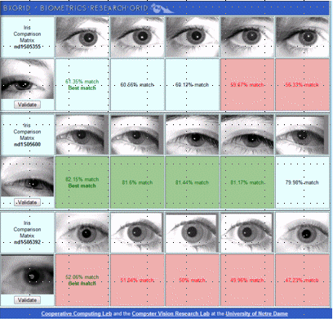
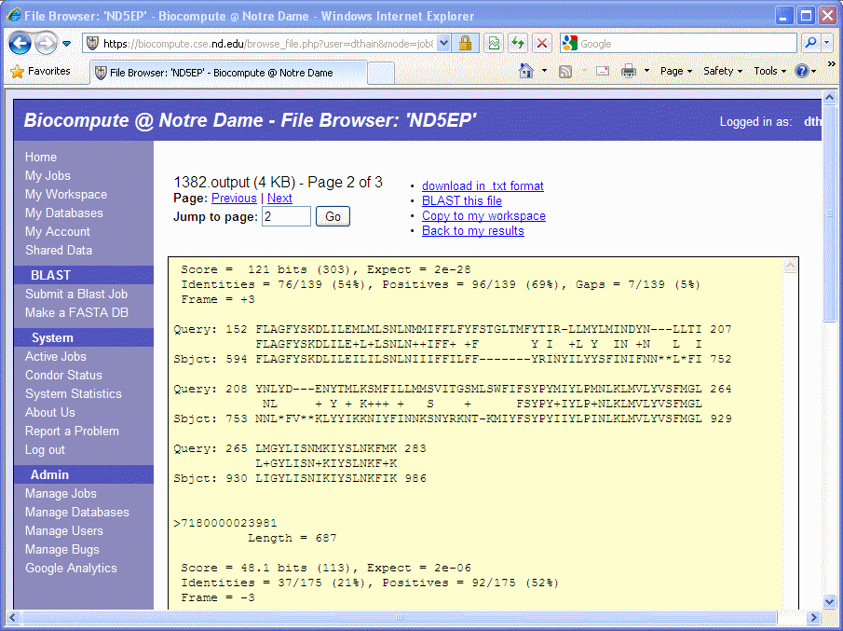
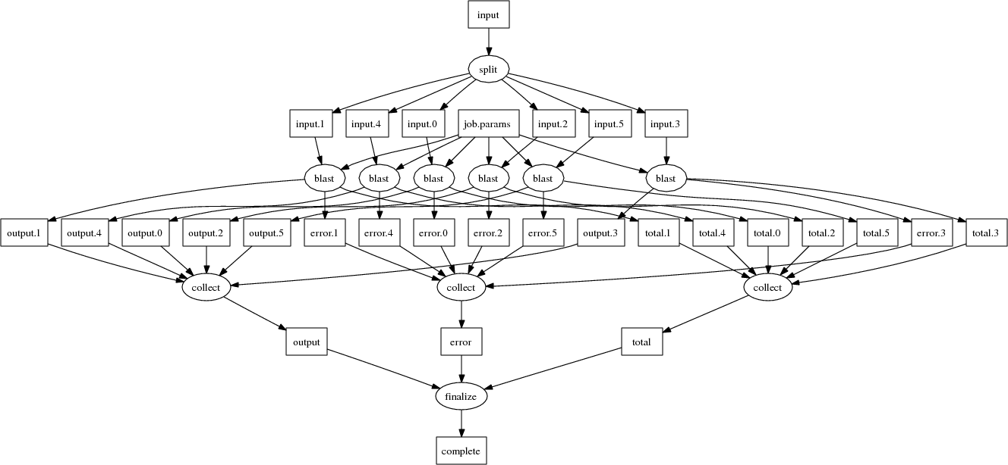
Makeflow Applications

Slide 31
Makeflow + Work Queue

Slide 32
Makeflow + Batch System
FutureGrid
Torque
Cluster
Private
Cluster
Makefile
makeflow –T torque
???
Makeflow
???
Campus
Condor
Pool
Public
Cloud
Provider
makeflow –T condor
Local Files and Programs

Slide 33
Makeflow + Work Queue
torque_submit_workers
FutureGrid
Torque
Cluster
Private
Cluster
Makefile
W
W
Thousands of Workers in a
Personal Cloud
W
submit
tasks
W
W
W
Makeflow
Campus
Condor
Pool
Public
Cloud
Provider
W
W
W
W
W
W
W
Local Files and Programs
condor_submit_workers
ssh

Slide 34
Advantages of Work Queue
Harness multiple resources simultaneously.
Hold on to cluster nodes to execute multiple tasks rapidly. (ms/task instead of min/task)
Scale resources up and down as needed.
Better management of data, with local caching for data intensive tasks.
Matching of tasks to nodes with data.

Slide 35
Makeflow and Work Queue
To start the Makeflow
% makeflow –T wq sims.mf
Could not create work queue on port 9123.
% makeflow –T wq –p 0 sims.mf
Listening for workers on port 8374…
To start one worker:
% work_queue_worker master.hostname.org 8374

Slide 36
Start 25 Workers in Batch System
Submit workers to Condor:
condor_submit_workers master.hostname.org 8374 25
Submit workers to SGE:
sge_submit_workers master.hostname.org 8374 25
Submit workers to Torque:
torque_submit_workers master.hostname.org 8374 25

Slide 37
Keeping track of port numbers gets old fast…

Slide 38
Project Names
makeflow …
–N myproject
work_queue_worker
–N myproject
Makeflow
(port 4057)
connect to
india:4057
Worker
advertise
query
Catalog
work_queue_status
query
“myproject”
is at india:4057

Slide 39
Project Names
Start Makeflow with a project name:
% makeflow –T wq –N myproject sims.mf
Listening for workers on port XYZ…
Start one worker:
% work_queue_worker -N myproject
Start many workers:
% torque_submit_workers –N myproject 5

Slide 40
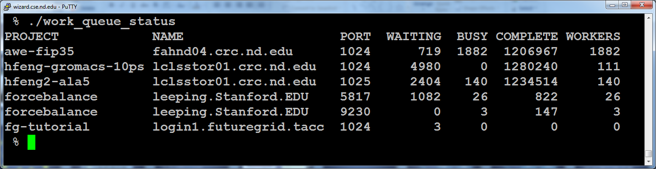
work_queue_status

Slide 41
Resilience and Fault Tolerance
MF +WQ is fault tolerant in many different ways:
  If Makeflow crashes (or is killed) at any point, it will recover by reading the transaction log and continue where it left off.
  Makeflow keeps statistics on both network and task performance, so that excessively bad workers are avoided.
  If a worker crashes, the master will detect the failure and restart the task elsewhere.
  Workers can be added and removed at any time during the execution of the workflow.
  Multiple masters with the same project name can be added and removed while the workers remain.
  If the worker sits idle for too long (default 15m) it will exit, so as not to hold resources idle.

Slide 42
Container Integration!

Slide 43
Containers Create Precise Execution Environments
docker run ubuntu-38.23 mysim.exe
code
code
mysim
libraries
libraries
kernel
kernel
ubuntu-38.23
image
Container
Environment

Slide 44
Containers and Makeflow
Approach 1:
  Create containers for starting MF and WQ, then let them run as normal. You are responsible for moving container images responsibly.
Approach 2:
  Let MF create containers as needed for each task. Provides more control over moving container images.

Slide 45
Approach 1: Container for MF/WQ
docker run ubuntu makeflow
Millions of Tasks
Make
Flow
W
Task
docker run ubuntu work_queue_worker . . .

Slide 46
Approach 2: Container for Each Task
Docker Image:
ubuntu-38.23
Millions of Tasks
Thousands of Nodes
Batch
System
T
T
Make
Flow
T
T
makeflow --docker ubuntu-38.23 –T sge . . .

Slide 47


Container Technology is Evolving
docker run ubuntu command
docker
dockerd
container
docker.io
installed service running as root
singularity exec ubuntu command
singular
container
singularity.lbl.gov
container runs directly as a child process
(still needs setuid tool, though)

Slide 48
Approach 2 Using Singularity
Singularity image:
ubuntu.img
Millions of Tasks
Thousands of Nodes
Batch
System
T
T
Make
Flow
T
T
makeflow –singularity ubuntu.img –T sge . . .

Slide 49
Writing Work Queue Programs

Slide 50
Makeflow vs. Work Queue
Makeflow
  Directed Acyclic Graph programming model.
  Static structure known in advance.
  All communication through files on disk.
Work Queue
  Submit-Wait programming model.
  Dynamic structure decided at run-time.
  Communicate through buffers or files.
  More detailed knowledge of how tasks ran.

Slide 51
Work Queue API
#include “work_queue.h”
queue = work_queue_create();
while( not done ) {
while (more work ready) {
task = work_queue_task_create();
// add some details to the task
work_queue_submit(queue, task);
}
task = work_queue_wait(queue);
// process the completed task
}
http://ccl.cse.nd.edu/software/workqueue
51

Slide 52
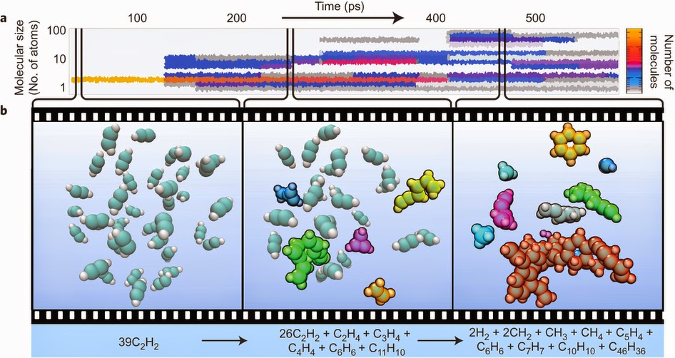

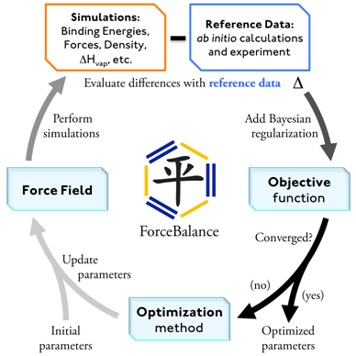
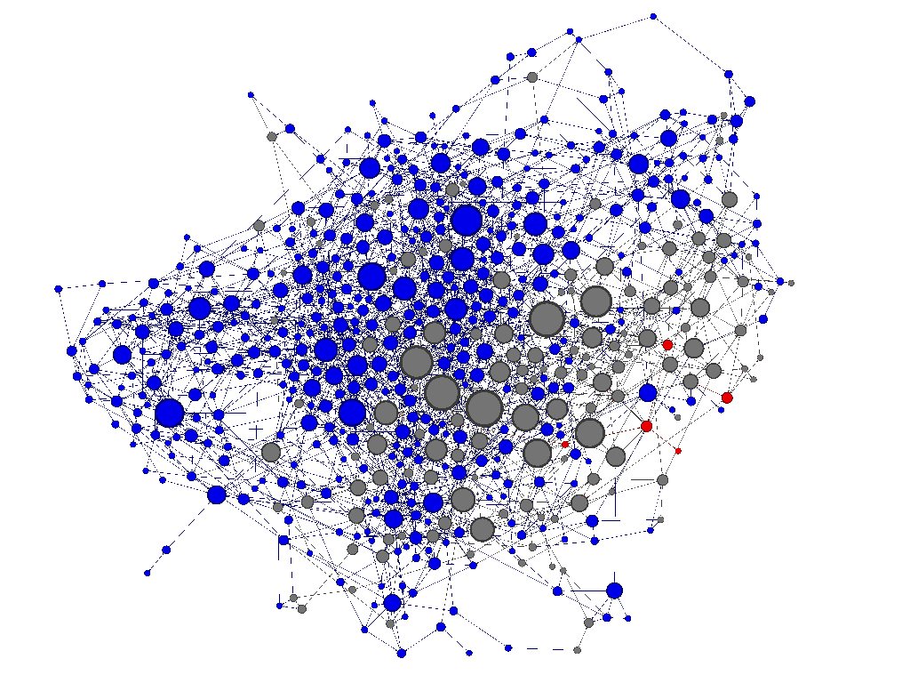
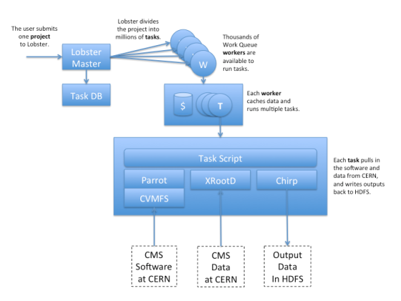
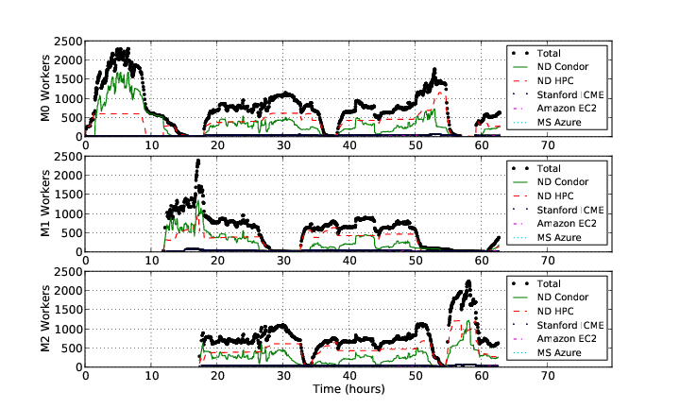
Work Queue Applications
Nanoreactor MD Simulations
Scalable Assembler at Notre Dame
ForceBalance
Adaptive Weighted Ensemble
Lobster HEP

Slide 53
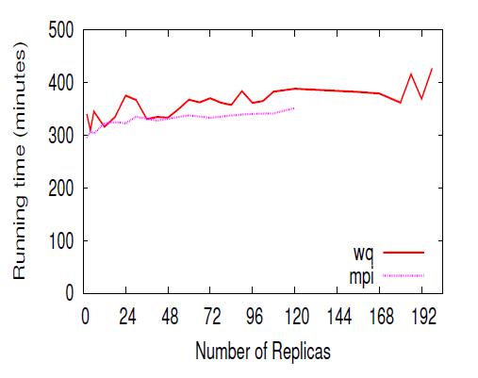
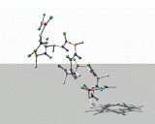
Replica Exchange
Simplified Algorithm:
Submit N short simulations at different temps.
Wait for all to complete.
Select two simulations to swap.
Continue all of the simulations.
Replica Exchange
Work Queue
T=10K
T=20K
T=30K
T=40K
Dinesh Rajan, Anthony Canino, Jesus A Izaguirre, and Douglas Thain,
Converting A High Performance Application to an Elastic Cloud Application, Cloud Com 2011.

Slide 54
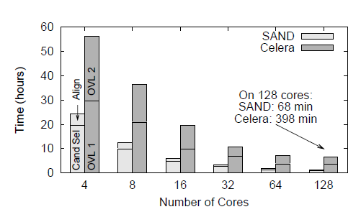
Genome Assembly
Sequence
Data
Modified Celera Assembler
SAND
filter
master
SAND
align
master
Celera
Consensus
W
W
Using WQ, we could assemble a human genome in 2.5 hours on a collection of clusters, clouds, and grids with a speedup of 952X.
W
W
W
W
W
Christopher Moretti, Andrew Thrasher, Li Yu, Michael Olson, Scott Emrich, and Douglas Thain,
A Framework for Scalable Genome Assembly on Clusters, Clouds, and Grids,
IEEE Transactions on Parallel and Distributed Systems, 2012

Slide 55
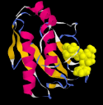
Adaptive Weighted Ensemble
Proteins fold into a number of distinctive states, each of which affects its function in the organism.
How common is each state?
How does the protein transition between states?
How common are those transitions?
55

Slide 56
AWE on Clusters, Clouds, and Grids
56

Slide 57
Work Queue Architecture
Application
Submit Task1(A,B)
Submit Task2(A,C)
Submit
Wait
4-core machine
Work Queue
Master Library
Send files
Worker Process
Send tasks
A
A
A
A
B
C
T
T
C
B
B
C
Local Files and Programs
Cache
Dir
Task.1
Sandbox
Task.2
Sandbox
2-core task
2-core task

Slide 58
Basic Queue Operations
#include “work_queue.h”
struct work_queue *queue;
struct work_queue_task *task;
// Creates a new queue listening on a port, use zero to pick any port.
queue = work_queue_create( port );
// Submits a task into a queue. (non-blocking)
work_queue_submit( queue, task );
// Waits for a task to complete, returns the complete task.
task = work_queue_wait( queue, timeout );
// Returns true if there are no tasks left in the queue.
work_queue_empty( queue );
// Returns true if the queue is hungry for more tasks.
work_queue_hungry( queue );

Slide 59
Basic Task Operations
#include “work_queue.h”
struct work_queue_task *task;
// Create a task that will run a given Unix command.
task = work_queue_task_create( command );
// Indicate an input or output file needed by the task.
work_queue_task_specify_file( task, name, remote_name, type, flags );
// Indicate an input buffer needed by the task.
work_queue_task_specify_buffer( task, data, length, remote_name, flags);
// Destroy the task object.
work_queue_task_delete( task );

Slide 60
Run One Task in C
#include “work_queue.h”
struct work_queue *queue;
struct work_queue_task *task;
queue = work_queue_create( 0 );
work_queue_specify_name( “myproject” );
task = work_queue_task_create(“sim.exe –p 50 in.dat >out.txt”);
/// Missing: Specify files needed by the task.
work_queue_submit( queue, task );
while(!work_queue_empty(queue)) {
task = work_queue_wait( queue, 60 );
if(task) work_queue_task_delete( task );
}

Slide 61
Run One Task in Perl
use work_queue;
$queue = work_queue_create( 0 );
work_queue_specify_name( “myproject” );
$task = work_queue_task_create(“sim.exe –p 50 in.dat >out.txt”);
### Missing: Specify files needed by the task.
work_queue_submit( $queue, $task );
while(!work_queue_empty($queue)) {
$task = work_queue_wait( $queue, 60 );
if($task) work_queue_task_delete( $task );
}

Slide 62
Run One Task in Python
from work_queue import *
queue = WorkQueue( port = 0 )
queue.specify_name( “myproject” );
task = Task(“sim.exe –p 50 in.dat >out.txt”)
### Missing: Specify files needed by the task.
queue.submit( task )
While not queue.empty():
task = queue.wait(60)

Slide 63
C: Specify Files for a Task
calib.dat
sim.exe
out.txt
in.dat
sim.exe in.dat –p 50 > out.txt
work_queue_task_specify_file( task,“in.dat”,”in.dat”,
WORK_QUEUE_INPUT, WORK_QUEUE_NOCACHE );
work_queue_task_specify_file( task,“calib.dat”,”calib.dat”,
WORK_QUEUE_INPUT, WORK_QUEUE_CACHE );
work_queue_task_specify_file( task,“out.txt”,”out.txt”,
WORK_QUEUE_OUTPUT, WORK_QUEUE_NOCACHE );
work_queue_task_specify_file( task,“sim.exe”,”sim.exe”,
WORK_QUEUE_INPUT, WORK_QUEUE_CACHE );

Slide 64
Perl: Specify Files for a Task
calib.dat
sim.exe
out.txt
in.dat
sim.exe in.dat –p 50 > out.txt
work_queue_task_specify_file( $task,“in.dat”,”in.dat”,
$WORK_QUEUE_INPUT, $WORK_QUEUE_NOCACHE );
work_queue_task_specify_file( $task,“calib.dat”,”calib.dat”,
$WORK_QUEUE_INPUT, $WORK_QUEUE_NOCACHE );
work_queue_task_specify_file( $task,“out.txt”,”out.txt”,
$WORK_QUEUE_OUTPUT, $WORK_QUEUE_NOCACHE );
work_queue_task_specify_file( $task,“sim.exe”,”sim.exe”,
$WORK_QUEUE_INPUT, $WORK_QUEUE_CACHE );

Slide 65
Python: Specify Files for a Task
calib.dat
sim.exe
out.txt
in.dat
sim.exe in.dat –p 50 > out.txt
task.specify_file( “in.dat”, ”in.dat”,
WORK_QUEUE_INPUT, cache = False )
task.specify_file( “calib.dat”, ”calib.dat”,
WORK_QUEUE_INPUT, cache = False )
task.specify_file( “out.txt”, ”out.txt”,
WORK_QUEUE_OUTPUT, cache = False )
task.specify_file( “sim.exe”, ”sim.exe”,
WORK_QUEUE_INPUT, cache = True )

Slide 66
You must state all the files needed by the command.

Slide 67
Running a Work Queue Program
gcc work_queue_example.c -o work_queue_example
-I $HOME/cctools/include/cctools
-L $HOME/cctools/lib
-lwork_queue -ldttools -lm
./work_queue_example
Listening on port 8374 …
In another window:
./work_queue_worker master.host.name.org 8374

Slide 68
… for Python
setenv PYTHONPATH ${PYTHONPATH}: (no line break)
${HOME}/cctools/lib/python2.6/site-package
./work_queue_example.py
Listening on port 8374 …
In another window:
./work_queue_worker master.host.name.org 8374

Slide 69
… for Perl
setenv PERL5LIB ${PERL5LIB}: (no line break)
${HOME}/cctools/lib/perl5/site_perl
./work_queue_example.pl
Listening on port 8374 …
In another window:
./work_queue_worker master.host.name.org 8374

Slide 70
Start Workers Everywhere
Submit workers to Condor:
condor_submit_workers master.hostname.org 8374 25
Submit workers to SGE:
sge_submit_workers master.hostname.org 8374 25
Submit workers to Torque:
torque_submit_workers master.hostname.org 8374 25

Slide 71
Use Project Names
work_queue_worker
–N myproject
Work Queue
(port 9037)
connect to
india:9037
Worker
advertise
query
Catalog
work_queue_status
query
“myproject”
is at india:9037

Slide 72
Specify Project Names in Work Queue
Specify Project Name for Work Queue master:
Python:
q.specify_name (“myproject”)
Perl:
work_queue_specify_name ($q, “myproject”);
C:
work_queue_specify_name (q, “myproject”);

Slide 73
Start Workers with Project Names
Start one worker:
$ work_queue_worker -N myproject
Start many workers:
$ sge_submit_workers -N myproject 5
$ condor_submit_workers -N myproject 5
$ torque_submit_workers -N myproject 5

Slide 74
Advanced Features (in the docs)
Submit / remove tasks by tag / name.
Auto reschedule tasks that take too long.
Send in-memory data as a file.
Log and graph system performance
Much more!

Slide 75
Managing Your Workforce
Master
A
Condor
Pool
work_queue_pool –T condor 200
W
WQ
Pool
200
W
W
Master
B
Submits new workers.
Restarts failed workers.
Removes unneeded workers.
SGE
Cluster
W
W
WQ
Pool
Master
C
100
W
work_queue_pool –T sge 100

Slide 76
Multi-Slot Workers
1 core
task
1 core
task
1 core
task
1 core
task
1 core
task
Master
4 cores
512 MB
specify_cores(4);
specify_memory(512);
Worker
Worker
work_queue_worker
--cores 8
--memory 1024
work_queue_worker
(implies 1 task, 1 core)

Slide 77
Using Foremen
Master
T
T
T
T
T
T
T
T
T
T
T
T
work_queue_worker
--foreman $MASTER $PORT
Fore man
Fore man
$$$
$$$
Approx X1000
at each fanout.
W
W
W
W
W
W
W
W
W
California
Chicago

Slide 78
Makeflow vs. Work Queue
Makeflow
  Directed Acyclic Graph programming model.
  Static structure known in advance.
  All communication through files on disk.
Work Queue
  Submit-Wait programming model.
  Dynamic structure decided at run-time.
  Communicate through buffers or files.
  More detailed knowledge of how tasks ran.

Slide 79
Go to http://ccl.cse.nd.edu and click on ACIC Tutorial.

