Slide 1
Creating Custom Work Queue Applications
Nicholas Hazekamp

Slide 2
Makeflow vs. Work Queue
Makeflow
Directed Acyclic Graph programming model.
Static structure known in advance.
All communication through files on disk.
Work Queue
Submit-Wait programming model.
Dynamic structure decided at run-time.
Communicate through buffers or files.
More detailed knowledge of how tasks ran.

Slide 3
Work Queue API
#include “work_queue.h”
queue = work_queue_create();
while( not done ) {
while (more work ready) { task = work_queue_task_create();
// add some details to the task
work_queue_submit(queue, task);
}
task = work_queue_wait(queue);
// process the completed task
}
http://ccl.cse.nd.edu/software/workqueue
‹#›

Slide 4
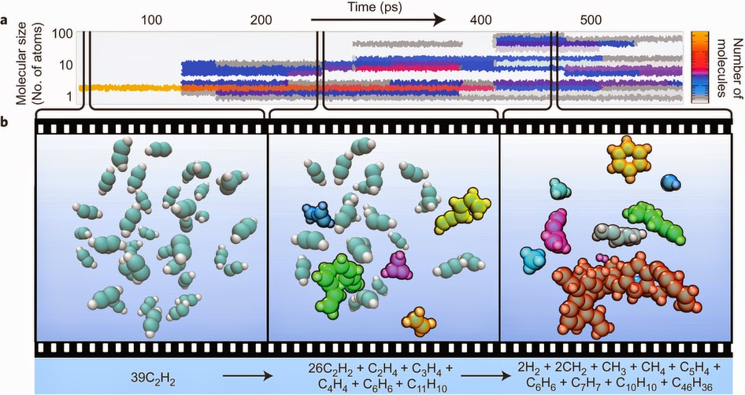
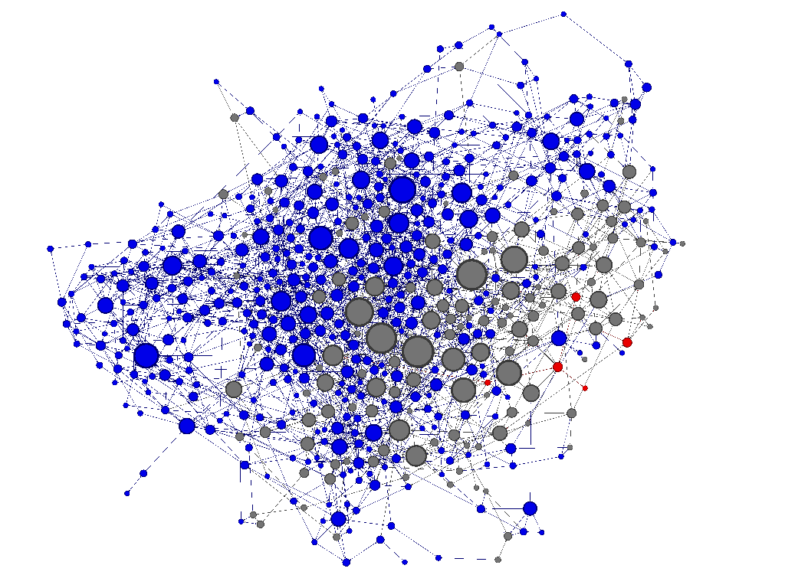
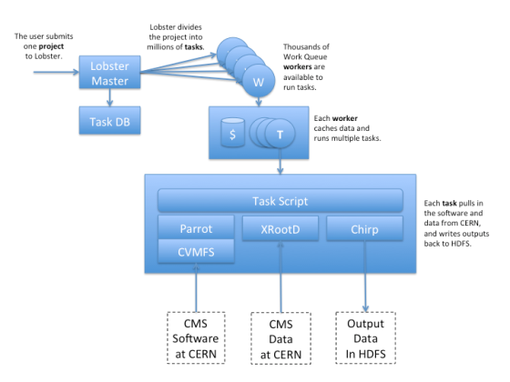
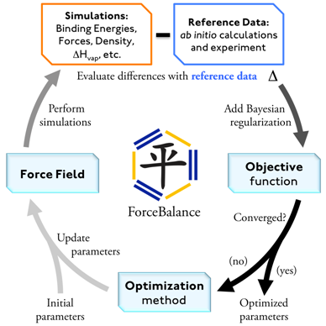
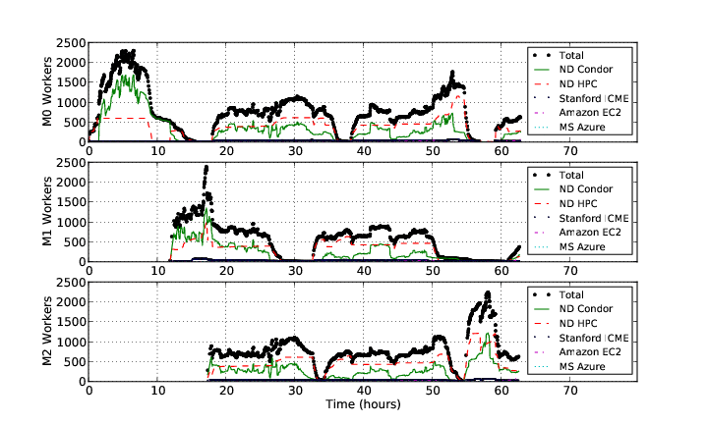
Work Queue Applications
Nanoreactor MD Simulations
Scalable Assembler at Notre Dame
Lobster HEP
ForceBalance
Adaptive Weighted Ensemble

Slide 5
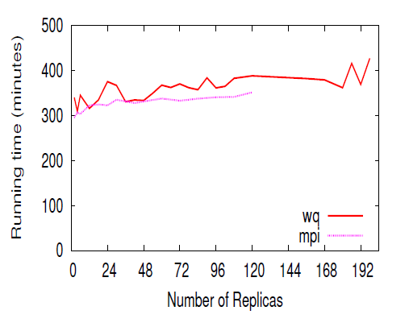
Replica Exchange
Simplified Algorithm:
Submit N short simulations at different temps.
Wait for all to complete.
Select two simulations to swap.
Continue all of the simulations.
Replica Exchange
Work Queue
T=10K
T=20K
T=30K
T=40K
Dinesh Rajan, Anthony Canino, Jesus A Izaguirre, and Douglas Thain, Converting A High Performance Application to an Elastic Cloud Application, Cloud Com 2011.

Slide 6
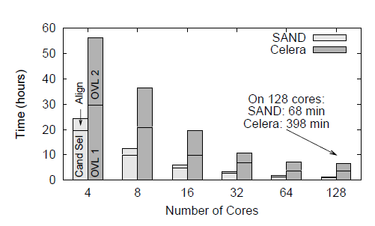
Genome Assembly
Sequence
Data
Modified Celera Assembler
SAND
filter
master
SAND
align
master
Celera
Consensus
W
W
Using WQ, we could assemble a human genome in 2.5 hours on a collection of clusters, clouds, and grids with a speedup of 952X.
W
W
W
W
W
Christopher Moretti, Andrew Thrasher, Li Yu, Michael Olson, Scott Emrich, and Douglas Thain, A Framework for Scalable Genome Assembly on Clusters, Clouds, and Grids, IEEE Transactions on Parallel and Distributed Systems, 2012

Slide 7
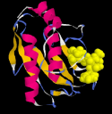
Adaptive Weighted Ensemble
Proteins fold into a number of distinctive states, each of which affects its function in the organism.
How common is each state?
How does the protein transition between states?
How common are those transitions?
‹#›

Slide 8
AWE on Clusters, Clouds, and Grids
‹#›

Slide 9
Work Queue Architecture
Application
Submit Task1(A,B)
Submit Task2(A,C)
Submit
Wait
4-core machine
Work Queue
Master Library
Send files
Worker Process
Send tasks
A
A
A
A
B
C
T
T
C
B
B
C
Local Files and Programs
Cache
Dir
Task.1
Sandbox
Task.2
Sandbox
2-core task
2-core task

Slide 10
Basic Queue Operations
#include “work_queue.h”
struct work_queue *queue;
struct work_queue_task *task;
// Creates a new queue listening on a port, use zero to pick any port.
queue = work_queue_create( port );
// Submits a task into a queue. (non-blocking)
work_queue_submit( queue, task );
// Waits for a task to complete, returns the complete task.
task = work_queue_wait( queue, timeout );
// Returns true if there are no tasks left in the queue.
work_queue_empty( queue );
// Returns true if the queue is hungry for more tasks.
work_queue_hungry( queue );

Slide 11
Basic Task Operations
#include “work_queue.h”
struct work_queue_task *task;
// Create a task that will run a given Unix command.
task = work_queue_task_create( command );
// Indicate an input or output file needed by the task.
work_queue_task_specify_file( task, name, remote_name, type, flags );
// Indicate an input buffer needed by the task.
work_queue_task_specify_buffer( task, data, length, remote_name, flags);
// Destroy the task object.
work_queue_task_delete( task );

Slide 12
Run One Task in C
#include “work_queue.h”
struct work_queue *queue;
struct work_queue_task *task;
queue = work_queue_create( 0 );
work_queue_specify_name( “myproject” );
task = work_queue_task_create(“sim.exe –p 50 in.dat >out.txt”);
/// Missing: Specify files needed by the task.
work_queue_submit( queue, task );
while(!work_queue_empty(queue)) {
task = work_queue_wait( queue, 60 );
if(task) work_queue_task_delete( task );
}

Slide 13
Run One Task in Perl
use work_queue;
$queue = work_queue_create( 0 );
work_queue_specify_name( “myproject” );
$task = work_queue_task_create(“sim.exe –p 50 in.dat >out.txt”);
### Missing: Specify files needed by the task.
work_queue_submit( $queue, $task );
while(!work_queue_empty($queue)) {
$task = work_queue_wait( $queue, 60 );
if($task) work_queue_task_delete( $task );
}

Slide 14
Run One Task in Python
from work_queue import *
queue = WorkQueue( port = 0 )
queue.specify_name( “myproject” );
task = Task(“sim.exe –p 50 in.dat >out.txt”)
### Missing: Specify files needed by the task.
queue.submit( task )
While not queue.empty():
task = queue.wait(60)

Slide 15
C: Specify Files for a Task
calib.dat
sim.exe
out.txt
sim.exe in.dat –p 50 > out.txt
in.dat
work_queue_task_specify_file( task,“in.dat”,”in.dat”,
WORK_QUEUE_INPUT, WORK_QUEUE_NOCACHE );
work_queue_task_specify_file(task,“calib.dat”,”calib.dat”,
WORK_QUEUE_INPUT, WORK_QUEUE_NOCACHE );
work_queue_task_specify_file( task,“out.txt”,”out.txt”,
WORK_QUEUE_OUTPUT, WORK_QUEUE_NOCACHE );
work_queue_task_specify_file( task,“sim.exe”,”sim.exe”,
WORK_QUEUE_INPUT, WORK_QUEUE_CACHE );

Slide 16
Perl: Specify Files for a Task
calib.dat
sim.exe
out.txt
sim.exe in.dat –p 50 > out.txt
in.dat
work_queue_task_specify_file( $task,“in.dat”,”in.dat”,
$WORK_QUEUE_INPUT, $WORK_QUEUE_NOCACHE );
work_queue_task_specify_file($task,“calib.dat”,”calib.dat”,
$WORK_QUEUE_INPUT, $WORK_QUEUE_NOCACHE );
work_queue_task_specify_file( $task,“out.txt”,”out.txt”,
$WORK_QUEUE_OUTPUT, $WORK_QUEUE_NOCACHE );
work_queue_task_specify_file( $task,“sim.exe”,”sim.exe”,
$WORK_QUEUE_INPUT, $WORK_QUEUE_CACHE );

Slide 17
Python: Specify Files for a Task
calib.dat
sim.exe
out.txt
sim.exe in.dat –p 50 > out.txt
in.dat
task.specify_file( “in.dat”, ”in.dat”,
WORK_QUEUE_INPUT, cache = False )
task.specify_file( “calib.dat”, ”calib.dat”,
WORK_QUEUE_INPUT, cache = False )
task.specify_file( “out.txt”, ”out.txt”,
WORK_QUEUE_OUTPUT, cache = False )
task.specify_file( “sim.exe”, ”sim.exe”,
WORK_QUEUE_INPUT, cache = True )

Slide 18
You must state all the files needed by the command.

Slide 19
Running a Work Queue Program
gcc work_queue_example.c -o work_queue_example
-I $HOME/cctools/include/cctools
-L $HOME/cctools/lib
-lwork_queue -ldttools -lm
./work_queue_example
Listening on port 8374 …
In another window:
./work_queue_worker master.host.name.org 8374

Slide 20
… for Perl
setenv PERL5LIB ${PERL5LIB}: (no line break)
${HOME}/cctools/lib/perl5/site_perl
./work_queue_example.pl
Listening on port 8374 …
In another window:
./work_queue_worker master.host.name.org 8374

Slide 21
… for Python
setenv PYTHONPATH ${PYTHONPATH}: (no line break)
${HOME}/cctools/lib/python2.6/site-package
./work_queue_example.py
Listening on port 8374 …
In another window:
./work_queue_worker master.host.name.org 8374

Slide 22
Start Workers Everywhere
Submit workers to Condor:
condor_submit_workers master.hostname.org 8374 25
Submit workers to SGE:
sge_submit_workers master.hostname.org 8374 25
Submit workers to Torque:
torque_submit_workers master.hostname.org 8374 25

Slide 23
Use Project Names
work_queue_worker
–N myproject
connect to
india:9037
Work Queue
(port 9037)
Worker
advertise
query
Catalog
work_queue_status
query
“myproject”
is at india:9037

Slide 24
Specify Project Names in Work Queue
Specify Project Name for Work Queue master:
C:
work_queue_specify_name (q, “myproject”);
Perl:
work_queue_specify_name ($q, “myproject”);
Python:
q.specify_name (“myproject”)

Slide 25
Start Workers with Project Names
Start one worker:
$ work_queue_worker -N myproject
Start many workers:
$ sge_submit_workers -N myproject 5
$ condor_submit_workers -N myproject 5
$ torque_submit_workers -N myproject 5

Slide 26
Advanced Features (in the docs)
Submit / remove tasks by tag / name.
Auto reschedule tasks that take too long.
Send in-memory data as a file.
Log and graph system performance
Much more!

Slide 27
Managing Your Workforce
Master
A
Condor
Pool
work_queue_factory –T condor 200
W
WQ
Pool
200
W
W
Master
B
Submits new workers.
Restarts failed workers.
Removes unneeded workers.
SGE
Cluster
W
W
WQ
Pool
Master
C
100
W
work_queue_factory –T sge 100

Slide 28
Using Foremen
Master
T
T
T
T
T
T
T
T
T
T
T
T
work_queue_worker
--foreman $MASTER $PORT
Fore man
Fore man
$$$
$$$
Approx X1000
at each fanout.
W
W
W
W
W
W
W
W
W
California
Chicago

Slide 29
Multi-Slot Workers
1 core
task
1 core
task
1 core
task
1 core
task
1 core
task
Master
4 cores
512 MB
specify_cores(4);
specify_memory(512);
Worker
Worker
work_queue_worker
--cores 8
--memory 1024
work_queue_worker
(implies 1 task, 1 core)

