Slide 1
Expanding and Scaling Lifemapper Computations Using CCTools
CJ Grady
University of Kansas

Slide 2
What is Lifemapper
Web service wrapped single and multi species tools for scaling biodiversity analysis

Slide 3
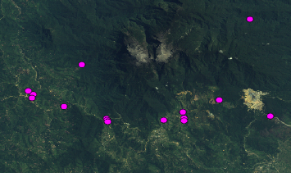
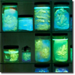
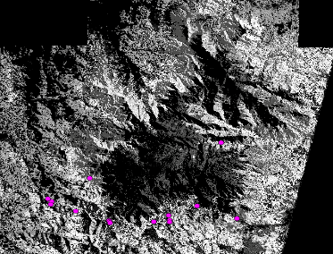
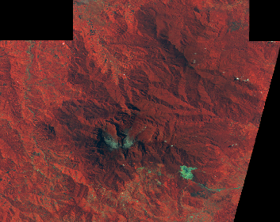
LmSDM: Species Distribution Modeling
Species Occurrence Data
Potential Habitat
Environmental Data
Notes:
This illustrates the basics of SDM modeling. We input
Species occurrence data, map coordinates of where a species has been found, with
Environmental data for those coordinates.
In our case we are using temperature, precipitation, and elevation data, to create a model of the habitat best suited for the species, based on its known locations.
We use OpenModeller with about 10 algorithms and MaxEnt softwares to create these models.
The models are then projected back onto maps of the environmental data to find other areas where the habitat is suitable for the species.

Slide 4
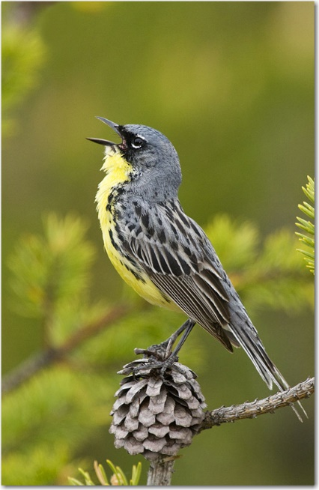
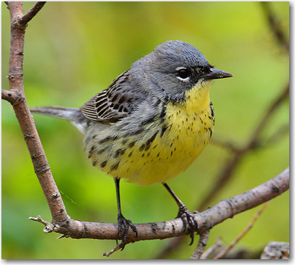
Kirtland’s Warbler Range
Notes:
Here is an example of the predicted distribution of the Kirtland’s Warbler – this is the predicted range given today’s climate

Slide 5
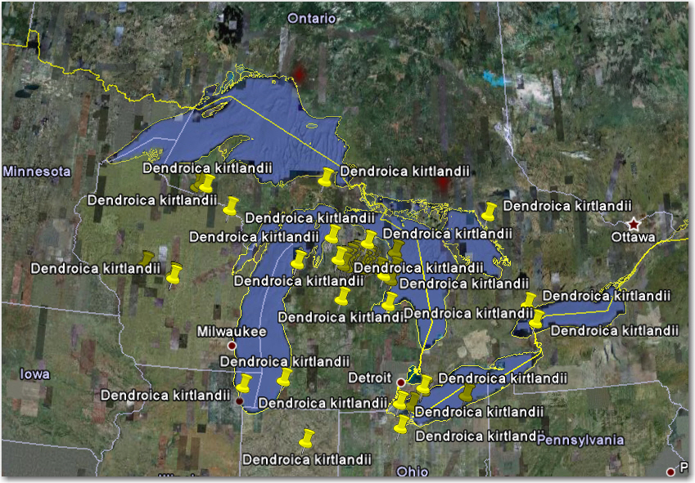
Kirtland’s Warbler Future
Notes:
And here is the predicted distribution after the climate change that might occur by the end of the century

Slide 6
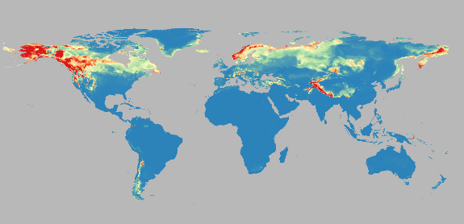
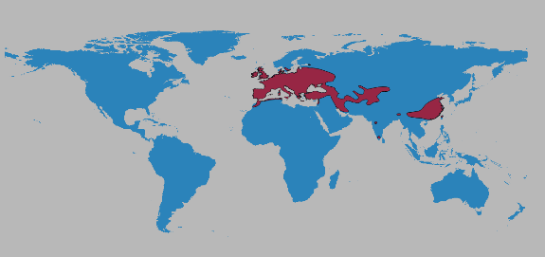
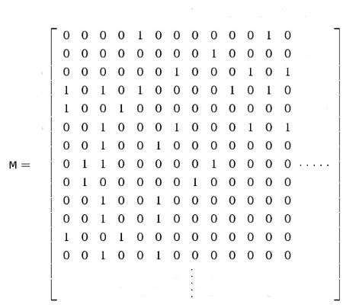
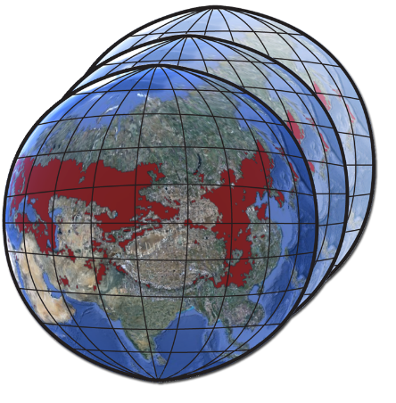
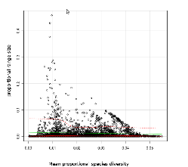
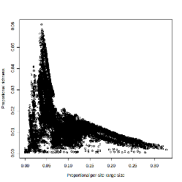
LmRAD: Range and Diversity
Presence Absence Matrix
(PAM)
Species Habitat Data
Multi-species analyses
Range and Diversity
Quantifications
Notes:
The second set of tools we are developing are Range and Diversity tools.
We begin with geospatial data, representing species habitat ranges for multiple species
These data are all summarized in a Presence Absence Matrix, or PAM: which then contains much of the information needed to understand species diversity.
From the PAM, we have different ways of representing species diversity, such as scatterplots, indices, and other quantifications
We connect these in an implementation using webservices and client software,
We will support large amounts of data, from multiple sources, and analyze them at multiple scales requiring huge computational resources

Slide 7
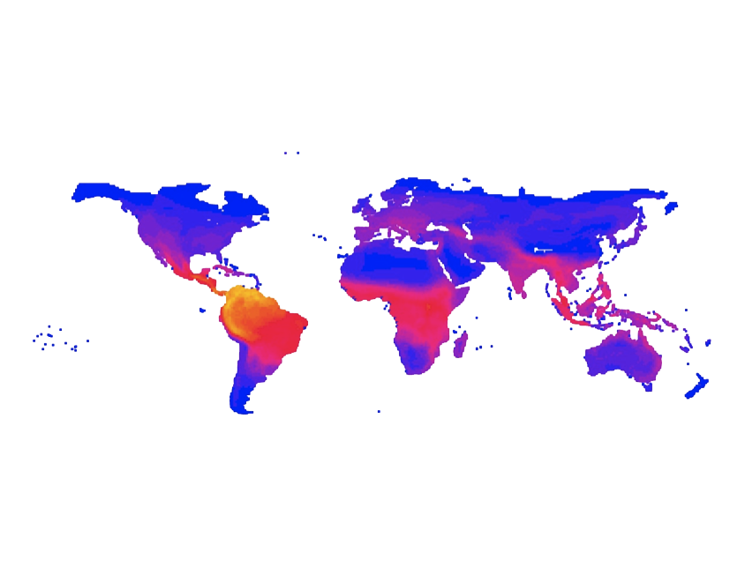
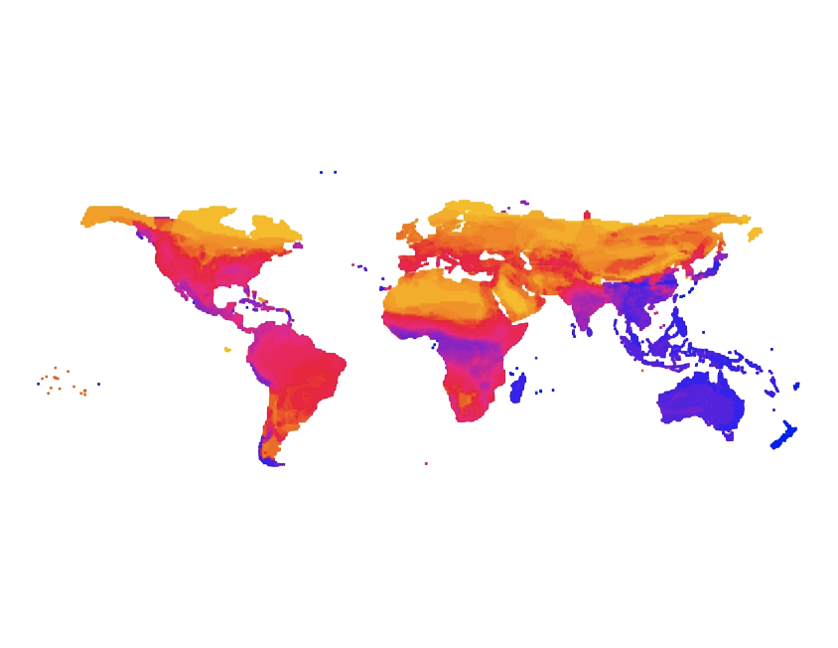
Terrestrial Mammals of the World
Proportional Species Richness
High Yellow
Moderate Red
Low Blue
Per-site Range Size
Notes:
Here is an example of some calculations that can be mapped from a PAM.
These are from the “Terrestrial Mammals of the World” data, with over 3600 species, compiled over a period of 3 years by Gerardo Ceballos at National University of Mexico, UMAN, then analyzed by Jorge Soberon and his students at the U of KS Biodiversity Institute
You can see the inverse relationship between species richness and range size is clearly visualized here.
Areas of high species richness, diversity are composed of species with very small range sizes, such as the most diverse area in the world, here in the Andes along the northern portion of South America
Areas where most of the species have large range size, such as the Arctic, have very low species diversity

Slide 8
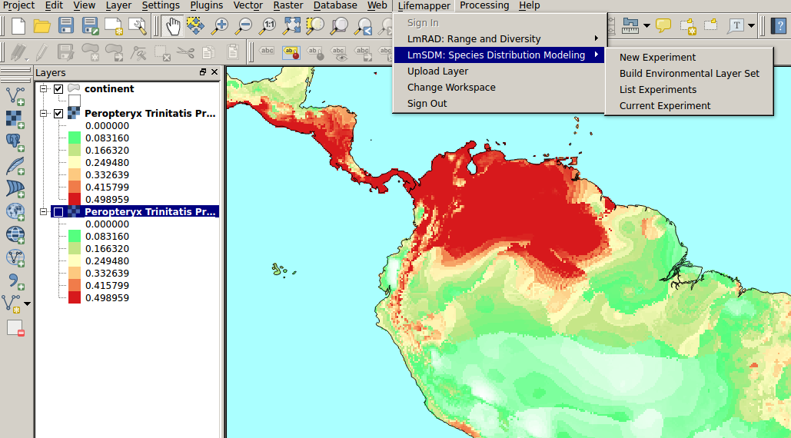
Client-side applications
Notes:
The Lifemapper QGIS plugin provides a visual interface for a user to connect to a LM server to examine and request analyses of their own data, and retrieve analysis results for further exploration.
Our QGIS plugin connects with the LM infrastructure and
allows users to examine single and multi species data inputs to and outputs from Lifemapper
it also allows users to request data and analyses, using their own, or Lifemapper data

Slide 9
Integrates Phylogenetic Trees
Notes:
This screen shows integration of phlogenetic trees in a multi-species analyses.
The analyses are done by the LM infrastructure, then returned to the user.

Slide 10
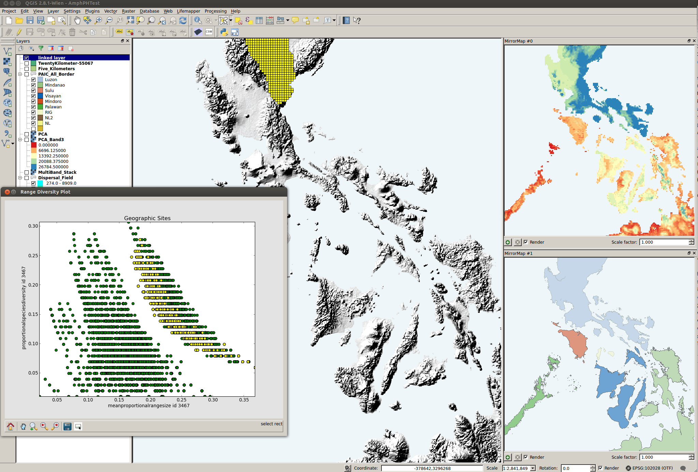
The PAICs of the Philippines
Notes:
Here is another example of the QGIS interface
looking at data calculated by Lifemapper for amphibians in the Phillipines.
On the right, the different colored Pleistocene aggregate island complexes (PAICs) on the right of the screen show similar species characteristics that evolved in islands that were previously connected by land bridges
In the plot on the lower left, you can see highlighted areas that are also highlighted in the in the northern island complex

Slide 11
Implementation
Rocks Cluster
Database and Webserver on Front End
Compute code on nodes

Slide 12
Harvard Collaboration
12,500 species
15 future climate scenarios (+1 current)
6 experiments
~500 MB per projection
~72 TB compressed outputs

Slide 13
Workflow
N per species per experiment
Projection Request
Occurrence Data
Climate data
Create Projection
Create Model
Projection
Model
Create Package
Package

Slide 14
Attempt 1
Used our existing 10 node cluster
Limited to 20 concurrent processes
Used entire resource
Would have taken more than 2 years

Slide 15
Attempt 2
Used KU community cluster
Limited by disk space
Accidentally created DDoS attack

Slide 16
CCTools and XSEDE
Modified our compute platform to run on Stampede
Split each experiment into chunks of 1000 species
4 hours per chunk on 1024 cores

Slide 17
Second Experiment
Limited to 128 or so cores
Disk performance has changed
Reduced input data resolution

Slide 18
Current Status
Integrating CCTools into core infrastructure
Moving from cataloging jobs to cataloging workflows
Simplified communication
Eliminate our job server
Reduce overhead
Pack multiple tasks into single job

Slide 19
Workflow
N per species per experiment
Projection Request
Occurrence Data
Climate data
Create Projection
Create Model
Projection
Model
Create Package
Package

Slide 20
Workflow
N per species per experiment
Projection Request
Occurrence Data
Climate data
Create Projection
Create Model
Projection
Modify Projection
Model
Create Package
Package

Slide 21
MF
W
MF
W
LM DB
Catalog Server
MF
W
MF
W

Slide 22
Near Future
Deploy integrated version of Lifemapper
Deploy on Comet
Suggestions from this meeting

