Slide 1
Building Scalable Scientific Applications with Makeflow
Douglas Thain and Dinesh Rajan
University of Notre Dame
Applied Cyber Infrastructure Concepts
University of Arizona, September 11, 2012

Slide 2
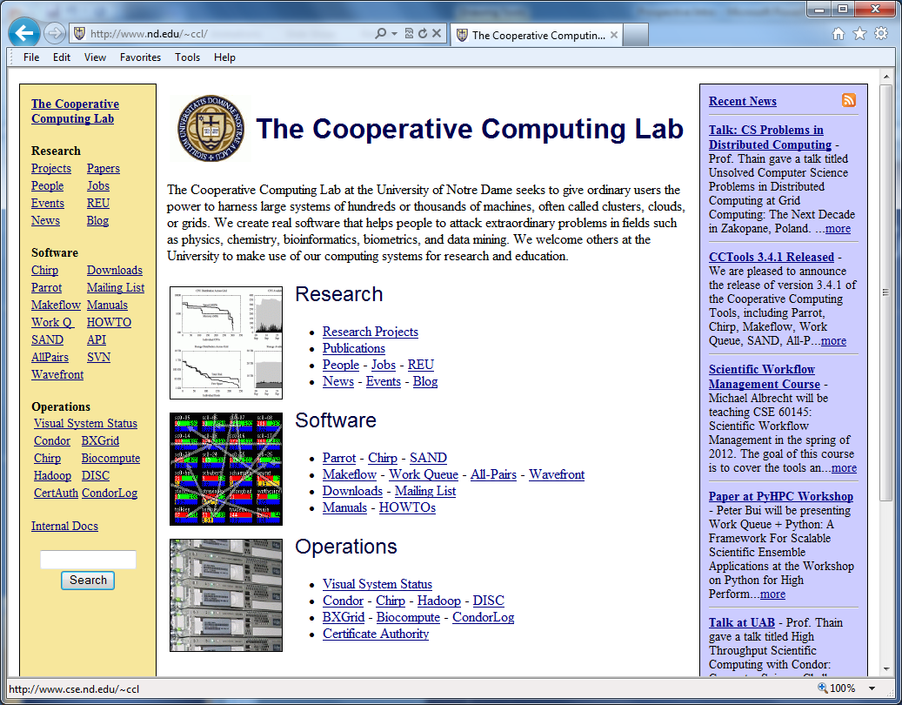
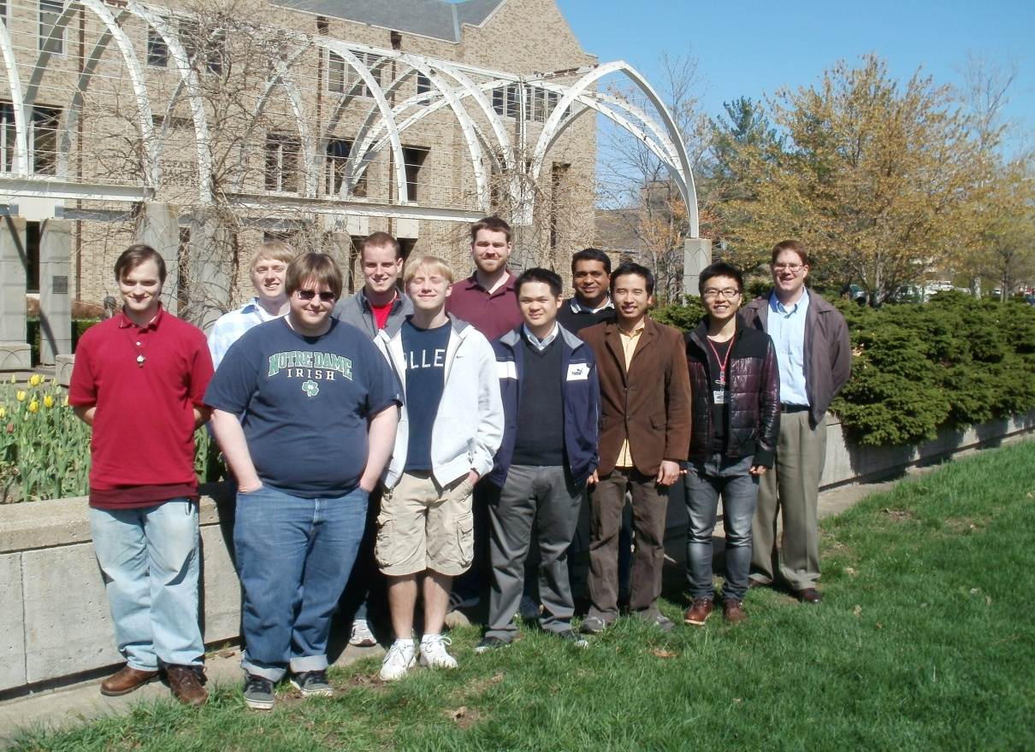
The Cooperative Computing Lab
http://nd.edu/~ccl

Slide 3
The Cooperative Computing Lab
We collaborate with people who have large scale computing problems in science, engineering, and other fields.
We operate computer systems on the O(10,000) cores: clusters, clouds, grids.
We conduct computer science research in the context of real people and problems.
We develop open source software for large scale distributed computing.
http://www.nd.edu/~ccl

Slide 4
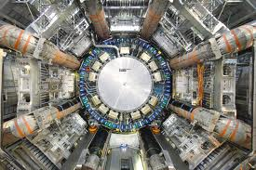
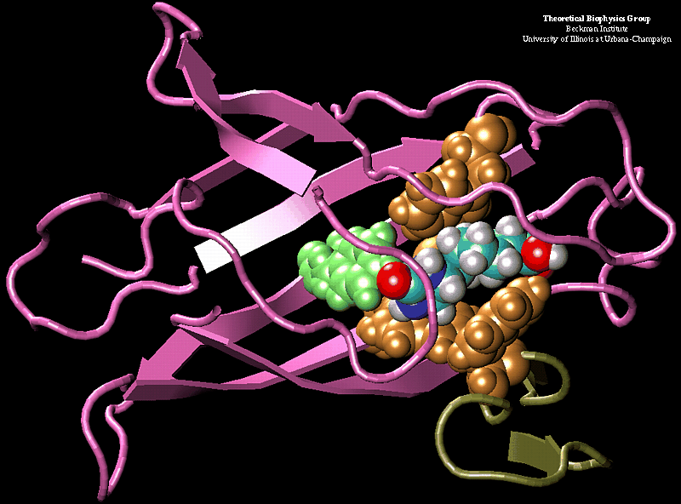
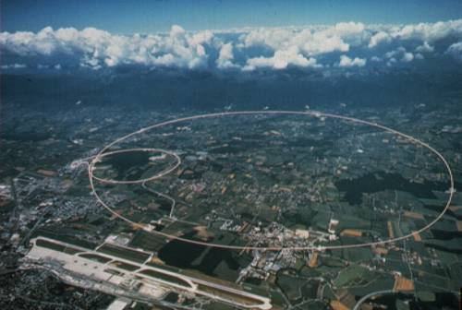
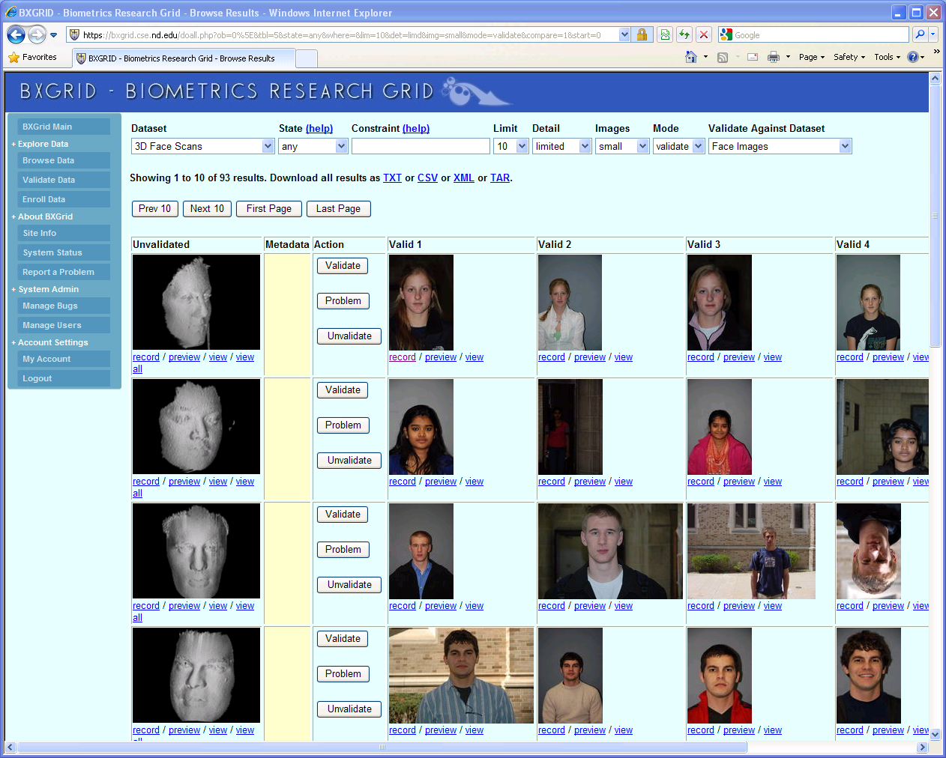
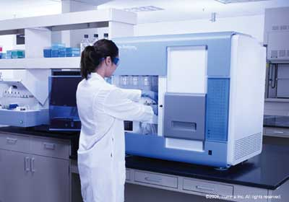

Science Depends on Computing!
AGTCCGTACGATGCTATTAGCGAGCGTGA…

Slide 5
The Good News:
Computing is Plentiful!

Slide 6
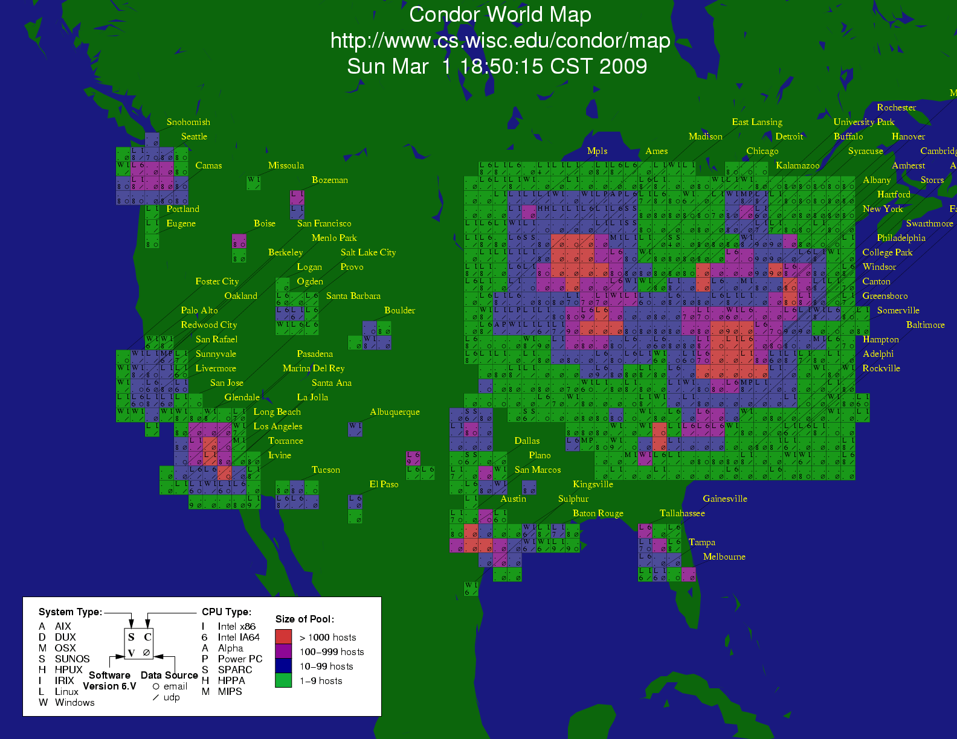
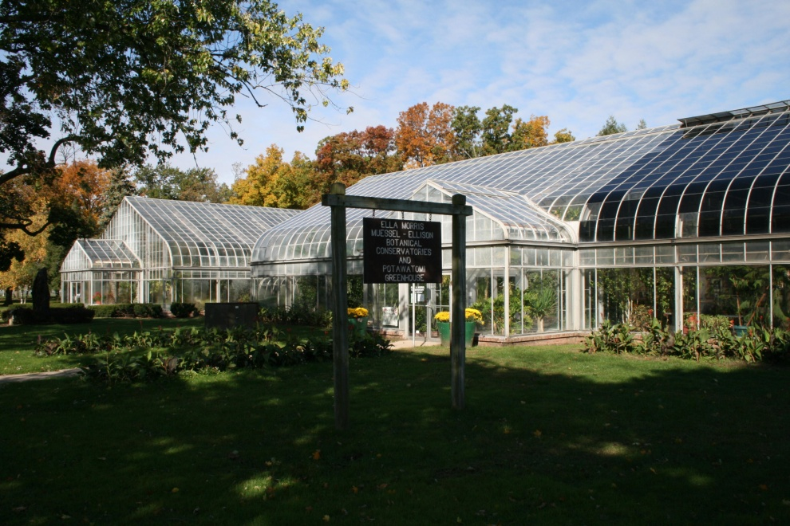




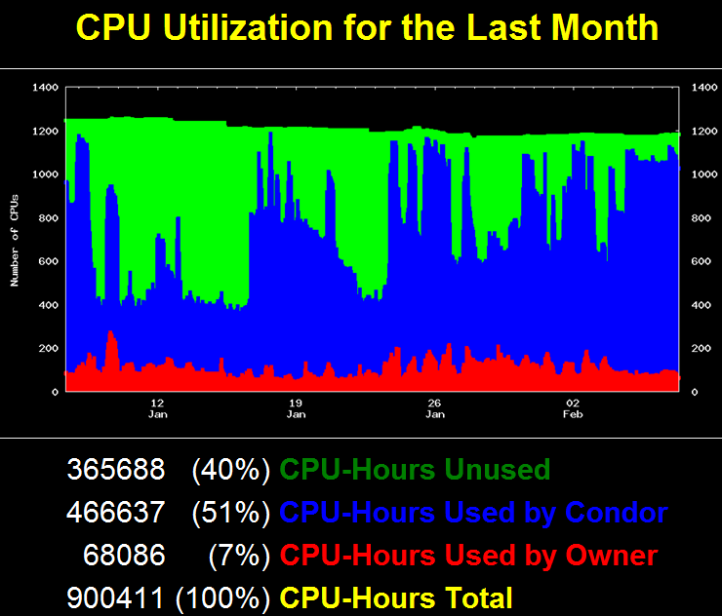
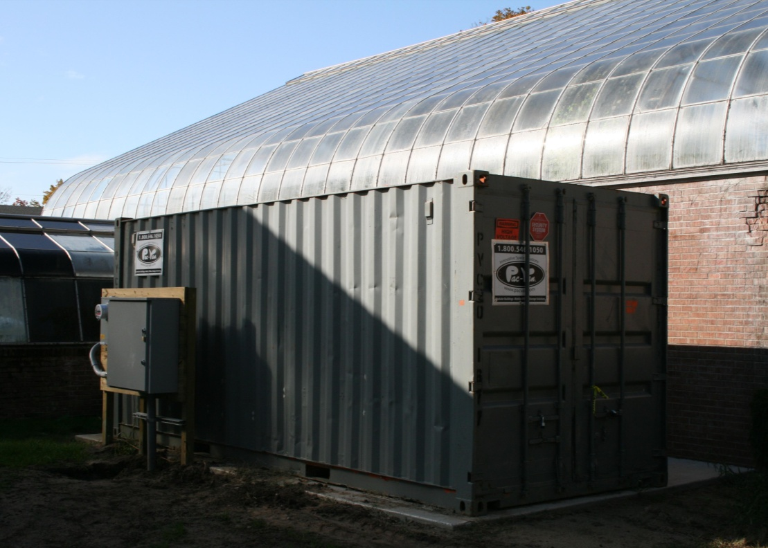




Slide 7
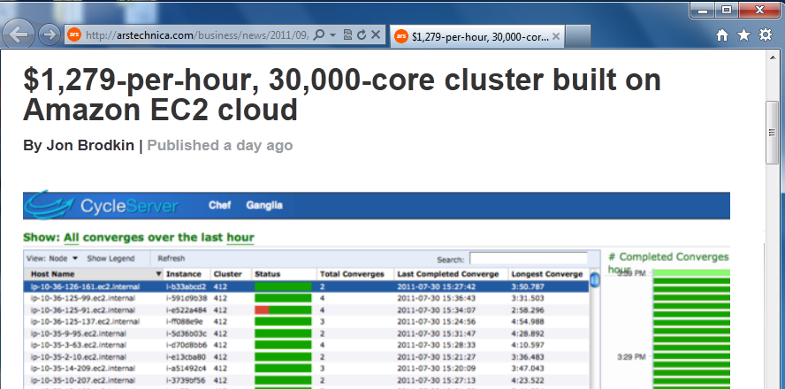
Big clusters are cheap!
http://arstechnica.com/business/news/2011/09/30000-core-cluster-built-on-amazon-ec2-cloud.ars

Slide 8


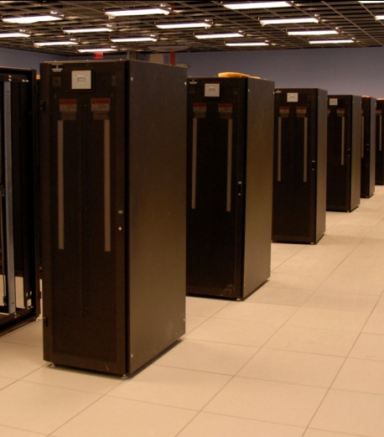
I have a standard, debugged, trusted application that runs on my laptop.
A toy problem completes in one hour.
A real problem will take a month (I think.)
Can I get a single result faster?
Can I get more results in the same time?
Last year,
I heard about
this grid thing.
This year,
I heard about
this cloud thing.
What do I do next?

Slide 9

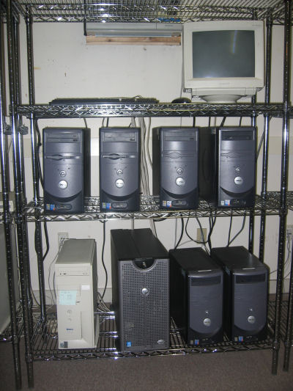

What they want.
What they get.

Slide 10
I can get as many machines on the cloud as I want!
How do I organize my application to run on those machines?

Slide 11
Our Philosophy:
Harness all the resources that are available: desktops, clusters, clouds, and grids.
Make it easy to scale up from one desktop to national scale infrastructure.
Provide familiar interfaces that make it easy to connect existing apps together.
Allow portability across operating systems, storage systems, middleware…
Make simple things easy, and complex things possible.
No special privileges required.

Slide 12
A Quick Tour of the CCTools
Open source, GNU General Public License.
Compiles in 1-2 minutes, installs in $HOME.
Runs on Linux, Solaris, MacOS, Cygwin, FreeBSD, …
Interoperates with many distributed computing systems.
  Condor, SGE, Torque, Globus, iRODS, Hadoop…
Components:
  Makeflow – A portable workflow manager.
  Work Queue – A lightweight distributed execution system.
  All-Pairs / Wavefront / SAND – Specialized execution engines.
  Parrot – A personal user-level virtual file system.
  Chirp – A user-level distributed filesystem.
http://www.nd.edu/~ccl/software

Slide 13
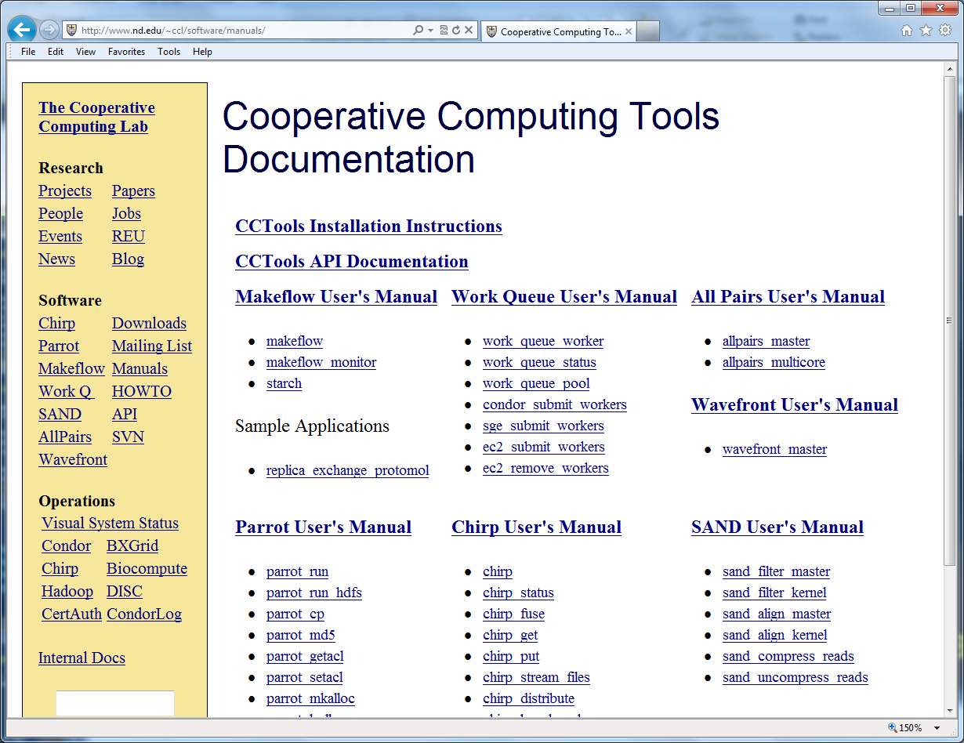
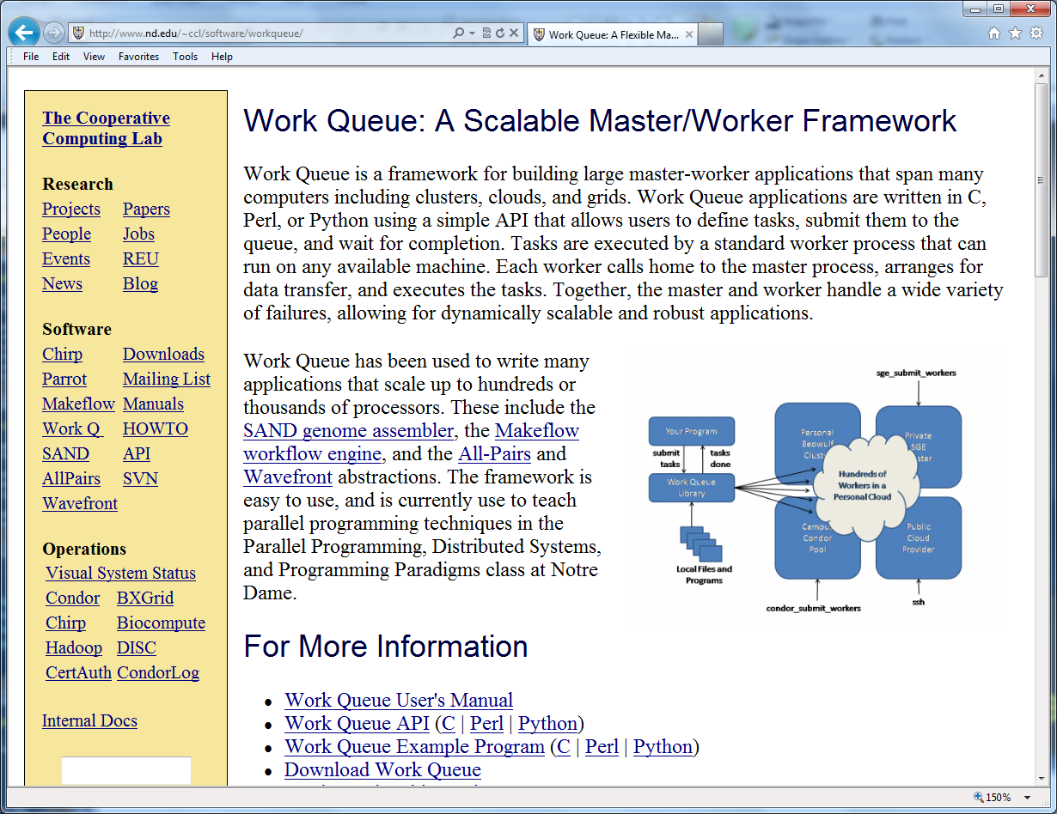
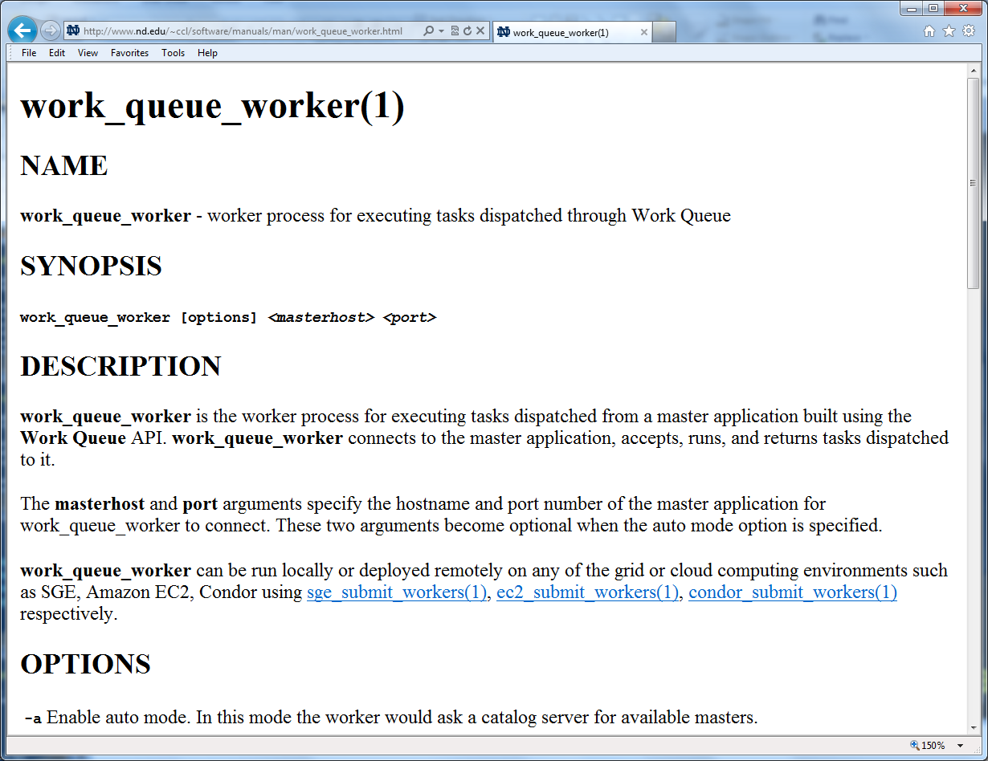
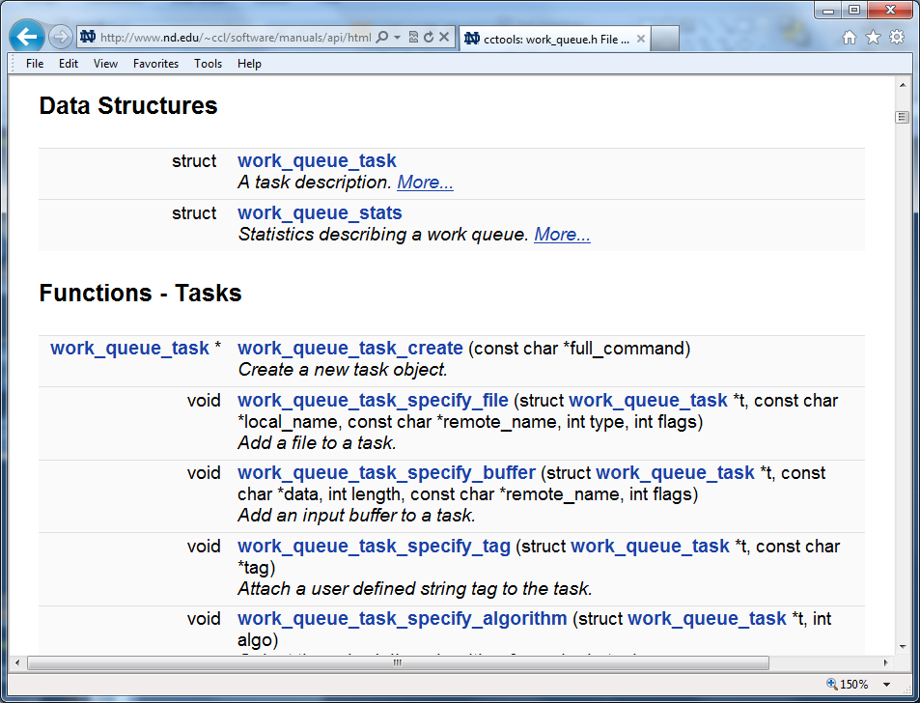
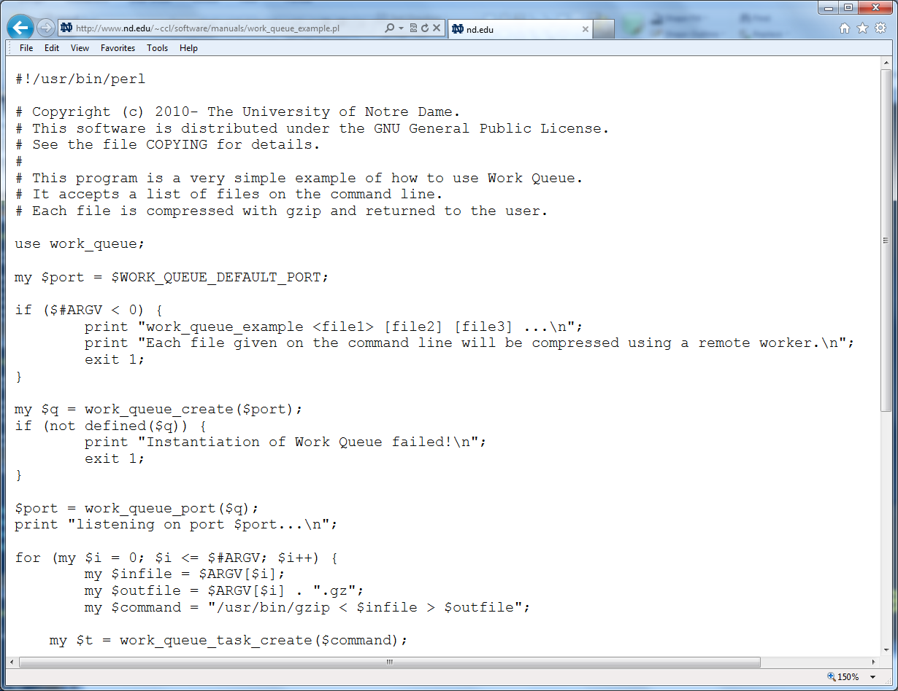
http://www.nd.edu/~ccl/software/manuals

Slide 14
Makeflow:
A Portable Workflow System

Slide 15
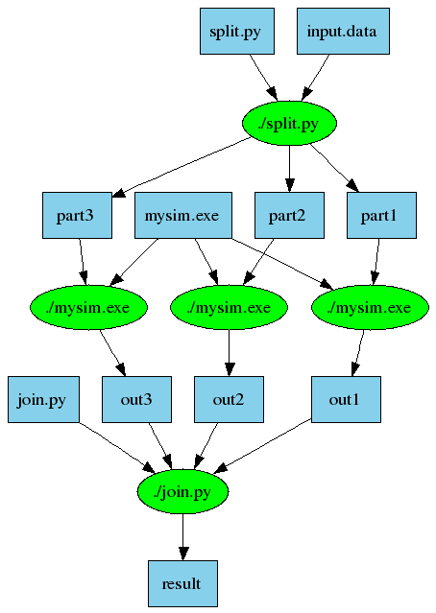
An Old Idea: Makefiles
part1 part2 part3: input.data split.py
./split.py input.data
out1: part1 mysim.exe
./mysim.exe part1 >out1
out2: part2 mysim.exe
./mysim.exe part2 >out2
out3: part3 mysim.exe
./mysim.exe part3 >out3
result: out1 out2 out3 join.py
./join.py out1 out2 out3 > result

Slide 16
Makeflow = Make + Workflow
Provides portability across batch systems.
Enable parallelism (but not too much!)
Fault tolerance at multiple scales.
Data and resource management.
Makeflow
Local
Condor
Torque
Work
Queue
http://www.nd.edu/~ccl/software/makeflow

Slide 17
Makeflow Syntax
[output files] : [input files]
[command to run]
One Rule
calib.dat
sim.exe
out.txt
in.dat
sim.exe in.dat –p 50 > out.txt
out.txt : in.dat
sim.exe –p 50 in.data > out.txt
out.txt : in.dat calib.dat sim.exe
sim.exe –p 50 in.data > out.txt
Not Quite Right!

Slide 18
You must state all the files needed by the command.

Slide 19
sims.mf
out.10 : in.dat calib.dat sim.exe
sim.exe –p 10 in.data > out.10
out.20 : in.dat calib.dat sim.exe
sim.exe –p 20 in.data > out.20
out.30 : in.dat calib.dat sim.exe
sim.exe –p 30 in.data > out.30

Slide 20
How to run a Makeflow
Run a workflow locally (multicore?)
  makeflow -T local sims.mf
Clean up the workflow outputs:
  makeflow –c sims.mf
Run the workflow on Torque:
  makeflow –T torque sims.mf
Run the workflow on Condor:
  makeflow –T condor sims.mf

Slide 21
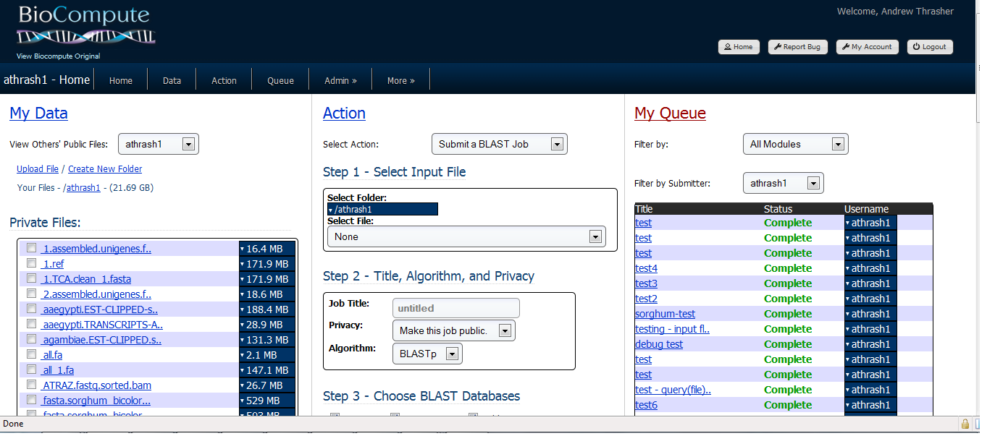

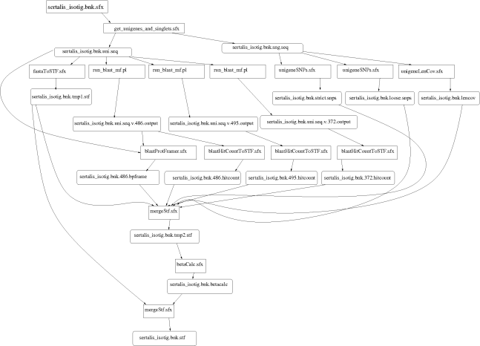
Example: Biocompute Portal
BLAST
SSAHA
SHRIMP
EST
MAKER
…
Progress
Bar
Generate Makefile
Transaction Log
Condor
Pool
Update
Status
Run
Workflow
Make
flow
Submit
Tasks

Slide 22
Makeflow + Work Queue

Slide 23
Makeflow + Batch System
FutureGrid
Torque
Cluster
Private
Cluster
Makefile
makeflow –T torque
???
Makeflow
???
Campus
Condor
Pool
Public
Cloud
Provider
makeflow –T condor
Local Files and Programs

Slide 24
Makeflow + Work Queue
torque_submit_workers
FutureGrid
Torque
Cluster
Private
Cluster
Makefile
W
W
Thousands of Workers in a
Personal Cloud
W
submit
tasks
W
W
W
Makeflow
Campus
Condor
Pool
Public
Cloud
Provider
W
W
W
W
W
W
W
Local Files and Programs
condor_submit_workers
ssh

Slide 25
Advantages of Work Queue
Harness multiple resources simultaneously.
Hold on to cluster nodes to execute multiple tasks rapidly. (ms/task instead of min/task)
Scale resources up and down as needed.
Better management of data, with local caching for data intensive tasks.
Matching of tasks to nodes with data.

Slide 26
Makeflow and Work Queue
To start the Makeflow
% makeflow –T wq sims.mf
Could not create work_queue on port 9123.
% makeflow –T wq –p 0 sims.mf
Listening for workers on port 8374…
To start one worker:
% work_queue_worker alamo.futuregrid.org 8374

Slide 27
Start Workers Everywhere!
Submit workers to Torque:
torque_submit_workers alamo.futuregrid.org 8374 25
Submit workers to Condor:
condor_submit_workers alamo.futuregrid.org 8374 25
Submit workers to SGE:
sge_submit_workers alamo.futuregrid.org 8374 25

Slide 28
Keeping track of port numbers gets old fast…

Slide 29
Project Names
makeflow …
–a –N myproject
work_queue_worker
-a –N myproject
Makeflow
(port 4057)
connect to
alamo:4057
Worker
advertise
query
Catalog
work_queue_status
query
“myproject”
is at alamo:4057

Slide 30
Project Names
Start Makeflow with a project name:
% makeflow –T wq –p 0 –a –N arizona-class sims.mf
Listening for workers on port XYZ…
Start one worker:
% work_queue_worker -a -N arizona-class
Start many workers:
% torque_submit_workers –a –N arizona-class 5

Slide 31
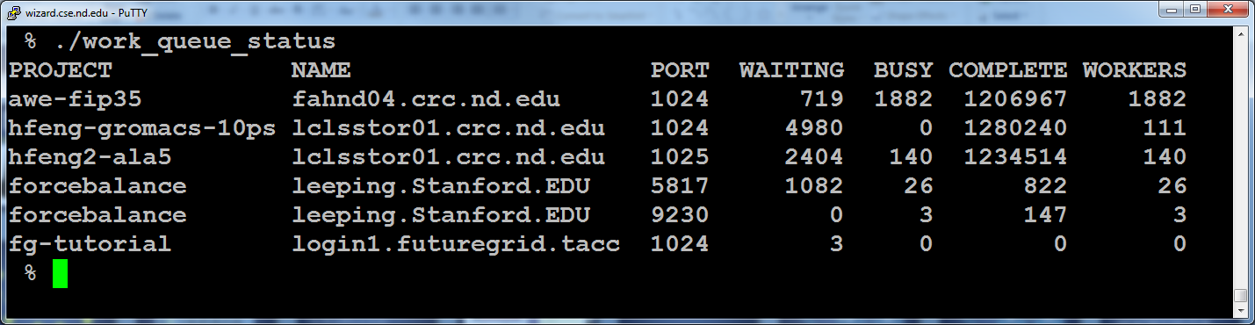
work_queue_status

Slide 32
Resilience and Fault Tolerance
MF +WQ is fault tolerant in many different ways:
  If Makeflow crashes (or is killed) at any point, it will recover by reading the transaction log and continue where it left off.
  Makeflow keeps statistics on both network and task performance, so that excessively bad workers are avoided.
  If a worker crashes, the master will detect the failure and restart the task elsewhere.
  Workers can be added and removed at any time during the execution of the workflow.
  Multiple masters with the same project name can be added and removed while the workers remain.
  If the worker sits idle for too long (default 15m) it will exit, so as not to hold resources idle.

Slide 33
Other parts of the CCTools…

Slide 34
Parrot Virtual File System
Ordinary
Appl
Filesystem Interface: open/read/write/close
Parrot Virtual File System
Local
HTTP
CVMFS
Chirp
iRODS
Web Servers
iRODS
Server
CVMFS
Network
Chirp
Server

Slide 35
Example of Using Parrot
% parrot_run bash
[short pause]
% cat /http/www.google.com/index.html
% ls –la /anonftp/ftp.gnu.org
% cd /irods/data.iplantcollaborative.org
% cd iplant/home
% ls –la
collections nirav nirav_test1 rogerab shared

Slide 36
All-Pairs and Wavefront
Specialized tools for very specific workflow patterns.
allpairs A.list B.list F.exe
wavefront M.data F.exe
A1
A2
A3
M[0,4]
M[2,4]
M[3,4]
M[4,4]
x
F
d
y
M[0,3]
M[3,2]
M[4,3]
B1
F
F
F
x
F
x
F
d
y
d
y
M[0,2]
x
M[4,2]
x
F
x
F
F
B2
F
F
F
d
y
d
y
d
y
M[0,1]
x
F
x
F
x
F
x
F
B3
F
F
F
d
y
d
y
d
y
d
y
M[0,0]
M[1,0]
M[2,0]
M[3,0]
M[4,0]

Slide 37
Example of Using All-Pairs
% compare.exe A1 B1
similarity 25.3% at position 65
% allpairs_master A.list B.list compare.exe
A1 B1 similarity 25.3% at position 65
A2 B1 similarity 85.6% at position 10
A3 B1 similarity 98.4% at position 48
A1 B2 similarity 31.3% at position 91
…

Slide 38
Elastic Application Stack
All-Pairs
Wavefront
Makeflow
Custom
Apps
Work Queue Library
Thousands of Workers in a
Personal Cloud
Public
Cloud
Provider
Shared
SGE
Cluster
Campus
Condor
Pool
Private
Cluster
W
W
Wv
W
W
W
W
W
W

Slide 39
Next Steps:
Tutorial: Basic examples of how to use Makeflow on Future Grid.
Homework: Problems to work on this week.

Slide 40
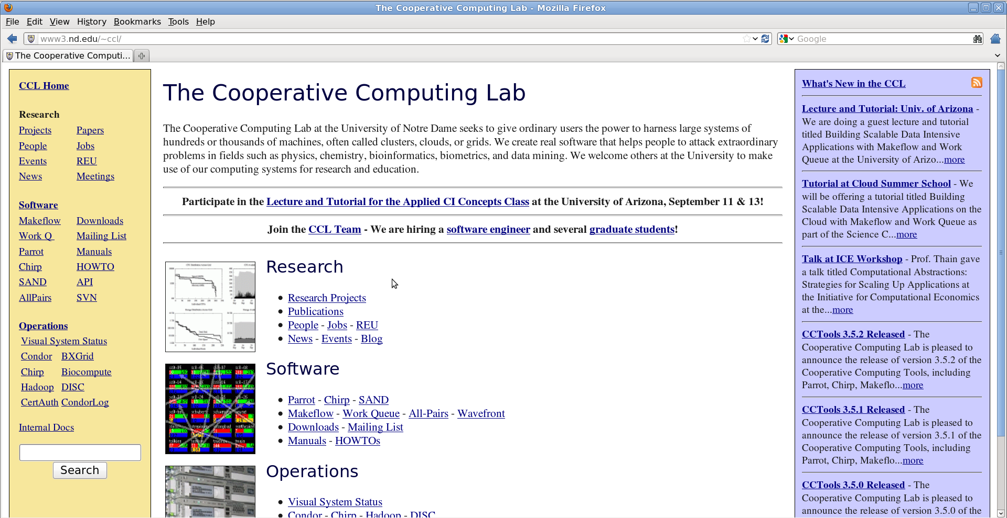
Go to: http://nd.edu/~ccl
Click “Lecture and Tutorial for Applied CI Concepts Class”

