Slide 1
Building Scalable Scientific Applications with Work Queue
Douglas Thain and Dinesh Rajan
University of Notre Dame
Applied Cyber Infrastructure Concepts
University of Arizona, October 3, 2013

Slide 2
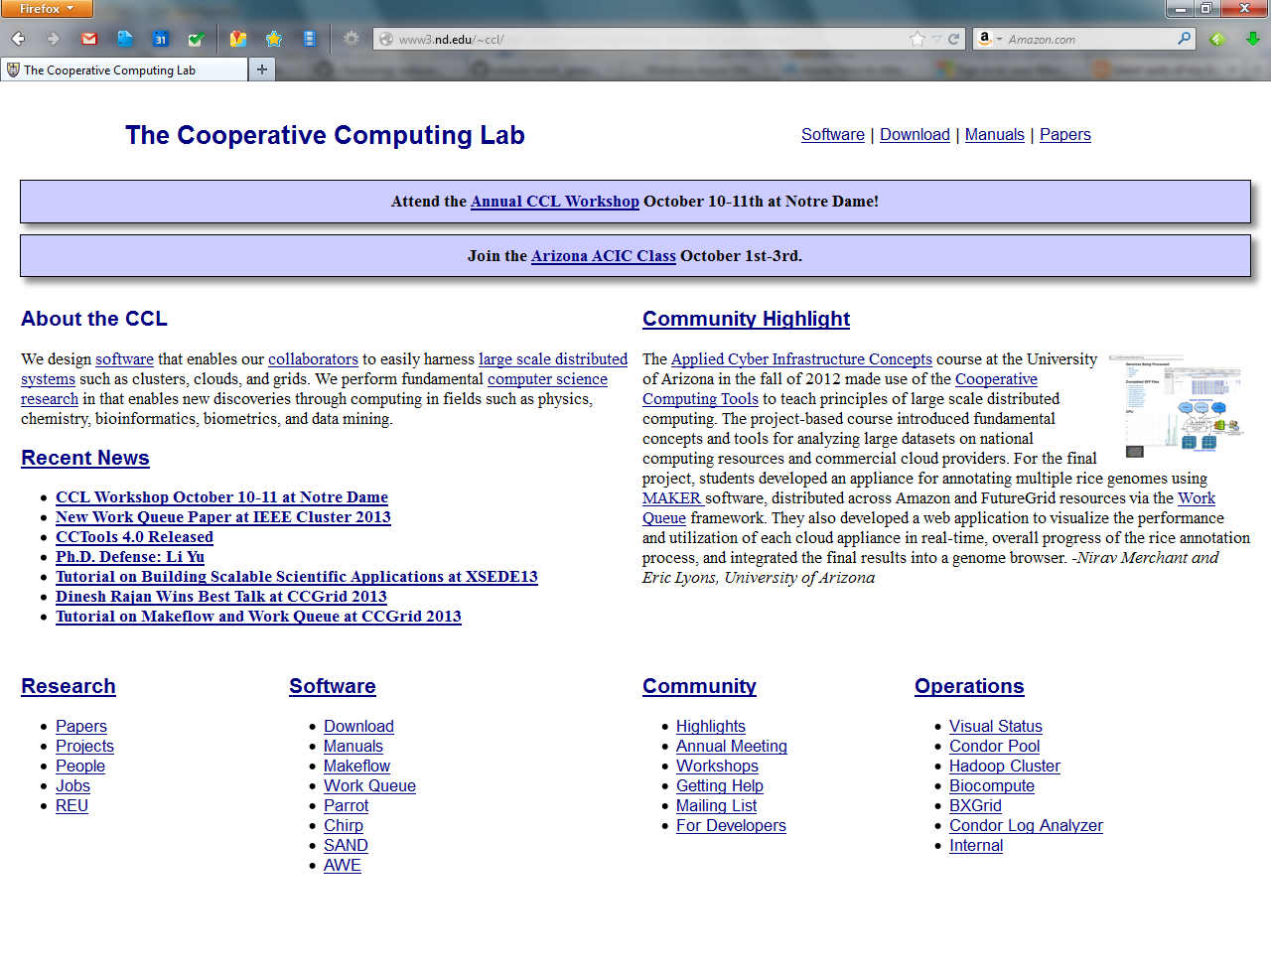
Go to: http://nd.edu/~ccl

Slide 3
Recap: Makeflow

Slide 4
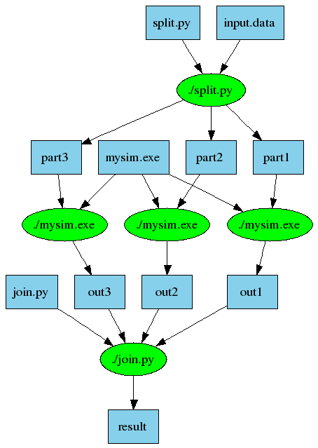
An Old Idea: Makefiles
part1 part2 part3: input.data split.py
./split.py input.data
out1: part1 mysim.exe
./mysim.exe part1 > out1
out2: part2 mysim.exe
./mysim.exe part2 > out2
out3: part3 mysim.exe
./mysim.exe part3 > out3
result: out1 out2 out3 join.py
./join.py out1 out2 out3 > result
4

Slide 5
Makeflow = Make + Workflow
Provides portability across batch systems.
Enable parallelism (but not too much!)
Fault tolerance at multiple scales.
Data and resource management.
Makeflow
Local
Condor
Torque
Work
Queue
http://www.nd.edu/~ccl/software/makeflow
5

Slide 6
Makeflow + Work Queue

Slide 7
Makeflow + Work Queue
torque_submit_workers
FutureGrid
Torque
Cluster
Private
Cluster
Makefile
W
W
Thousands of Workers in a
Personal Cloud
W
submit
tasks
W
W
W
Makeflow
Campus
Condor
Pool
Public
Cloud
Provider
W
W
W
W
W
W
W
Local Files and Programs
condor_submit_workers
ssh

Slide 8
Advantages of Using Work Queue
Harness multiple resources simultaneously.
Hold on to cluster nodes to execute multiple tasks rapidly. (ms/task instead of min/task)
Scale resources up and down as needed.
Better management of data, with local caching for data intensive tasks.
Matching of tasks to nodes with data.

Slide 9
Makeflow
Great for static workflows!
- Tasks/dependencies are known beforehand
- Directed Acyclic Graphs
Great for file-based workflows!
- Input: files, Output: files

Slide 10
What if my workflow is dynamic?
Write a native Work Queue program using Work Queue API

Slide 11
Work Queue API
use work_queue;
queue = work_queue_create();
while( not done ) {
while (more work ready) {
task = work_queue_task_create();
// add some details to the task
work_queue_submit(queue, task);
}
task = work_queue_wait(queue);
// process the completed task
}
http://www.nd.edu/~ccl/software/workqueue
11

Slide 12
Work Queue System
1000s of workers
dispatched to clusters, clouds, & grids
worker
worker
worker
worker
worker
worker
Work Queue Program
C / Python / Perl
Work Queue Library
put sim.exe
put in.txt
exec sim.exe < in.txt >out.txt
get out.txt
worker
in.txt
sim
out.txt
cache recently used files
12

Slide 13
Run One Task in Python
from work_queue import *
queue = WorkQueue( port = 0 )
queue.specify_name( “myproject” );
task = Task(“sim.exe –p 50 in.dat >out.txt”)
### Missing: Specify files needed by the task.
queue.submit( task )
While not queue.empty():
task = queue.wait(60)

Slide 14
Run One Task in Perl
use work_queue;
$queue = work_queue_create( 0 );
work_queue_specify_name( “myproject” );
$task = work_queue_task_create(“sim.exe –p 50 in.dat >out.txt”);
### Missing: Specify files needed by the task.
work_queue_submit( $queue, $task );
while(!work_queue_empty($queue)) {
$task = work_queue_wait( $queue, 60 );
if($task) work_queue_task_delete( $task );
}

Slide 15
Run One Task in C
#include “work_queue.h”
struct work_queue *queue;
struct work_queue_task *task;
queue = work_queue_create( 0 );
work_queue_specify_name( “myproject” );
task = work_queue_task_create(“sim.exe –p 50 in.dat >out.txt”);
/// Missing: Specify files needed by the task.
work_queue_submit( queue, task );
while(!work_queue_empty(queue)) {
task = work_queue_wait( queue, 60 );
if(task) work_queue_task_delete( task );
}

Slide 16
Python: Specify Files for a Task
calib.dat
sim.exe
out.txt
in.dat
sim.exe in.dat –p 50 > out.txt
task.specify_file( “in.dat”, ”in.dat”,
WORK_QUEUE_INPUT, cache = False )
task.specify_file( “calib.dat”, ”calib.dat”,
WORK_QUEUE_INPUT, cache = False )
task.specify_file( “out.txt”, ”out.txt”,
WORK_QUEUE_OUTPUT, cache = False )
task.specify_file( “sim.exe”, ”sim.exe”,
WORK_QUEUE_INPUT, cache = True )

Slide 17
Perl: Specify Files for a Task
calib.dat
sim.exe
out.txt
in.dat
sim.exe in.dat –p 50 > out.txt
work_queue_task_specify_file( $task,“in.dat”,”in.dat”,
$WORK_QUEUE_INPUT, $WORK_QUEUE_NOCACHE );
work_queue_task_specify_file( $task,“calib.dat”,”calib.dat”,
$WORK_QUEUE_INPUT, $WORK_QUEUE_NOCACHE );
work_queue_task_specify_file( $task,“out.txt”,”out.txt”,
$WORK_QUEUE_OUTPUT, $WORK_QUEUE_NOCACHE );
work_queue_task_specify_file( $task,“sim.exe”,”sim.exe”,
$WORK_QUEUE_INPUT, $WORK_QUEUE_CACHE );

Slide 18
C: Specify Files for a Task
calib.dat
sim.exe
out.txt
in.dat
sim.exe in.dat –p 50 > out.txt
work_queue_task_specify_file( task,“in.dat”,”in.dat”,
WORK_QUEUE_INPUT, WORK_QUEUE_NOCACHE );
work_queue_task_specify_file( task,“calib.dat”,”calib.dat”,
WORK_QUEUE_INPUT, WORK_QUEUE_CACHE );
work_queue_task_specify_file( task,“out.txt”,”out.txt”,
WORK_QUEUE_OUTPUT, WORK_QUEUE_NOCACHE );
work_queue_task_specify_file( task,“sim.exe”,”sim.exe”,
WORK_QUEUE_INPUT, WORK_QUEUE_CACHE );

Slide 19
You must state all the files needed by the command.

Slide 20
Running the Work Queue program
Python:
$ python work_queue_example.py
Perl:
  $ perl work_queue_example.pl
C:
$ gcc work_queue_example.c -o work_queue_example
-I~/cctools/include/cctools -L~/cctools/lib -ldttools -lm
$ ./work_queue_example

Slide 21
Start workers for your Work Queue program
Start one local worker:
$ work_queue_worker $MASTERHOST $MASTERPORT
Submit (10) workers to SGE:
$ sge_submit_workers $MASTERHOST $MASTERPORT 10
Submit (10) workers to Condor:
$ condor_submit_workers $MASTERHOST $MASTERPORT 10
$MASTERHOST = Name of machine where Work Queue program runs. (e.g., alamo.fgrid.org)
$MASTERPORT = Port on which Work Queue program is listening. (e.g., 1024)

Slide 22
Harness resources from multiple platforms
torque_submit_workers
FutureGrid
Torque
Cluster
Private
Cluster
W
W
Thousands of Workers in a
Personal Cloud
W
submit
tasks
W
W
W
Work Queue Master
Campus
Condor
Pool
Public
Cloud
Provider
W
W
W
W
W
W
W
Local Files and Programs
condor_submit_workers
ssh

Slide 23
Keeping track of port numbers gets old really fast

Slide 24
Use Project Names
work_queue_worker
-a –N myproject
Work Queue
(port 9037)
connect to
alamo:9037
Worker
advertise
query
Catalog
work_queue_status
query
“myproject”
is at alamo:9037

Slide 25
Specify Project Names in Work Queue
Specify Project Name for Work Queue master:
Python:
q.specify_name (“arizona-tutorial”)
Perl:
work_queue_specify_name ($q, “arizona-tutorial”);
C:
work_queue_specify_name (q, “arizona-tutorial”);

Slide 26
Start Workers with Project Names
Start one worker:
$ work_queue_worker -N arizona-tutorial
Start many workers:
$ sge_submit_workers -N arizona-tutorial 5
$ condor_submit_workers -N arizona-tutorial 5

Slide 27
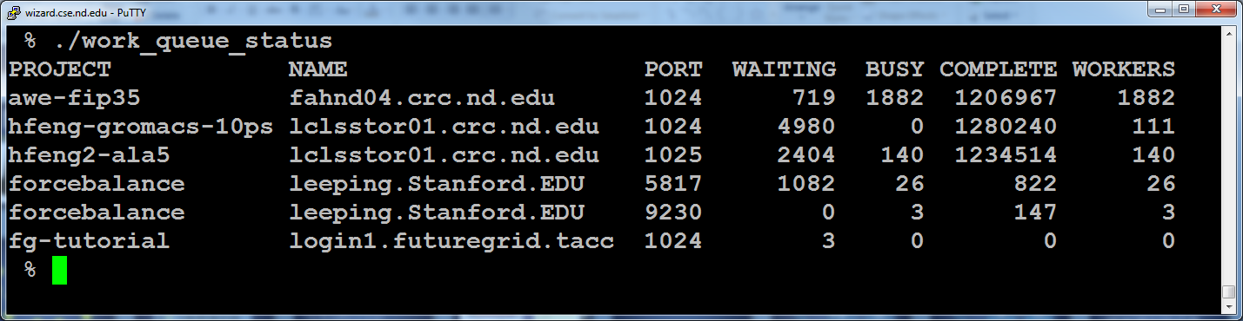
work_queue_status

Slide 28
Advanced Features

Slide 29
Work Queue Task Structure
The Work Queue task structure contains information about the task and its execution.
The following information is available in the task structure:
  Task command (command line arguments)
  Task output (stdout)
  Task return status (exit code of command)
  Task host (hostname and port on which it ran)
  Task submit time, Task completion time
  Task execution time (command)
  And more..

Slide 30
Accessing Work Queue Task structure
Python:
# After ‘t’ has been retrieved through q.wait()
print % t.output
print % t.host
Perl:
# After ‘t’ has been retrieved through work_queue_wait()
print “$t->{output}\n”;
print “$t->{host})\n”:
C:
// After ‘t’ has been retrieved through work_queue_wait()
printf (“%s\n”, t->output);
printf (“%s\n”, t->host):

Slide 31
Work Queue Statistics
Work Queue collects statistics on tasks & workers during run time
The statistics can be retrieved anytime during run time
Global statistics
  Total bytes sent, Total send time
  Total bytes received, Total receive time
  Total tasks dispatched, Total tasks complete
  Total workers joined, Total workers removed
Statistics on Tasks
  Tasks running, Tasks complete, Tasks waiting
Statistics on Workers
  Workers ready, workers busy, workers cancelling
And more…

Slide 32
Accessing Work Queue Statistics
You can access the Work Queue statistics anytime during run time as follows:
Python:
print q.stats
print q.stats.tasks_running
Perl:
my $work_queue_stats = work_queue_stats->new();
work_queue_get_stats ($q, $work_queue_stats);
print “$work_queue_stats->{tasks_running}”;

Slide 33
Work Queue Statistics
You can access the Work Queue statistics anytime during run time as follows:
C:
struct work_queue_stats *wq_stats;
work_queue_get_stats (q, wq_stats);
printf (“%d”, work_queue_stats->tasks_running);

Slide 34
Tag a Work Queue task
You can specify a tag for a task
  Batch together related tasks with a tag
  Add a unique identifier as tag to quickly identify on completed.
Python:
t.specify_tag(“iteration_1”)
Perl:
work_queue_task_specify_tag($t, “iteration_1”);
C:
work_queue_task_specify_tag(t, “iteration_1”);

Slide 35
Cancel Work Queue task
You can cancel any task anytime after it has been submitted to Work Queue as follows:
Python:
q.cancel_by_taskid(q, cancel_taskid)
q.cancel_by_tasktag(q, “redudant_task”)
Perl:
work_queue_cancel_by_taskid($q, $cancel_taskid);
work_queue_cancel_by_tasktag($q, “redudant_task”);
C:
work_queue_cancel_by_taskid(q, cancel_taskid);
work_queue_cancel_by_tasktag(q, “redudant_task”);

Slide 36
Retry “slow” Work Queue tasks
Running on large number of resources
  High probability of stragglers
  These stragglers slow down completion of your computation
Work Queue has a “fast abort” feature to detect stragglers and migrate tasks to other available resources.
  It keeps running average of the task execution times.
  Activate fast abort by specifying a multiple of the average task execution time
  Work Queue will abort any task executing beyond the specified multiple of the task execution time.
  The aborted task will then be retried for execution on another available machine.

Slide 37
Activating fast abort in Work Queue
Python:
#abort if task exceeds 2.5 * avg execution time
q.activate_fast_abort (2.5)
Perl:
work_queue_activate_fast_abort ($q, 2.5);
C:
work_queue_activate_fast_abort (q, 2.5);

Slide 38
Send intermediate buffer data as input file for Work Queue Task
You may have data stored in a buffer (e.g., output of a computation) that will serve as input for a work queue task.
To send buffer data as input to a task:
Python:
buffer = “This is intermediate data”
t.specify_buffer(buffer, input.txt, WORK_QUEUE_INPUT, cache=True)

Slide 39
Send intermediate buffer data as input file for Work Queue Task
Perl:
my $buffer = “This is intermediate buffer data”
my $buff_len = length($buffer);
work_queue_task_specify_buffer($t,$buffer,$buf_len, “input.txt”, $WORK_QUEUE_CACHE);
C:
const char * buffer = “This is intermediate buffer data”;
int buff_len = strlen(buffer);
work_queue_task_specify_buffer(t, buffer, buff_len, “input.txt”, WORK_QUEUE_CACHE);

Slide 40
Password Authentication
Authentication between Work Queue master (Makeflow) and Work Queue workers
Set password to use at master
Only workers started with the same password will be accepted by master
Challenge-response authentication
  Password not sent out in the open

Slide 41
Managing Your Workforce
Master
A
work_queue_pool –T condor
Condor
Pool
W
WQ
Pool
200
500
W
W
Master
B
Submits new workers.
Restarts failed workers.
Removes unneeded workers.
SGE
Cluster
W
W
WQ
Pool
200
0
Master
C
W
work_queue_pool –T sge

Slide 42
Hierarchical Work Queue
Hierarchy in Work Queue: Master, Foremen, Workers
Master
Foreman
Foreman
Foreman
Foreman
Thousands of Workers in XSEDE
Thousands of Workers in FutureGrid
Thousands of Workers in Condor
Thousands of Workers in SGE

Slide 43
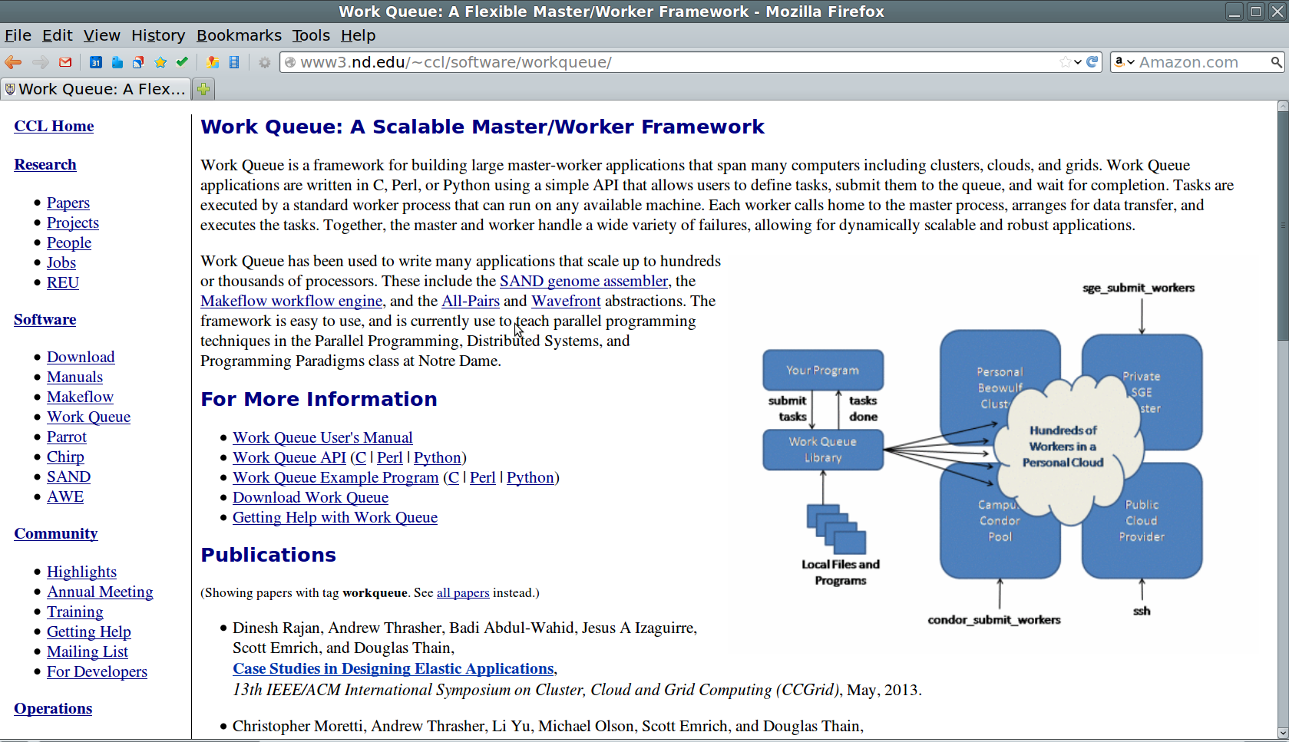
Work Queue Documentation
www.nd.edu/~ccl/software/workqueue/

Slide 44
Sample Applications of Work Queue

Slide 45
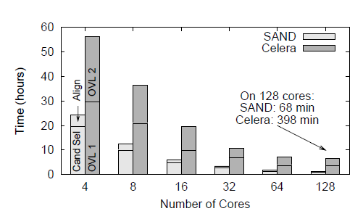
Genome Assembly
Sequence
Data
Modified Celera Assembler
SAND
filter
master
SAND
align
master
Celera
Consensus
W
W
Using WQ, we could assemble a human genome in 2.5 hours on a collection of clusters, clouds, and grids with a speedup of 952X.
W
W
W
W
W
Christopher Moretti, Andrew Thrasher, Li Yu, Michael Olson, Scott Emrich, and Douglas Thain,
A Framework for Scalable Genome Assembly on Clusters, Clouds, and Grids,
IEEE Transactions on Parallel and Distributed Systems, 2012

Slide 46
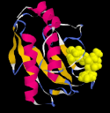
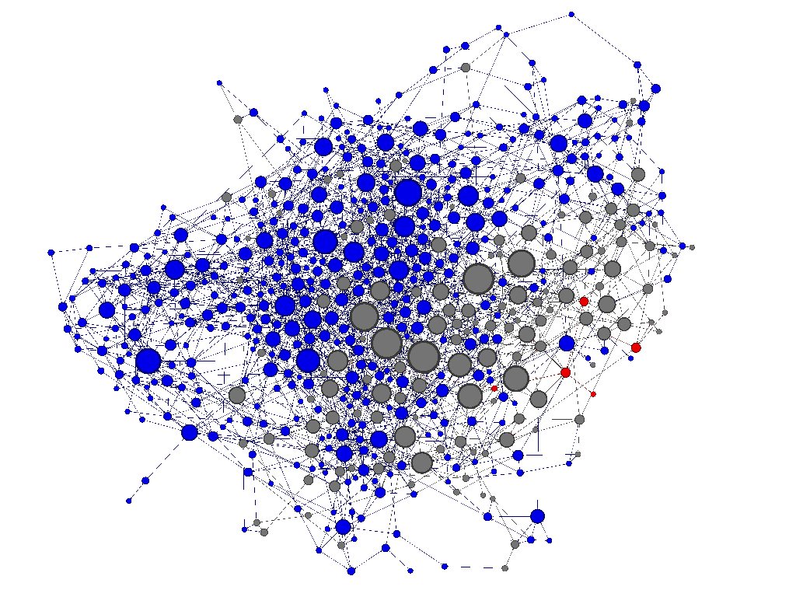
Adaptive Weighted Ensemble
Proteins fold into a number of distinctive states, each of which affects its function in the organism.
How common is each state?
How does the protein transition between states?
How common are those transitions?
46

Slide 47
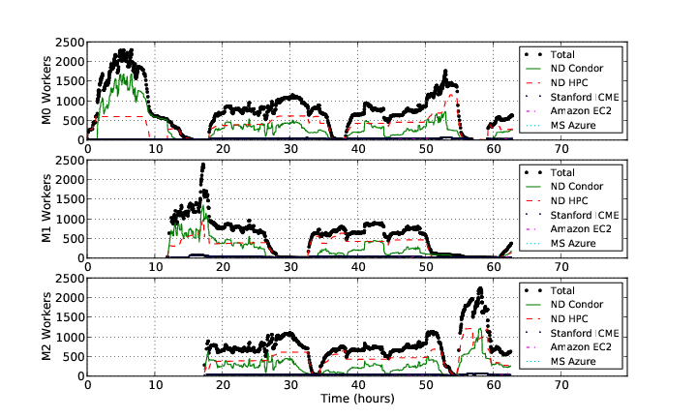
AWE on Clusters, Clouds, and Grids
47

Slide 48
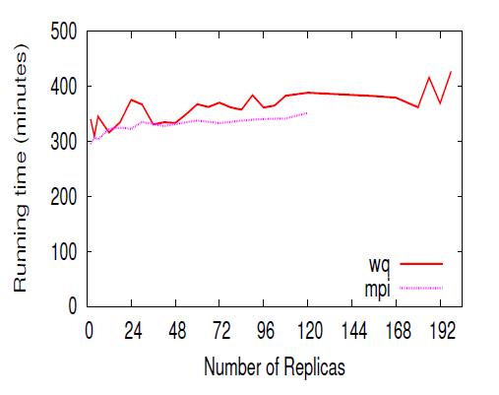
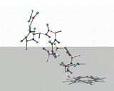
Replica Exchange
Simplified Algorithm:
Submit N short simulations at different temps.
Wait for all to complete.
Select two simulations to swap.
Continue all of the simulations.
Replica Exchange
Work Queue
T=10K
T=20K
T=30K
T=40K
Dinesh Rajan, Anthony Canino, Jesus A Izaguirre, and Douglas Thain,
Converting A High Performance Application to an Elastic Cloud Application, Cloud Com 2011.

Slide 49
Elastic Application Stack
All-Pairs
Wavefront
Makeflow
Custom
Apps
Work Queue Library
Thousands of Workers in a
Personal Cloud
Public
Cloud
Provider
Shared
SGE
Cluster
Campus
Condor
Pool
Private
Cluster
W
W
W
W
W
W
W
W
W
W

Slide 50
Go to: http://nd.edu/~ccl

