Slide 1
Introduction to
Makeflow and Work Queue
Applied Cyberinfrastructure Concepts Course
University of Arizona
30 September 2014
Douglas Thain and Nicholas Hazekamp
University of Notre Dame

Slide 2
The Cooperative Computing Lab
We collaborate with people who have large scale computing problems in science, engineering, and other fields.
We operate computer systems on the O(10,000) cores: clusters, clouds, grids.
We conduct computer science research in the context of real people and problems.
We develop open source software for large scale distributed computing.
http://www.nd.edu/~ccl

Slide 3
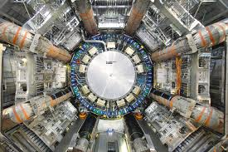
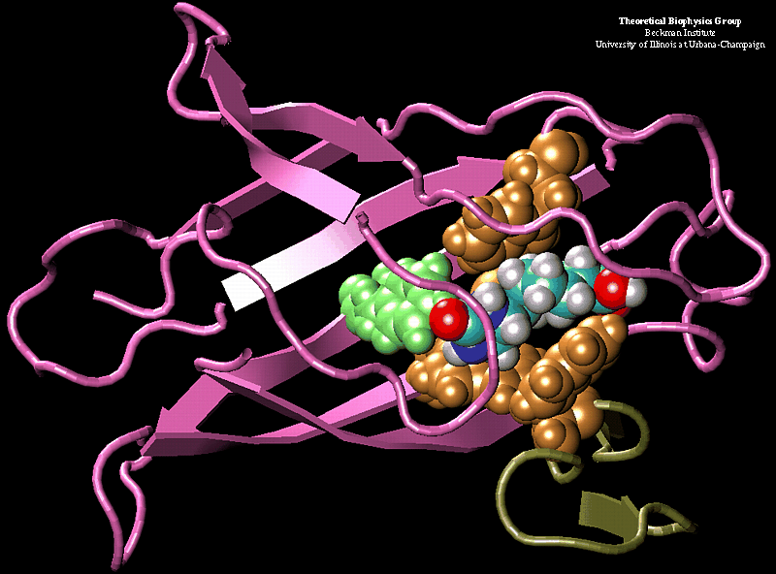
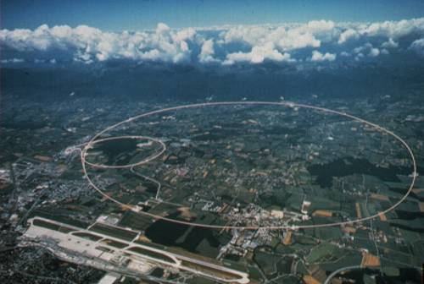
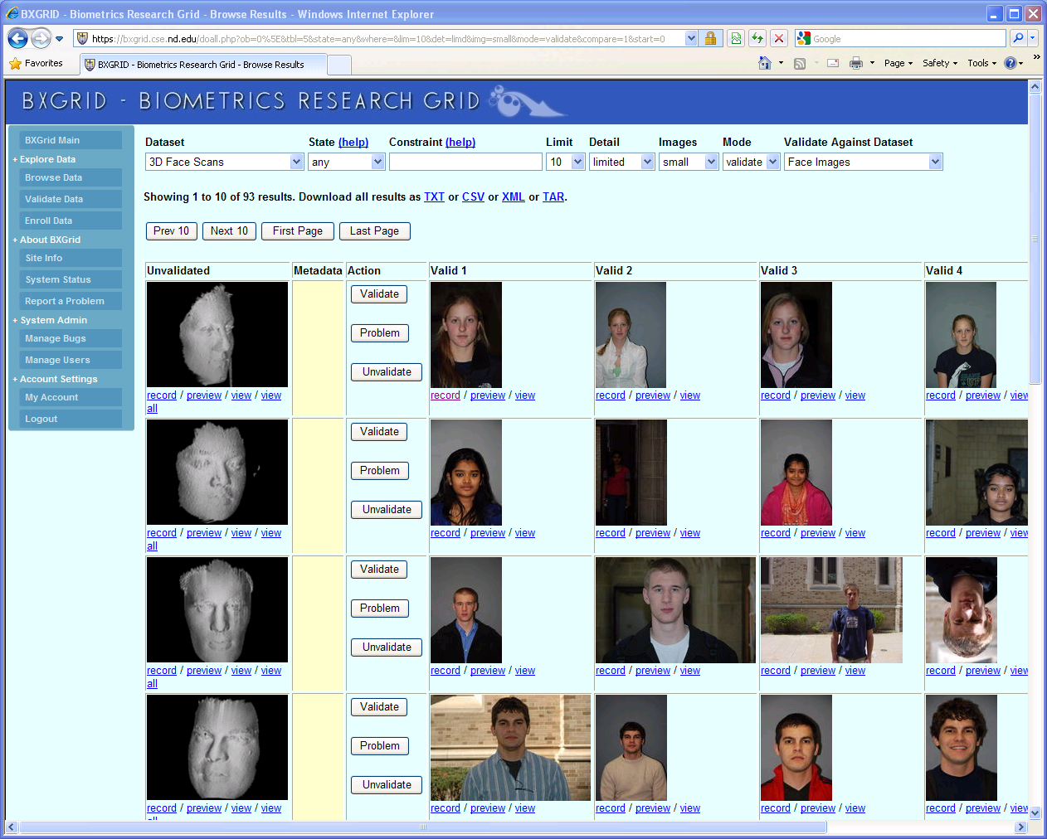


Science Depends on Computing!
AGTCCGTACGATGCTATTAGCGAGCGTGA…

Slide 4
The Good News:
Computing is Plentiful!

Slide 5

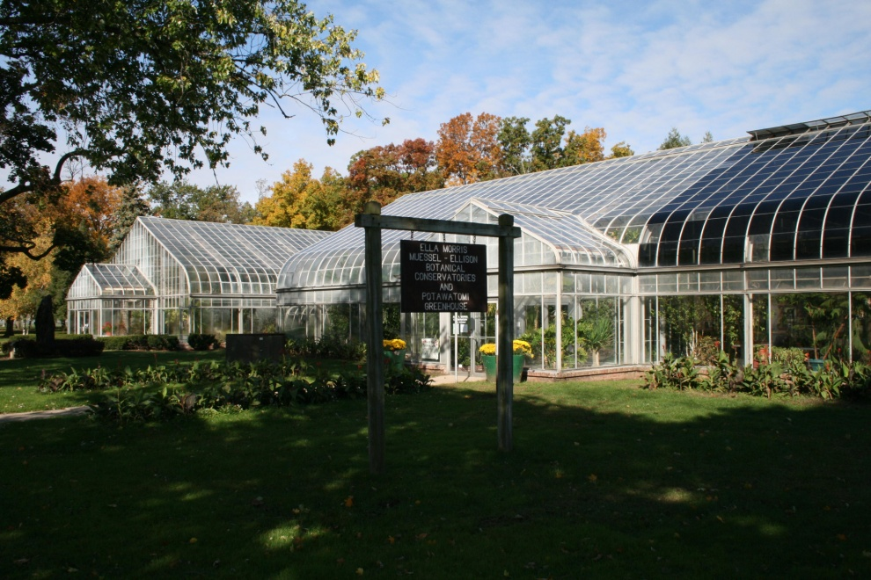




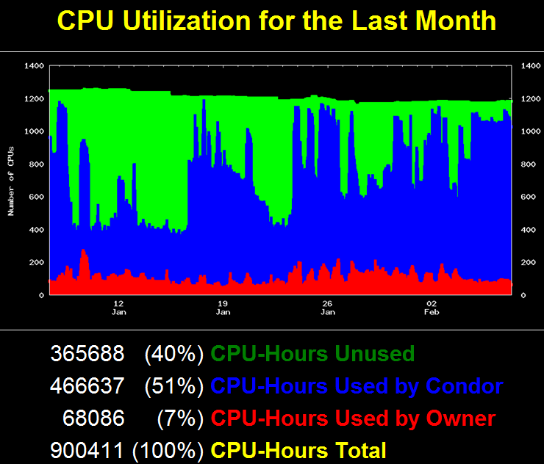
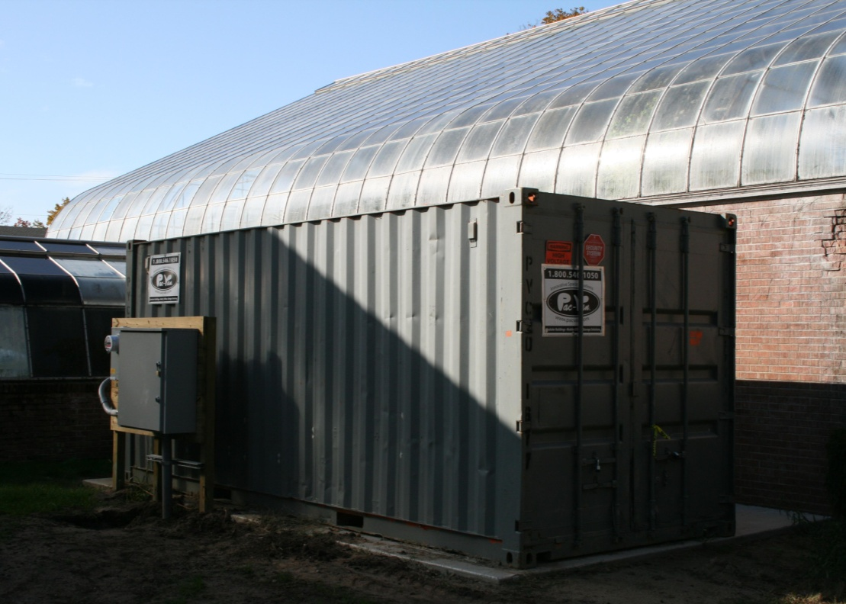




Slide 6
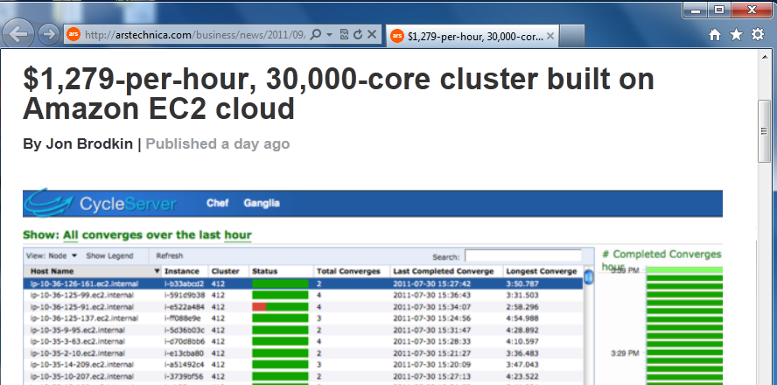
Big clusters are cheap!
http://arstechnica.com/business/news/2011/09/30000-core-cluster-built-on-amazon-ec2-cloud.ars

Slide 7


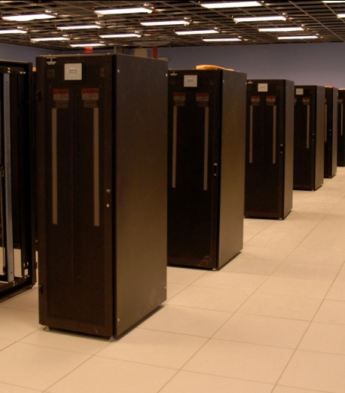
I have a standard, debugged, trusted application that runs on my laptop.
A toy problem completes in one hour.
A real problem will take a month (I think.)
Can I get a single result faster?
Can I get more results in the same time?
Last year,
I heard about
this grid thing.
This year,
I heard about
this cloud thing.
What do I do next?

Slide 8

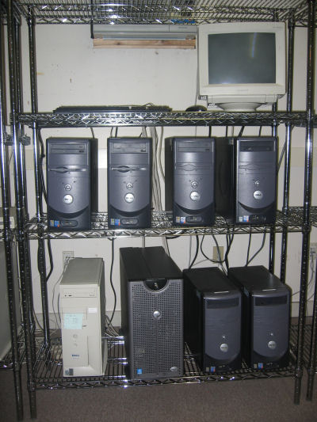

What they want.
What they get.

Slide 9
I can get as many machines on the cloud as I want!
How do I organize my application to run on those machines?

Slide 10
Our Philosophy:
Harness all the resources that are available: desktops, clusters, clouds, and grids.
Make it easy to scale up from one desktop to national scale infrastructure.
Provide familiar interfaces that make it easy to connect existing apps together.
Allow portability across operating systems, storage systems, middleware…
Make simple things easy, and complex things possible.
No special privileges required.

Slide 11
A Quick Tour of the CCTools
Open source, GNU General Public License.
Compiles in 1-2 minutes, installs in $HOME.
Runs on Linux, Solaris, MacOS, Cygwin, FreeBSD, …
Interoperates with many distributed computing systems.
  Condor, SGE, Torque, Globus, iRODS, Hadoop…
Components:
  Makeflow – A portable workflow manager.
  Work Queue – A lightweight distributed execution system.
  All-Pairs / Wavefront / SAND – Specialized execution engines.
  Parrot – A personal user-level virtual file system.
  Chirp – A user-level distributed filesystem.
http://ccl.cse.nd.edu/software

Slide 12
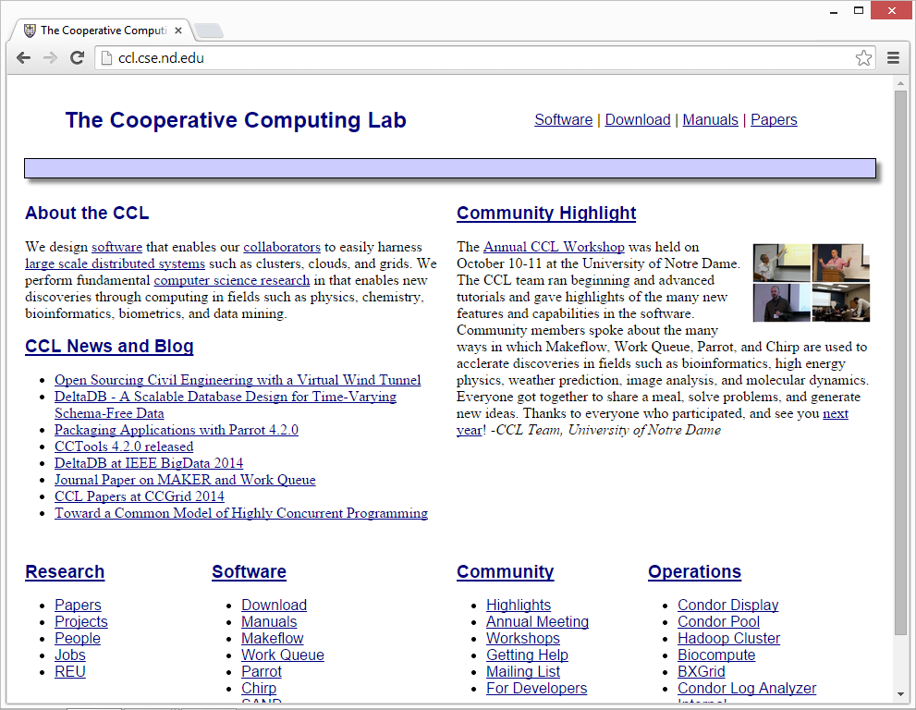
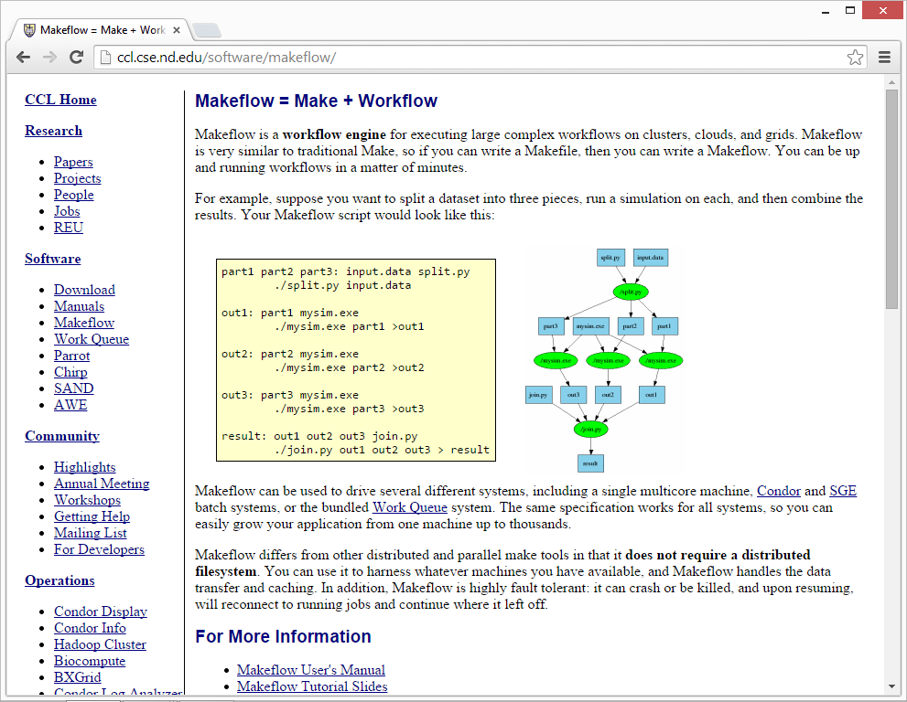
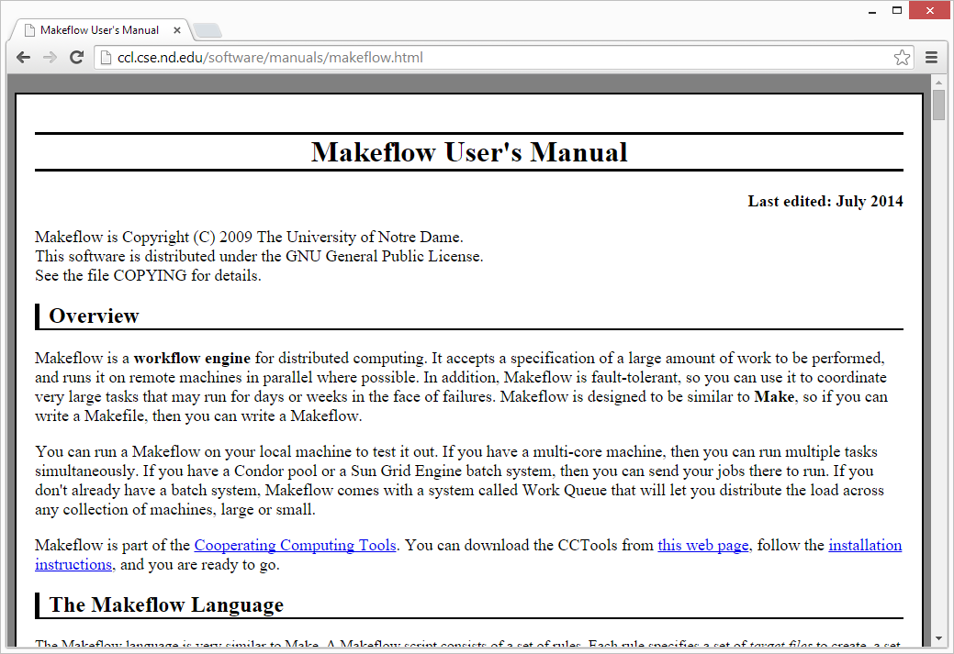
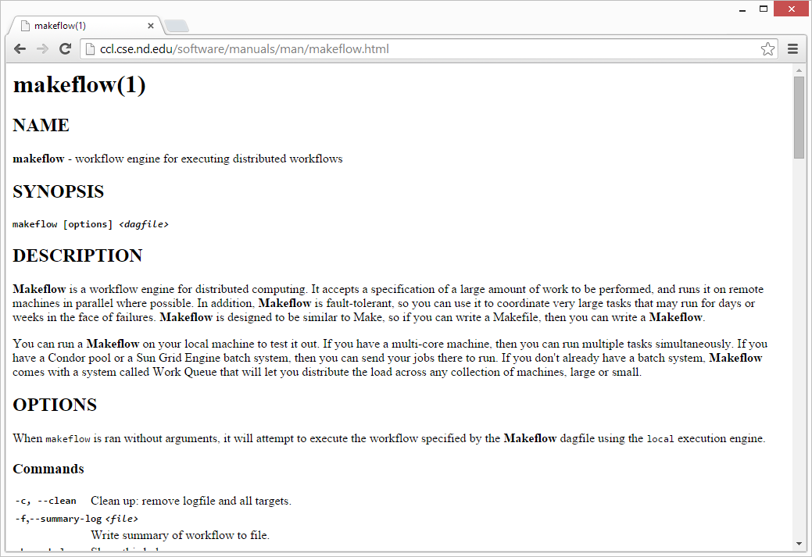
http://ccl.cse.nd.edu
Lots of Documentation

Slide 13
Makeflow:
A Portable Workflow System

Slide 14
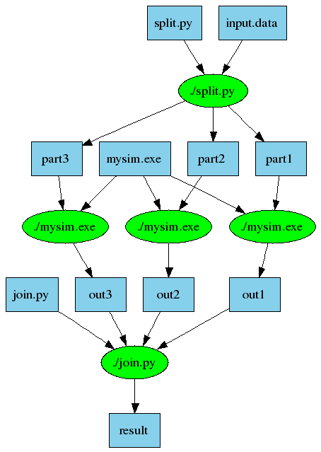
An Old Idea: Makefiles
part1 part2 part3: input.data split.py
./split.py input.data
out1: part1 mysim.exe
./mysim.exe part1 >out1
out2: part2 mysim.exe
./mysim.exe part2 >out2
out3: part3 mysim.exe
./mysim.exe part3 >out3
result: out1 out2 out3 join.py
./join.py out1 out2 out3 > result

Slide 15
Makeflow = Make + Workflow
Provides portability across batch systems.
Enable parallelism (but not too much!)
Trickle out work to batch system.
Fault tolerance at multiple scales.
Data and resource management.
Makeflow
Local
Condor
Torque
Work
Queue
http://ccl.cse.nd.edu/software/makeflow

Slide 16
Makeflow Syntax
[output files] : [input files]
[command to run]
One Rule
calib.dat
sim.exe
out.txt
in.dat
sim.exe in.dat –p 50 > out.txt
out.txt : in.dat
sim.exe –p 50 in.data > out.txt
out.txt : in.dat calib.dat sim.exe
sim.exe –p 50 in.data > out.txt
Not Quite Right!

Slide 17
You must state all the files needed by the command.

Slide 18
sims.mf
out.10 : in.dat calib.dat sim.exe
sim.exe –p 10 in.data > out.10
out.20 : in.dat calib.dat sim.exe
sim.exe –p 20 in.data > out.20
out.30 : in.dat calib.dat sim.exe
sim.exe –p 30 in.data > out.30

Slide 19
How to run a Makeflow
Run a workflow locally (multicore?)
  makeflow -T local sims.mf
Clean up the workflow outputs:
  makeflow –c sims.mf
Run the workflow on Torque:
  makeflow –T torque sims.mf
Run the workflow on Condor:
  makeflow –T condor sims.mf

Slide 20
Job States
0: WAITING
1: RUNNING
Means given to the batch system, which decides when to run it.
2: COMPLETE
3:
FAILED
4:
ABORTED

Slide 21
Transaction Log
# TIME, TASKID, STATE, JOBID, STATE[0], STATE[1], …
1347281321284638 5 1 9206 5 1 0 0 0 6 1347281321348488 5 2 9206 5 0 1 0 0 6 1347281321348760 4 1 9207 4 1 1 0 0 6 1347281321348958 3 1 9208 3 2 1 0 0 6 1347281321629802 4 2 9207 3 1 2 0 0 6 1347281321630005 2 1 9211 2 2 2 0 0 6

Slide 22
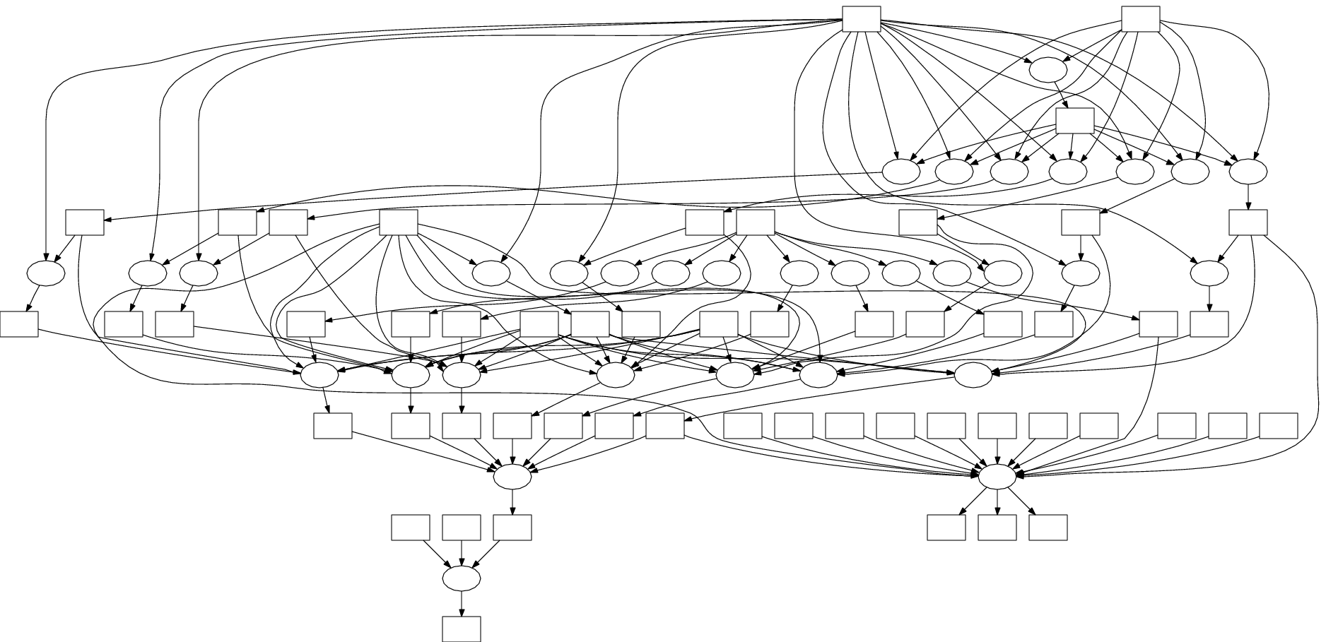
Visualization with DOT
makeflow_viz –D example.mf > example.dot
dot –T gif < example.dot > example.gif
DOT and related tools:
http://www.graphviz.org

Slide 23
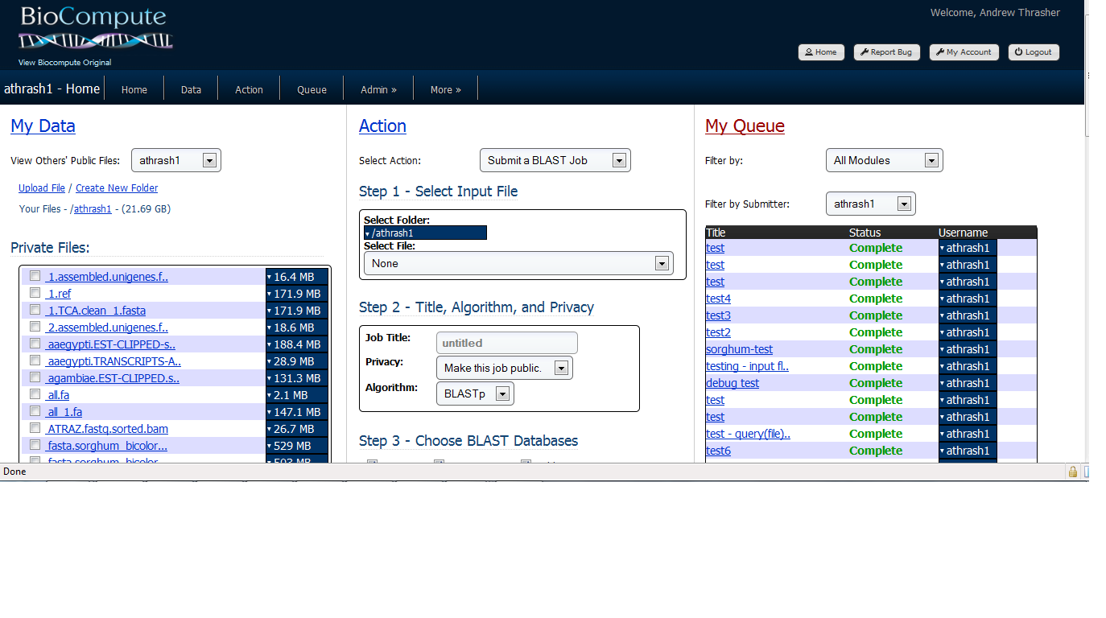

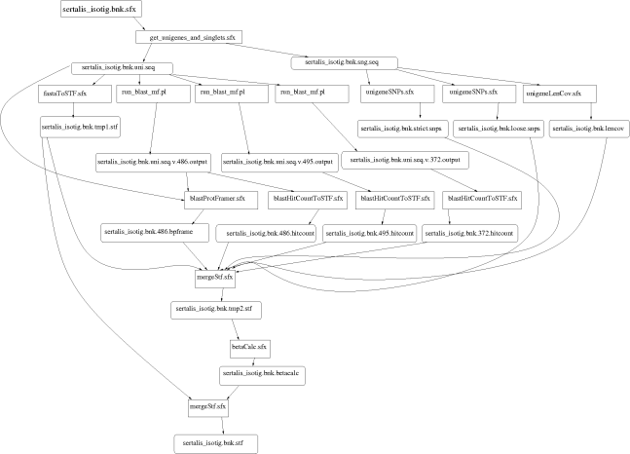
Example: Biocompute Portal
BLAST
SSAHA
SHRIMP
EST
MAKER
…
Progress
Bar
Generate Makefile
Transaction Log
Condor
Pool
Update
Status
Run
Workflow
Make
flow
Submit
Tasks

Slide 24

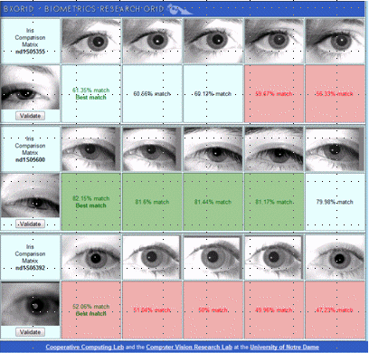
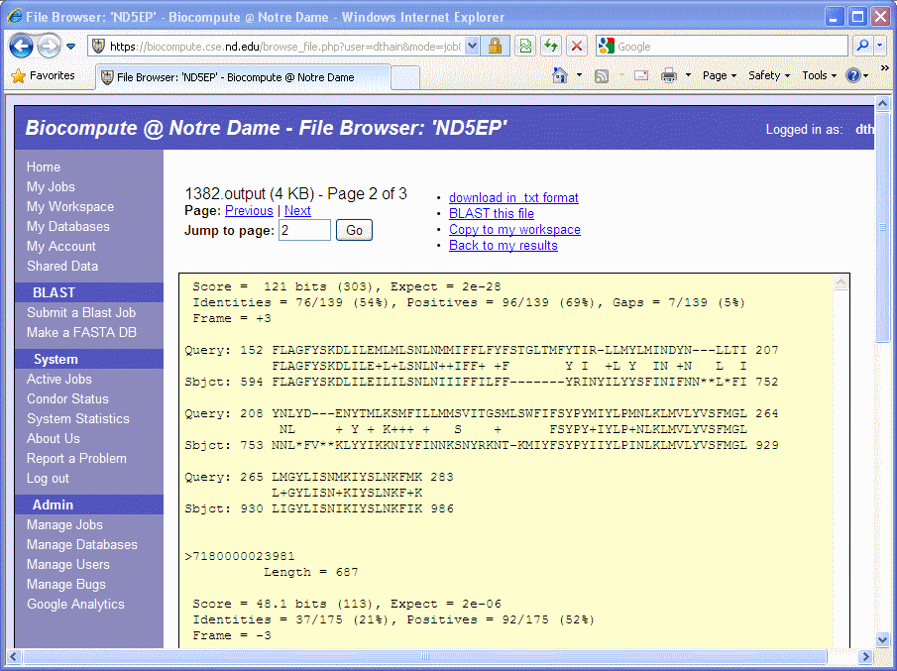
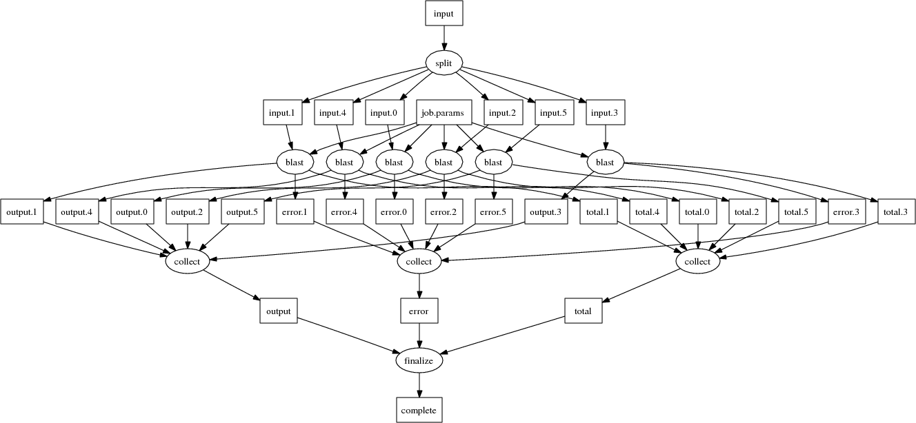
Makeflow Applications

Slide 25
Makeflow + Work Queue

Slide 26
Makeflow + Batch System
FutureGrid
Torque
Cluster
Private
Cluster
Makefile
makeflow –T torque
???
Makeflow
???
Campus
Condor
Pool
Public
Cloud
Provider
makeflow –T condor
Local Files and Programs

Slide 27
Makeflow + Work Queue
torque_submit_workers
FutureGrid
Torque
Cluster
Private
Cluster
Makefile
W
W
Thousands of Workers in a
Personal Cloud
W
submit
tasks
W
W
W
Makeflow
Campus
Condor
Pool
Public
Cloud
Provider
W
W
W
W
W
W
W
Local Files and Programs
condor_submit_workers
ssh

Slide 28
Advantages of Work Queue
Harness multiple resources simultaneously.
Hold on to cluster nodes to execute multiple tasks rapidly. (ms/task instead of min/task)
Scale resources up and down as needed.
Better management of data, with local caching for data intensive tasks.
Matching of tasks to nodes with data.

Slide 29
Makeflow and Work Queue
To start the Makeflow
% makeflow –T wq sims.mf
Could not create work queue on port 9123.
% makeflow –T wq –p 0 sims.mf
Listening for workers on port 8374…
To start one worker:
% work_queue_worker india.futuregrid.org 8374

Slide 30
Start Workers Everywhere
Submit workers to Condor:
condor_submit_workers india.futuregrid.org 8374 25
Submit workers to SGE:
sge_submit_workers india.futuregrid.org 8374 25
Submit workers to Torque:
torque_submit_workers india.futuregrid.org 8374 25

Slide 31
Keeping track of port numbers gets old fast…

Slide 32
Project Names
makeflow …
–N myproject
work_queue_worker
–N myproject
Makeflow
(port 4057)
connect to
indiaX:4057
Worker
advertise
query
Catalog
work_queue_status
query
“myproject”
is at india:4057

Slide 33
Project Names
Start Makeflow with a project name:
% makeflow –T wq –N myproject sims.mf
Listening for workers on port XYZ…
Start one worker:
% work_queue_worker -N myproject
Start many workers:
% torque_submit_workers –N myproject 5

Slide 34
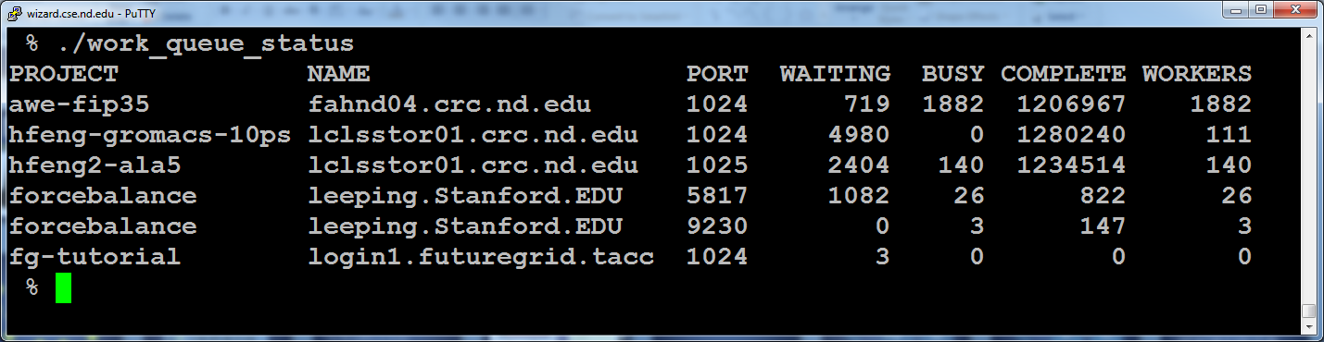
work_queue_status

Slide 35
Resilience and Fault Tolerance
MF +WQ is fault tolerant in many different ways:
  If Makeflow crashes (or is killed) at any point, it will recover by reading the transaction log and continue where it left off.
  Makeflow keeps statistics on both network and task performance, so that excessively bad workers are avoided.
  If a worker crashes, the master will detect the failure and restart the task elsewhere.
  Workers can be added and removed at any time during the execution of the workflow.
  Multiple masters with the same project name can be added and removed while the workers remain.
  If the worker sits idle for too long (default 15m) it will exit, so as not to hold resources idle.

Slide 36
Elastic Application Stack
All-Pairs
Wavefront
Makeflow
Custom
Apps
Work Queue Library
Thousands of Workers in a
Personal Cloud
Public
Cloud
Provider
Shared
SGE
Cluster
Campus
Condor
Pool
Private
Cluster
W
W
Wv
W
W
W
W
W
W

Slide 37
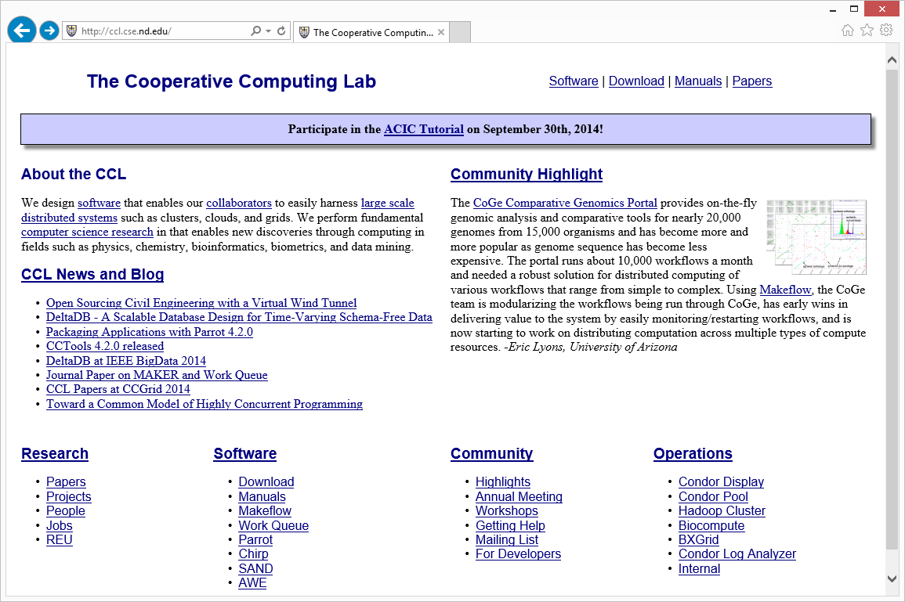
Go to http://ccl.cse.nd.edu and click on ACIC Tutorial.

