Slide 1
Introduction to Makeflow and Work Queue

Slide 2
The Cooperative Computing Lab
We collaborate with people who have large scale computing problems in science, engineering, and other fields.
We operate computer systems on the O(10,000) cores: clusters, clouds, grids.
We conduct computer science research in the context of real people and problems.
We develop open source software for large scale distributed computing.
ccl.cse.nd.edu

Slide 3
Our philosophy
Harness all available resources: desktops, clusters, clouds, and grids.
Make it easy to scale up from one desktop to national scale infrastructure.
Provide familiar interfaces that make it easy to connect existing apps together.
Allow portability across operating systems, storage systems, middleware…
Make simple things easy, and complex things possible.
No special privileges required.

Slide 4
A quick tour of CCTools
Open source, GNU General Public License.
Compiles in 1-2 minutes, installs in $HOME.
Runs on Linux, Solaris, MacOS, FreeBSD, …
Interoperates with many distributed computing systems.
Condor, SGE, Torque, Globus, iRODS, Hadoop…
Components:
Makeflow – A portable workflow manager.
Work Queue – A lightweight distributed execution system.
Parrot – A personal user-level virtual file system.
Chirp – A user-level distributed filesystem.

Slide 5
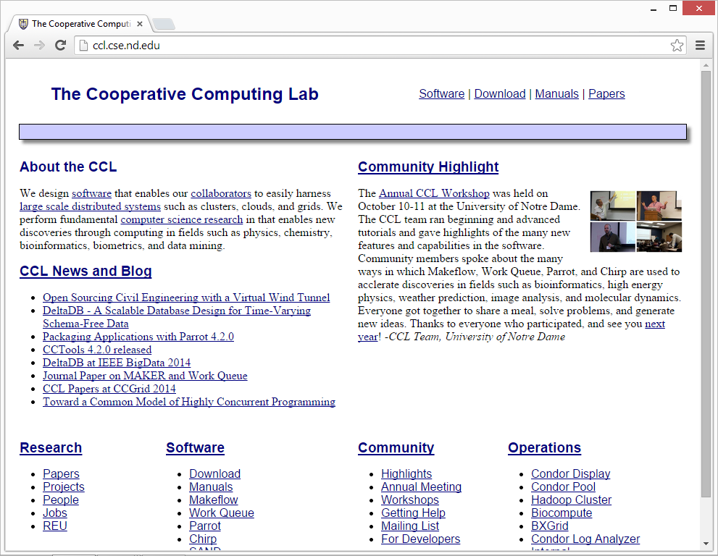
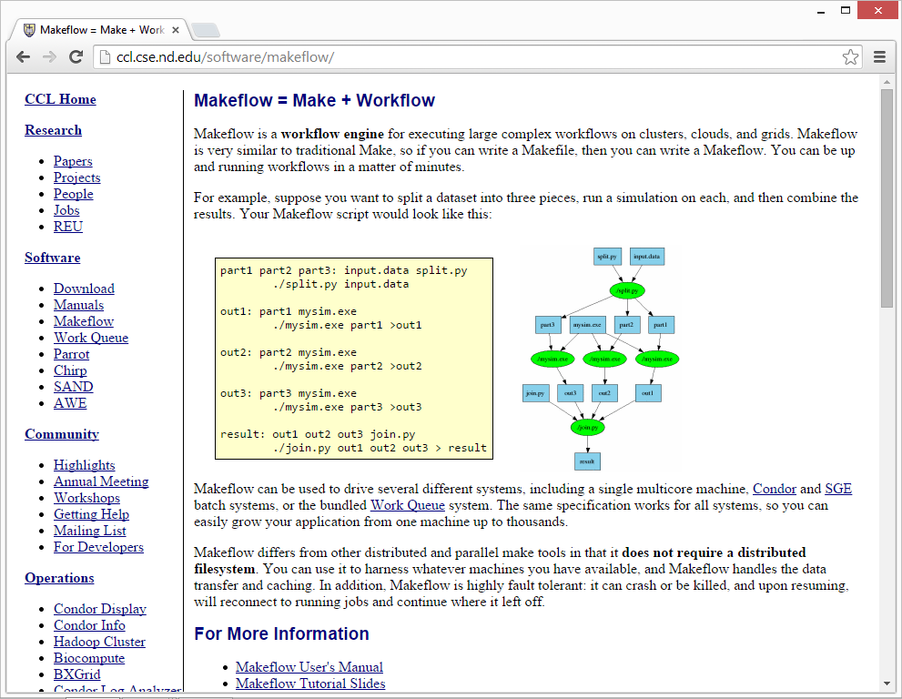
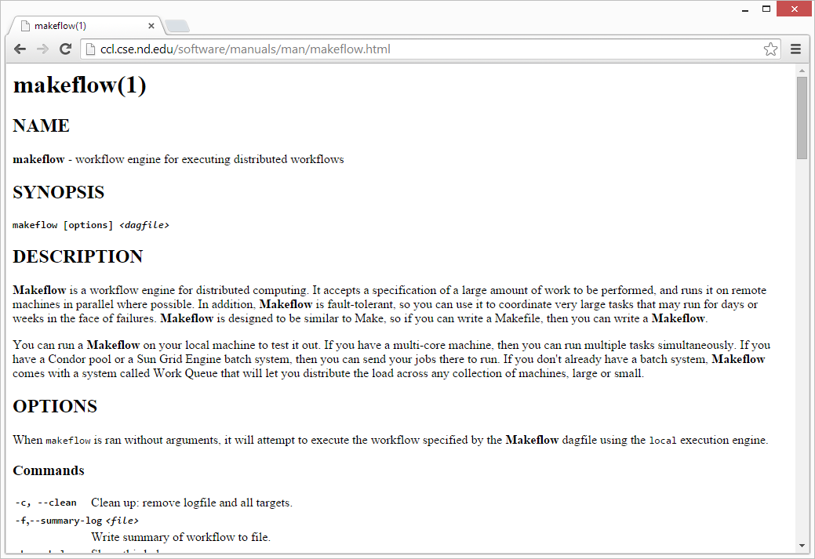
Lots of documentation

Slide 6
Makeflow
A portable workflow system

Slide 7
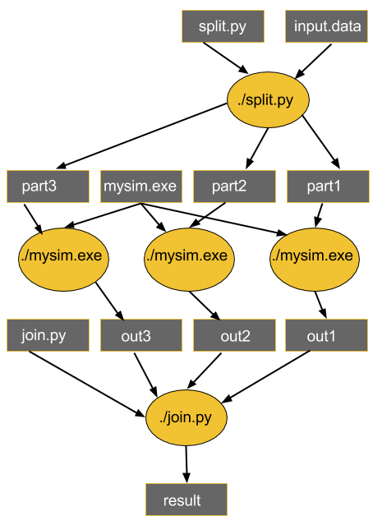
Makeflow (make + workflow)
Provides portability across batch systems.
Enable parallelism (but not too much!)
Trickle out work to batch system
Fault tolerance at multiple scales.
Data and resource management.
Makeflow
Local
SLURM
Work Queue

Slide 8
Based off an old idea: Makefiles
part1 part2 part3: input.data split.py
./split.py input.data
out1: part1 mysim.exe
./mysim.exe part1 >out1
out2: part2 mysim.exe
./mysim.exe part2 >out2
out3: part3 mysim.exe
./mysim.exe part3 >out3
result: out1 out2 out3 join.py
./join.py out1 out2 out3 > result

Slide 9
Makeflow syntax
[output files] : [input files]
[command to run]
One Rule
calib.dat
sim.exe
out.txt
in.dat
sim.exe in.dat –p 50 > out.txt
out.txt : in.dat calib.dat sim.exe
sim.exe in.data –p 50 > out.txt
out.txt : in.dat
sim.exe in.data –p 50 > out.txt
Not Quite Right!

Slide 10
Makeflow syntax
out.10 : in.dat calib.dat sim.exe
sim.exe –p 10 in.data > out.10
out.20 : in.dat calib.dat sim.exe
sim.exe –p 20 in.data > out.20
out.30 : in.dat calib.dat sim.exe
sim.exe –p 30 in.data > out.30

Slide 11
A Makefile is a really compact specification.
How about we try JSON to more verbosely define our tasks!

Slide 12
Makeflow JSON syntax
Verbose and flexible
Familiar structure
Consists of four items:
"categories": Object<Category>
"default_category": String
"environment": Object<String>
"rules": Array<Rule>

Slide 13
Makeflow JSON syntax
calib.dat
sim.exe
out.txt
in.dat
sim.exe in.dat –p 50 > out.txt
{
"outputs": ["out.txt"],
"inputs": [ "in.dat", "calib.dat", "sim.exe"]
"command": "sim.exe –p 50 in.data > out.txt",
}
One Rule

Slide 14
Makeflow JSON syntax
{
"outputs": [{"out_10.txt"}],
"inputs": [ {"in.dat"}, {"calib.dat"},
{"sim.exe"}]
"command": "sim.exe –p 10 in.data > out_10.txt",
},
{
"outputs": [{"path": "out_20.txt"}],
"inputs": [ {"in.dat"}, {"calib.dat"},
{"sim.exe"}]
"command": "sim.exe –p 20 in.data > out_20.txt",
},...

Slide 15
Makeflow JSON rule
"inputs": Array<File>
"outputs": Array<File>
"command": String
"local_job": Boolean
"category": String
"resources": Resources
"allocation": String
"environment": Object<String>

Slide 16
JSON can be a bit too verbose sometimes.
How about we shorten it with JX!

Slide 17
Makeflow JX syntax
Allows for more compact makeflows.
Provides functions for expanding tasks: range, variables, etc...
Can be used as templates in conjunction with an arguments file.
Useful for consistently structure data and different data.
args.jx
Batch
System
args.jx
Makeflow
args.jx

Slide 18
Makeflow JX syntax
{
"outputs": [{"out_10.txt"}],
"inputs": [ {"in.dat"}, {"calib.dat"},
{"sim.exe"}]
"command": "sim.exe –p 10 in.data > out_10.txt",
},...
We can represent this JSON with JX:
{
"outputs": [{format("out_%d.txt", i)}],
"inputs": [ {"in.dat"}, {"calib.dat"},
{"sim.exe"}]
"command": format("sim.exe –p %d in.data > out_%d.txt", i),
} for i in range(10, 30, 10),

Slide 19
Tutorial time!
ccl.cse.nd.edu/software/tutorials/makeflow/makeflow-tutorial.php
Work to the end of part 1

Slide 20
Makeflow + Work Queue
Harnessing concurrency with an execution engine

Slide 21
MAKEFLOW
XSEDE
Torque
Cluster
Private
Cluster
Makefile
makeflow -T torque
???
Makeflow
???
makeflow -T condor
Campus
Condor
Pool
Public
Cloud
Provider
Local Files and Programs

Slide 22
MAKEFLOW + WORK QUEUE
XSEDE
Torque
Cluster
Private
Cluster
Makefile
W
W
Thousands of Workers in a
Personal Cloud
W
submit
tasks
W
W
W
Makeflow
Campus
Condor
Pool
Public
Cloud
Provider
W
W
W
W
W
W
W
Local Files and Programs

Slide 23
WORK QUEUE
XSEDE
Torque
Cluster
Private
Cluster
Application
W
W
API
Thousands of Workers in a
Personal Cloud
W
W
W
W
Tasks
submit
tasks
Campus
Condor
Pool
Public
Cloud
Provider
W
W
W
Master
W
W
W
W

Slide 24
Advantages of Work Queue
Harness multiple resources simultaneously.
Hold on to cluster nodes to execute multiple tasks rapidly.
(ms/task instead of min/task)
Scale resources up and down as needed.
Better management of data, with local caching for data intensive tasks.
Matching of tasks to nodes with data.

Slide 25
Keeping track of port numbers is tedious.

Slide 26
Project names
makeflow …
-N myproject
work_queue_worker
-N myproject
Connect to
jetstream:4057
Master
Port 4057
Worker
Advertise
Query
Catalog
Query
work_queue_status
“myproject”
is at jetstream:4057

Slide 27
Advantages of Work Queue
MF +WQ is fault tolerant in many different ways:
If Makeflow crashes (or is killed) at any point, it will recover by reading the transaction log and continue where it left off.
Makeflow keeps statistics on both network and task performance, so that excessively bad workers are avoided.
If a worker crashes, the master detects failure and restarts the task.
Workers can be added and removed at any time during workflow execution.
Multiple masters with the same project name can be added and removed while the workers remain.
If the worker sits idle for too long (default 15m) it will exit, so as not to hold resources idle.

Slide 28
Let’s try it out!
ccl.cse.nd.edu/software/tutorials/makeflow/makeflow-tutorial.php
Continue where you left off, and work to the end of the tutorial

Slide 29
Container Integration
Providing consistent environments
If you are not interested in utilizing containers for your workflows, the following slides will be supplementary material you may skip.

Slide 30
Containers create precise execution environments
singularity run ubuntu-38.23.img mysim.exe
mysim.exe
Code
Code
Libraries
Libraries
Kernel
Kernel
Ubuntu-38.23
image
Container
Environment

Slide 31
Running a container for Makeflow tasks
makeflow --singularity ubuntu.img
Tasks
Worker
Makeflow
T
T
T
singularity run ubuntu.img ...

Slide 32
Last hands-on section!
ccl.cse.nd.edu/software/tutorials/makeflow/container-tutorial.php
Work through the container tutorial from start to finish.

Slide 33
Questions?
Please contact us!
Nate Kremer-Herman
nkremerh@nd.edu
ccl.cse.nd.edu

