Slide 1
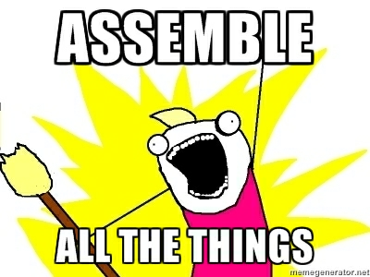
C. Titus Brown
Asst Prof, CSE and Micro
Michigan State University ctb@msu.edu

Slide 2
Acknowledgements
Lab members involved
Collaborators
Adina Howe (w/Tiedje)
Jason Pell
Arend Hintze
Rosangela Canino-Koning
Qingpeng Zhang
Elijah Lowe
Likit Preeyanon
Jiarong Guo
Tim Brom
Kanchan Pavangadkar
Eric McDonald
Jim Tiedje, MSU
Janet Jansson, LBNL
Susannah Tringe, JGI
Funding
USDA NIFA; NSF IOS; BEACON.

Slide 3
Open science, blogging, etc.
All pub-ready work is available through arXiv.
“k-mer percolation”
“diginorm”
Future papers will go there on submission, too.
I discuss this stuff regularly on my blog (ivory.idyll.org/blog/) and Twitter (@ctitusbrown).
All source code (Python/C++) is freely available, open source, documented, tested, etc. (github.com/ctb/khmer)/
…life’s too short to hide useful approaches!
~20-50 people independently using our approaches.

Slide 4
Soil contains thousands to millions of species
(“Collector’s curves” of ~species)
Number of OTUs
Number of Sequences

Slide 5
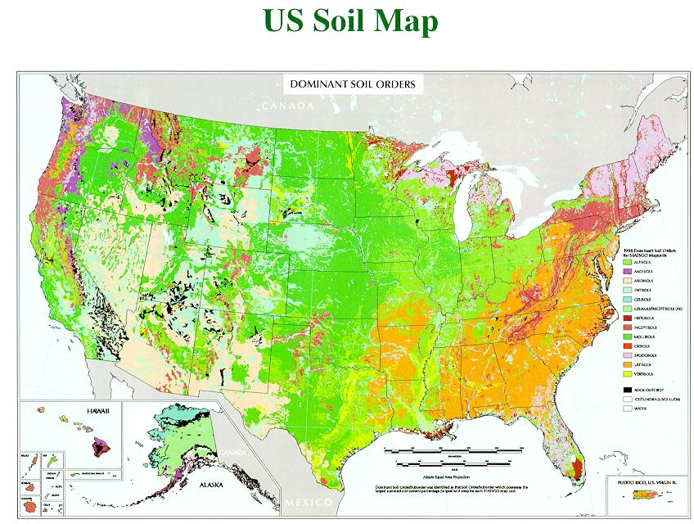
SAMPLING LOCATIONS
Notes:
Fly-over country (that I live in)

Slide 6
A “Grand Challenge” dataset (DOE/JGI)

Slide 7
Assembly
It was the best of times, it was the wor
, it was the worst of times, it was the
isdom, it was the age of foolishness
mes, it was the age of wisdom, it was th
It was the best of times, it was the worst of times, it was the age of wisdom, it was the age of foolishness
…but for lots and lots of fragments!

Slide 8
Assemble based on word overlaps:
the quick brown fox jumped
jumped over the lazy dog
the quick brown fox jumped over the lazy dog
Repeats do cause problems:
my chemical romance: na na na
na na na, batman!

Slide 9
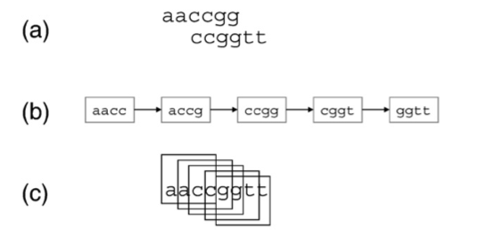
De Bruijn graph assembly: k-mers as nodes, connected using overlaps.
J.R. Miller et al. / Genomics (2010)

Slide 10
Fun Facts about de Bruijn graphs
Memory usage lower bound scales as # of unique k-mers.
Real sequence +
Sequencing errors
Assembly is a “big graph” problem – famously difficult to parallelize.
We are looking at graphs with 15-20 billion nodes.
Need bigmem machines.

Slide 11
3 years of compressible probabilistic de Bruijn graphs & lossy compression algorithms =>
Notes:
May solve the JCVI 454 ⬄ Illumina issue.

Slide 12
Contig assembly now scales with underlying genome size
Transcriptomes, microbial genomes incl MDA, and most metagenomes can be assembled in under 50 GB of RAM, with identical or improved results.
Has solved some specific problems with eukaryotic genome assembly, too.
Can do ~300 Gbp agricultural soil sample in 300 GB of RAM, ~15 days (compare: 3 TB for others).
Notes:
Goal is to do first stage data reduction/analysis in less time than it takes to generate the data. Compression => OLC assembly.

Slide 13
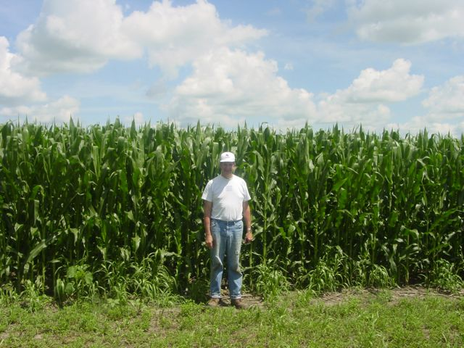
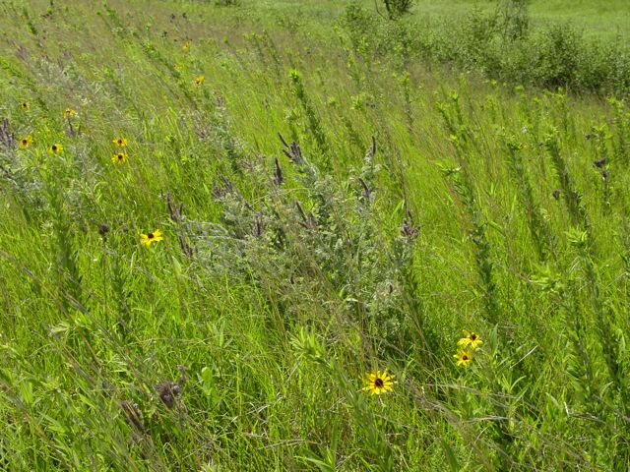
What do we get from assembling soil?
(20% of reads assembled; est 50 Gbp needed for thorough sampling.)
Total Assembly | Total Contigs | % Reads Assembled | Predicted protein coding | rplb genes
2.5 bill | 4.5 mill | 19% | 5.3 mill | 391
3.5 bill | 5.9 mill | 22% | 6.8 mill | 466
This estimates number of species ^
Putting it in perspective:
Total equivalent of ~1200 bacterial genomes
Human genome ~3 billion bp
Adina Howe

Slide 14
What’s next? (~2 years)
Improved digital normalization algorithms.
Lossy compression for resequencing analysis.
Eukaryotic genome assembly, incl high-heterozygosity samples.
~1.1 pass error-correction approach.
“Infinite” metagenomic/mRNAseq assembly.
Application to 454, PacBio, etc. data.
Reasonably confident we can solve all assembly scaling problems.

Slide 15
…workflows?
Mostly we’re running on single machines now: single pass, fixed memory algorithms => discard your HPC.
One big remaining problem (much bigger metagenome data!) remains ahead…
Want to enable sophisticated users to efficiently run pipeline, tweak parameters, and re-run. How???
Hack Makefiles? NONONONONONONONONONO. It might catch on!

Slide 16
Things we don’t need more of:
1. Assemblers.
2. Workflow management systems.

Slide 17
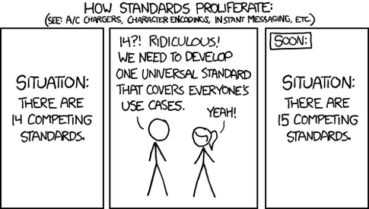
Things people like to write
1. Assemblers.
2. Workflow management systems.

Slide 18
Slightly more serious thoughts
For workflows distributed with my tool,
Want to enable good default behavior.
Want to avoid stifling exploration and adaptation.
GUI as an option, but not a necessity.

Slide 19
Introducing… ipython notebook
Interactive ipython prompt, with Mathematica style cells
ipython already contains DAG dependency tools, various kinds of scheduling, and multiple topologies for parallel work spawning and gathering.
And it’s python!
At first glance, may not seem that awesome.
It is worth a second & third glance, and an hour or three of your time.

Slide 20
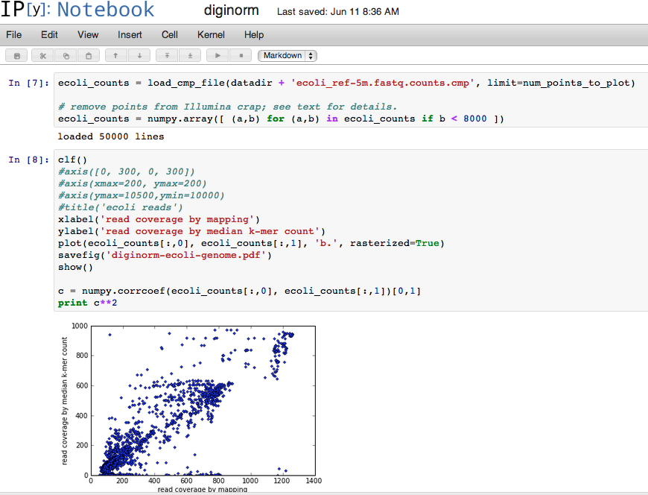

Slide 21
…but it’s still young.
ipynb is not built for long-running processes.
Right now I’m using it for “terminal” data analysis, display, and publications; ‘make’ (just ‘make’) for doing analyses.
Many plans for
Periodic reporting
Collaboration environments
Replicable research
…all of which is easily supported at a protocol level by the nb.

Slide 22
Our problems
We have “Big Data” and not “Big Compute” problems.
We need bigmem more than anything else.
…so nobody likes us ☹.
We also need a workflow system that supports interaction.
We really like Amazon. People at the NIH are exploring…

