Slide 1
Development and application of automatic force field optimization methods for molecular simulation
Lee-Ping Wang
Stanford Department of Chemistry
CCL Workshop, Notre Dame University
June 11, 2012

Slide 2
Outline
Introduction
  Physical chemistry and theoretical chemistry
  The many faces of molecular dynamics simulation
Force fields for molecular mechanics simulation
  Three components: Functional form, reference data, optimization
  Implementation of systematic force field optimization
  Challenges in scalable computing
  Results and discussion

Slide 3
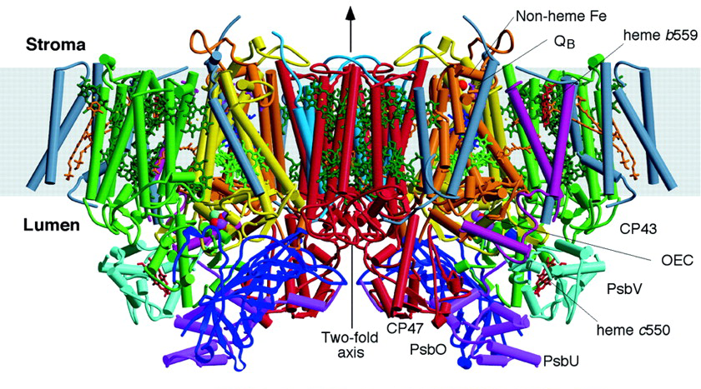
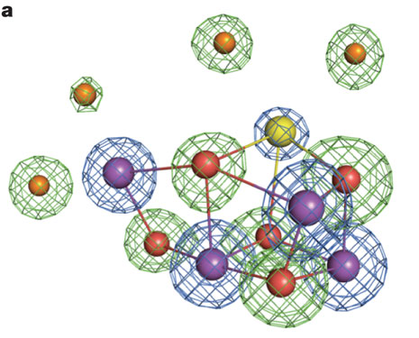


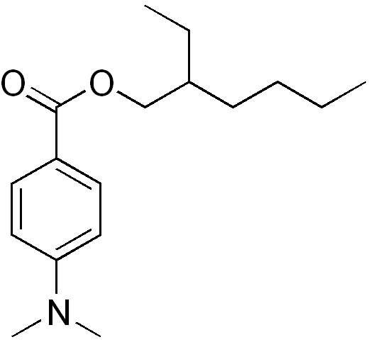



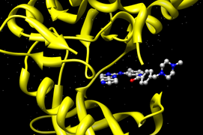
Introduction: Physical Chemistry
Physics helps us to understand chemical processes.
Chemical bonding and reactivity
Molecular interactions with:
Electric potentials (electrochemistry)
Synthesis of new chemical compounds
Photosystem II
splits water in
green plants
Light (photochemistry)
From nylon to kevlar
OD-PABA,
found in sunscreen
Accelerating chemical reactions via catalysis
Other molecules (noncovalent interactions)
Anticancer drug
“Gleevec” docking
into tyrosine kinase
Creating fuels and reducing pollution

Slide 4
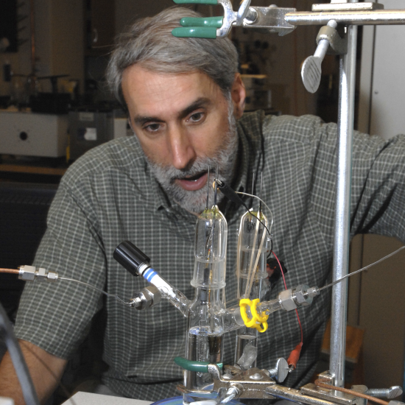
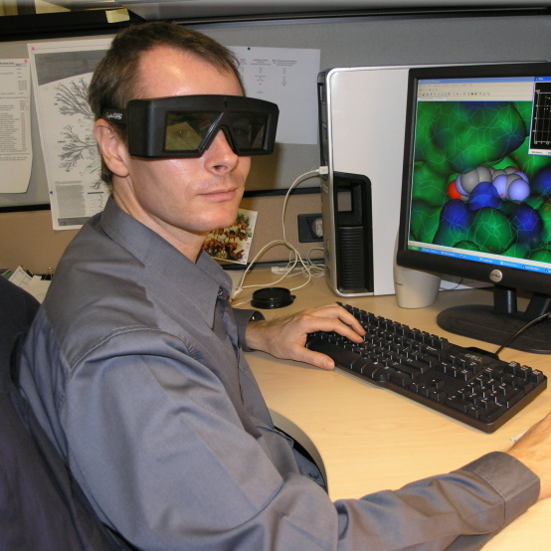
Introduction: Theory and Experiment
Theoretical and computational chemistry can offer explanations and predictions.
Insight into
atomic scale processes
Predictions of
experimental results
Experiment
Theory and Computation
THEORY + EXPERIMENT COLLABORATION
Observations
needing explanation
Verification of
approximations

Slide 5
Introduction: Physical Theories
The main tools of theoretical chemistry are
quantum mechanics and statistical mechanics.
The electronic structure of a molecule is completely described by solving Schrodinger’s equation
For most systems, exact solution not available; approximations are computationally intensive
The partition function is a roadmap for how molecular systems evolve
High-dimensional integral is evaluated by sampling, requiring computer power and efficient algorithms
QUANTUM MECHANICS
STATISTICAL MECHANICS

Slide 6
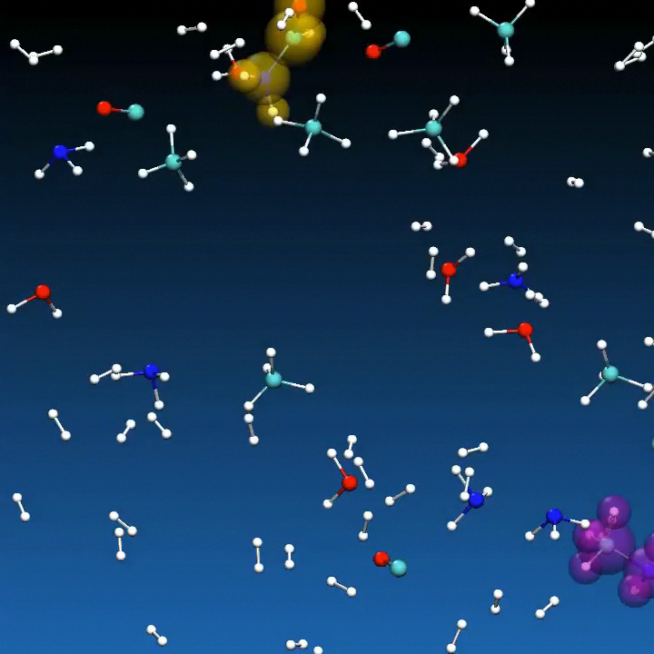
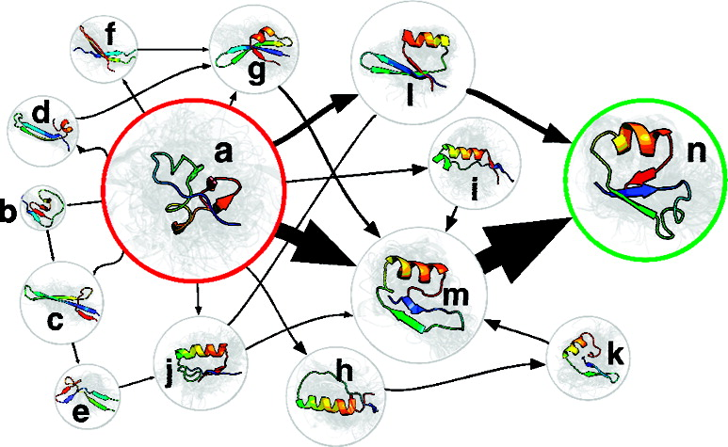

Introduction: Molecular dynamics simulation
Molecular dynamics (MD) simulation is a combined application of quantum and statistical mechanics.
A classical MD simulation illustrating a protein folding process.
A statistical model (Markov state model) built using data from several thousand protein folding simulations.
A reactive ab initio MD simulation of early Earth atmosphere, with reaction products identified and highlighted

Slide 7
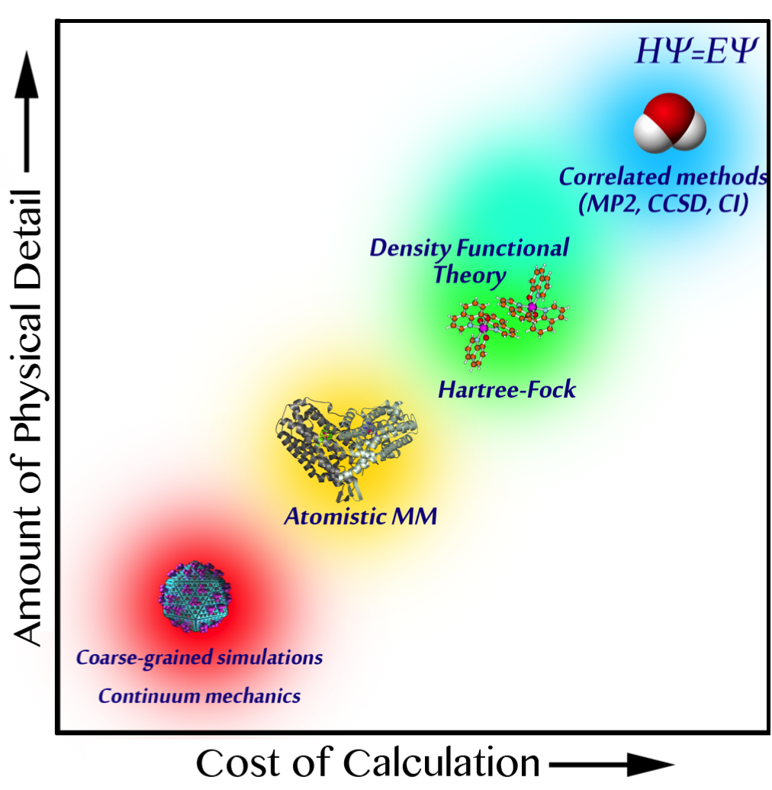
Introduction: A wide range of simulation domains
Single-point, 2-3 atoms
100 fs, 10 atoms: photochemistry
Less detailed theories allow for simulation of larger systems / longer timescales
More detailed theories can describe complex phenomena and offer higher accuracy
10 ps, 100 atoms: chemical reactions
10 μs, thousands of atoms:
protein folding,
drug binding
1 ms+, 1 million atoms: dynamics of large proteins, cell membranes, viruses

Slide 8
Outline
Introduction
  Physical chemistry and theoretical chemistry
  The many faces of molecular dynamics simulation
Force fields for molecular mechanics simulation
  Three components: Functional form, reference data, optimization
  Implementation of systematic force field optimization
  Challenges in scalable computing
  Results and discussion

Slide 9
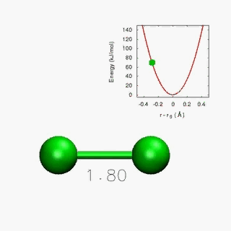
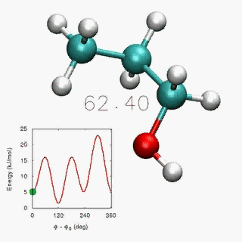
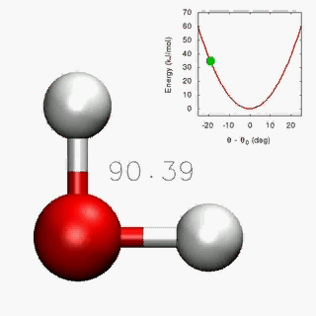
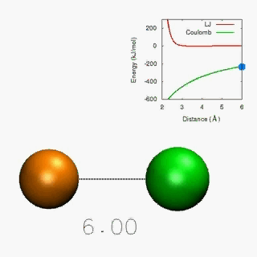
Force Fields
Force fields are built from functional forms and empirical parameters
Interactions include bonded pairwise, 3-body, and 4-body interactions…
… as well as non-bonded pairwise interactions
Simulation accuracy depends critically on choice of parameters

Slide 10
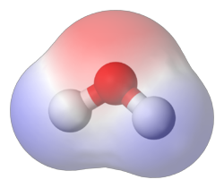
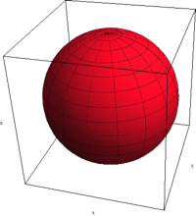
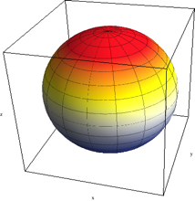
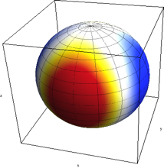
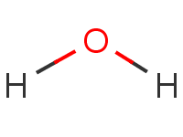
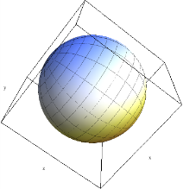
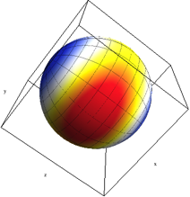
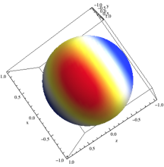
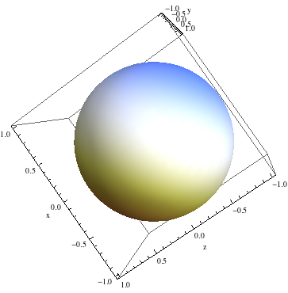
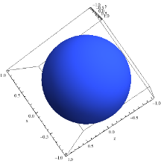
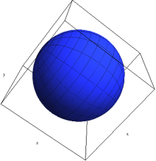
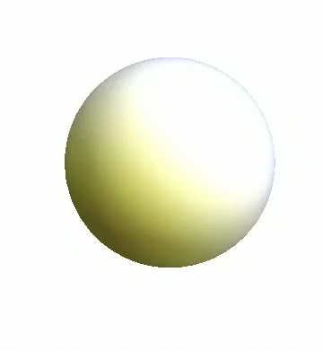
Creating a force field: Functional form
Force fields employ a variety of functional forms to represent the potential energy surface.
AMBER fixed-charge force field:
Point charge on each atom
AMOEBA polarizable force field:
Point charge, dipole, and quadrupole on each atom
Polarizable point dipole on each atom with short-range damping

Slide 11
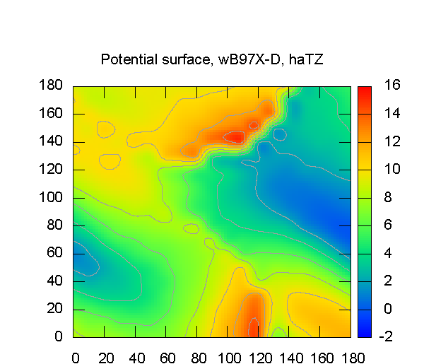
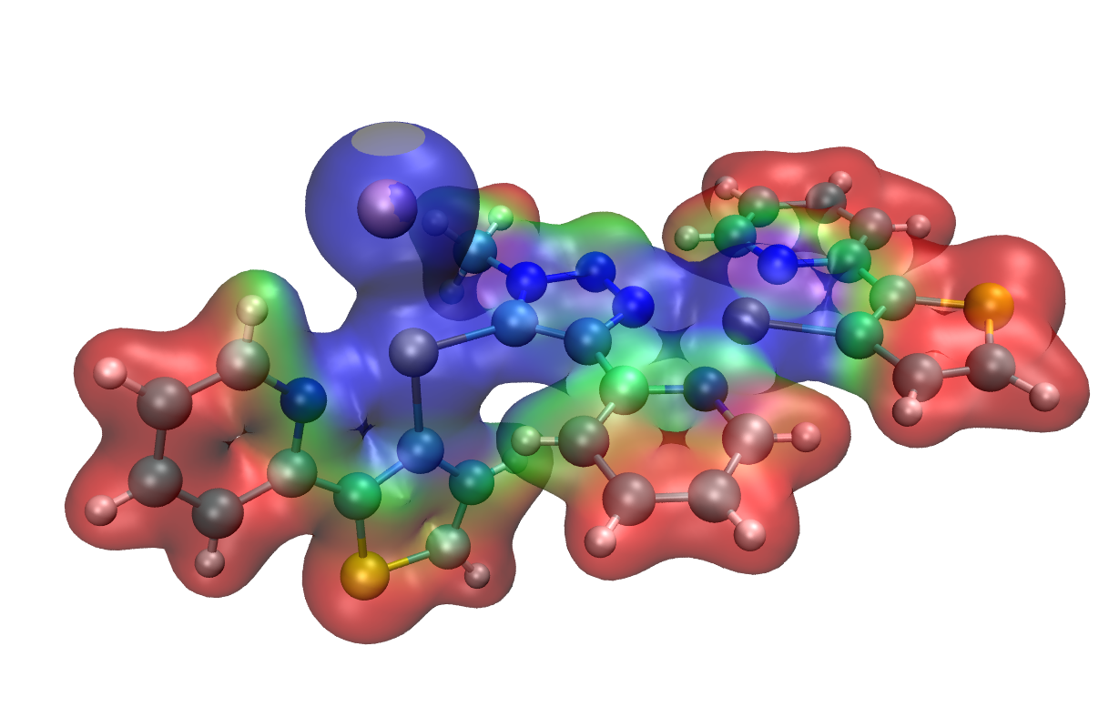
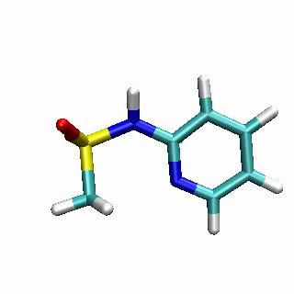
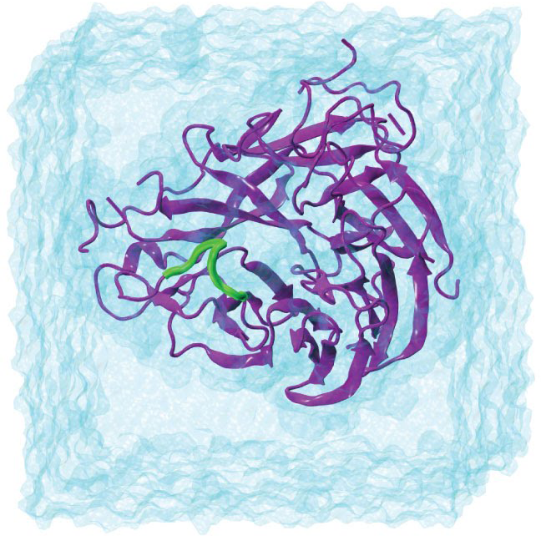
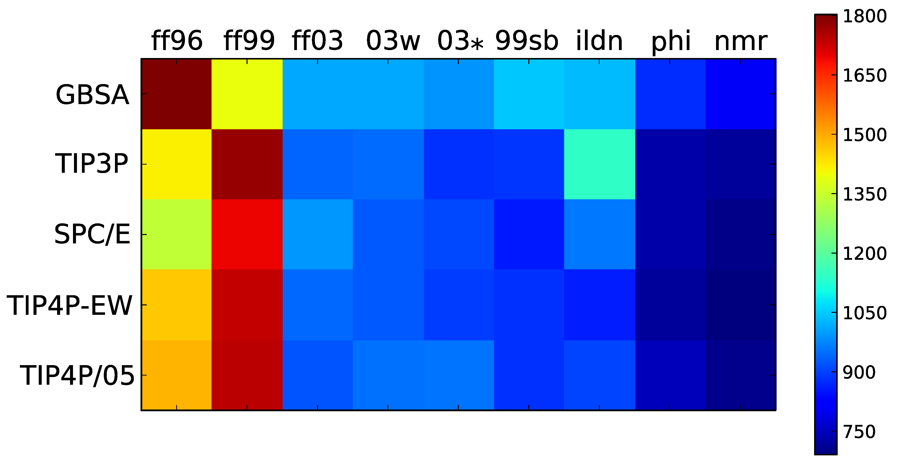
Creating a force field: Reference data
Data for developing force fields can come from quantum mechanical calculations or experiment.
Electrostatic potential on a molecular surface (red = positive, blue = negative)
Energy scan across 2 dihedral angles
Simulated vs. experimental NMR chemical shifts for proteins (red = bad, blue = good)

Slide 12
Creating a force field: Optimization
The objective function χ² is made from simulation results M minus reference values Q
Local optimization methods (BFGS, Levenberg-Marquardt) require analytic derivatives in parameter space but converge quickly
Global optimization methods (simulated annealing, genetic algorithm) can cross barriers, but require many objective function evaluations

Slide 13
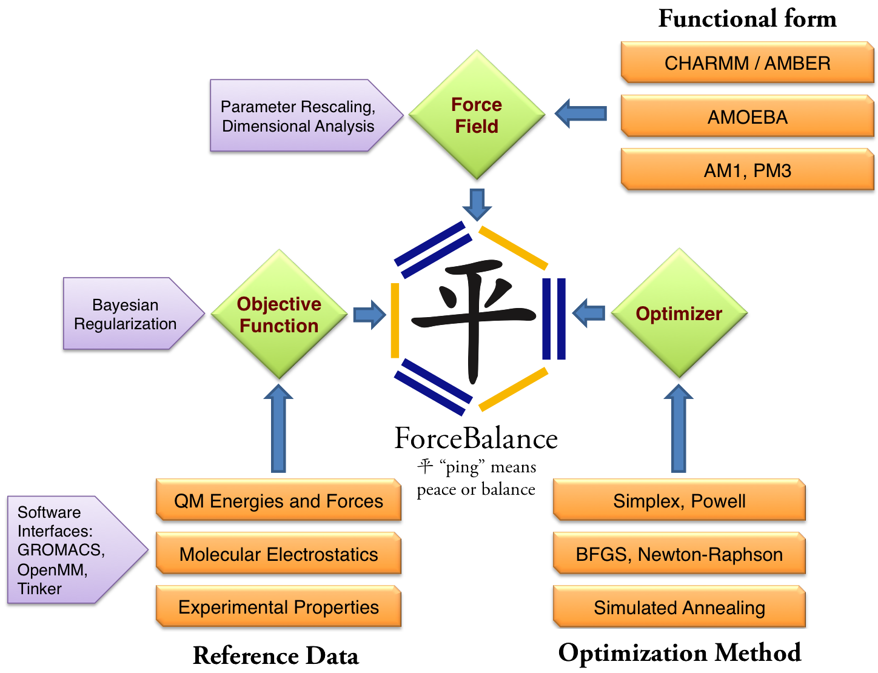
Implementation: ForceBalance software package
Framework supports fitting of diverse reference data
Source code and installer freely available on the Web (simtk.org)

Slide 14
Self-Consistent Parameterization Workflow
Initial
Parameters:
Start Here
Run MM dynamics for sampling
Extract
Snapshots
{r_{s}}
Converged?
Optimized
Parameters
QM Calculations on Snapshots
ts
Update Parameters k
Reference Data Q(r_{s})
Compute MM data M(r_{s})
New
Parameters
k_{n+1}
Compute χ² and Derivatives
Minimize χ²

Slide 15
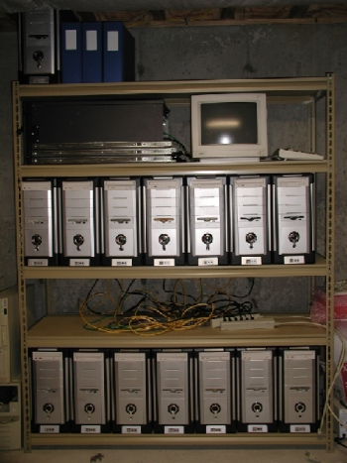
Scalable Computing Challenges
Cluster Name | CPU cores | GPUs | Availability
certainty | 12,800 | 120 | Low
vsp-compute | 1,440 |  | High
exiton | 320 |  | Medium
fire | 1,500 | 120 | High
icme-gpu1 |  | 105 | Medium
keeneland |  | 360 | Medium
Resources are ample but availability fluctuates
Calculation workflow is complex and involves multiple types of software and hardware
Work Queue is an ideal tool set for managing multi-cluster calculations – it is simple and powerful
Some trickery needed for compute nodes to connect to master (through login node and firewall)
Modify OpenMM XML
force field file
Objective & Derivative
Optimizer
OpenMM
Module
Next Parameter Step
Distribute
calculation
(Work Queue)
Clusters run OpenMM

Slide 16
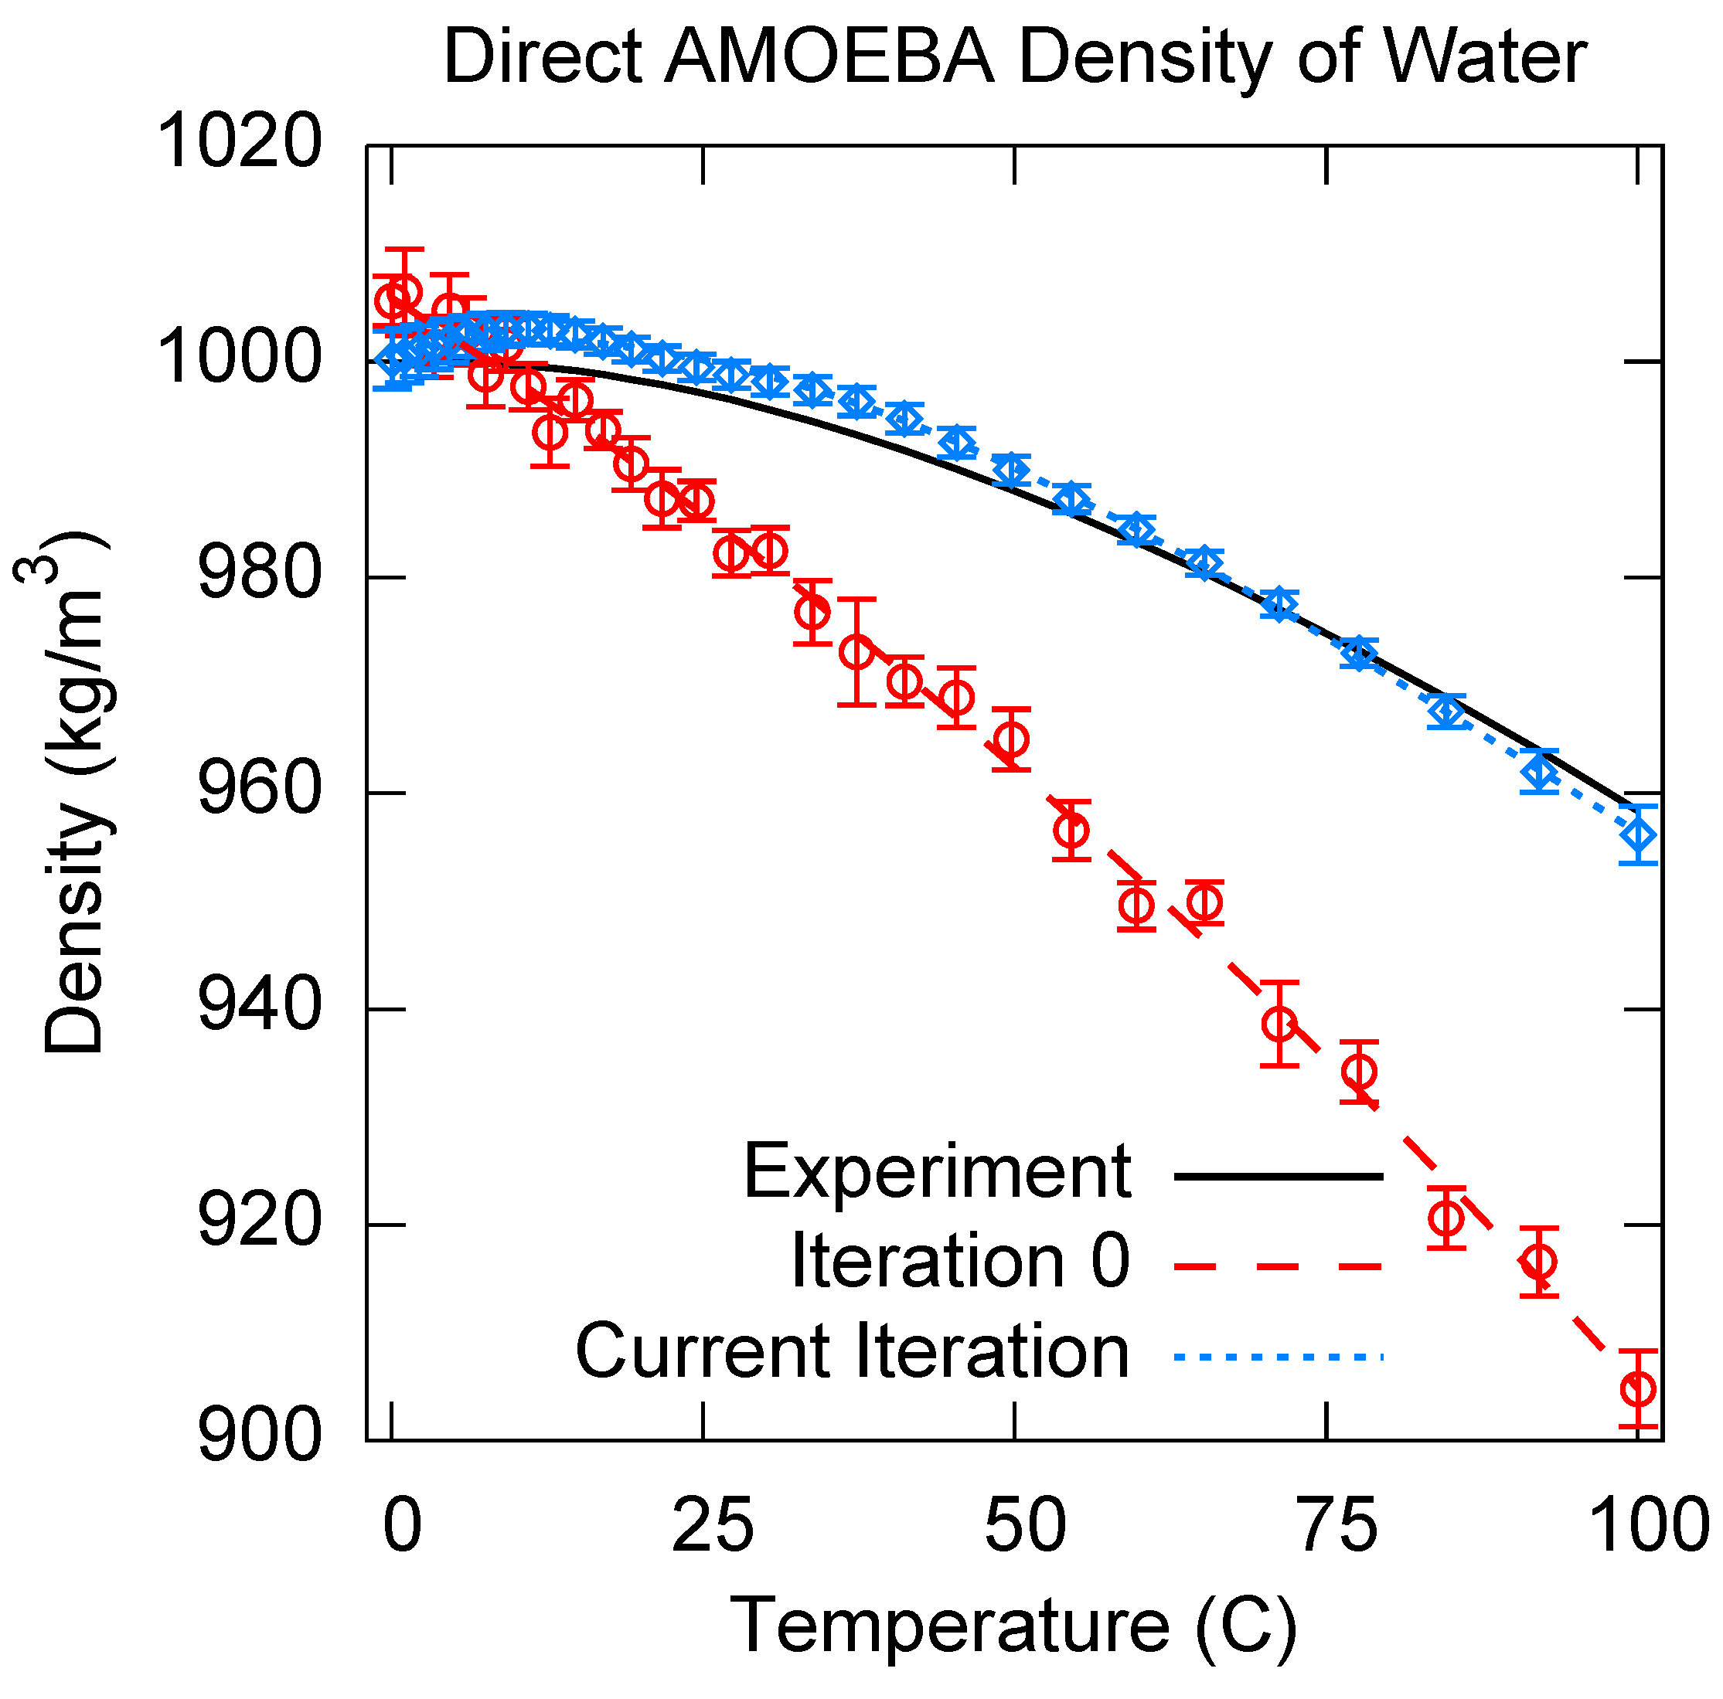
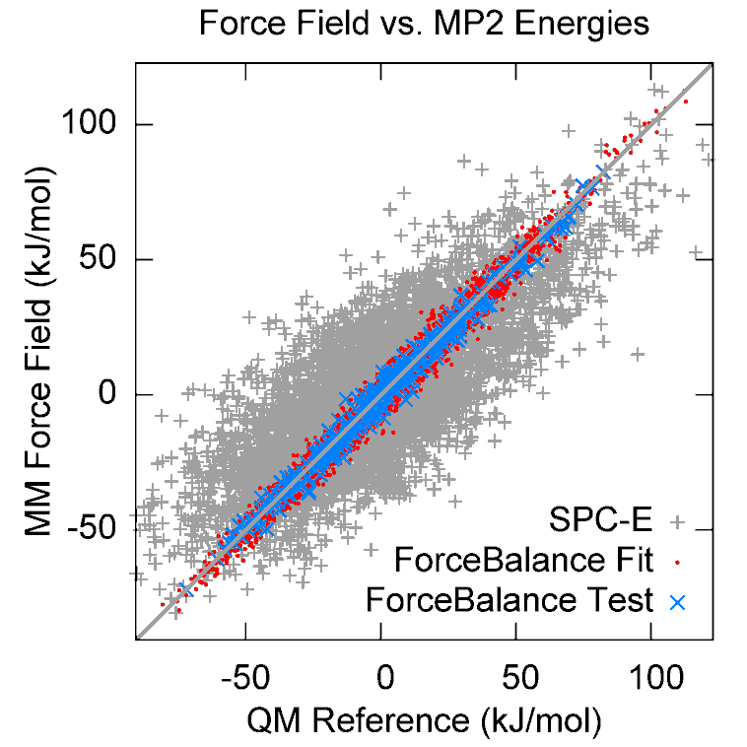

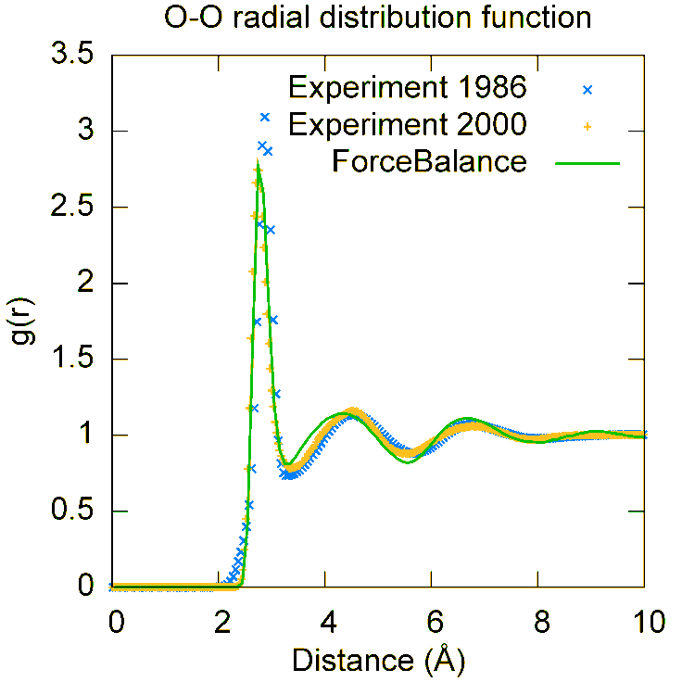
Results: A Polarizable Water Model
Using a detailed functional form, QM data can be fitted to high accuracy
With distributed GPU simulations, direct fitting of experimental data is possible
Validation simulations show some promise of predictive power

Slide 17
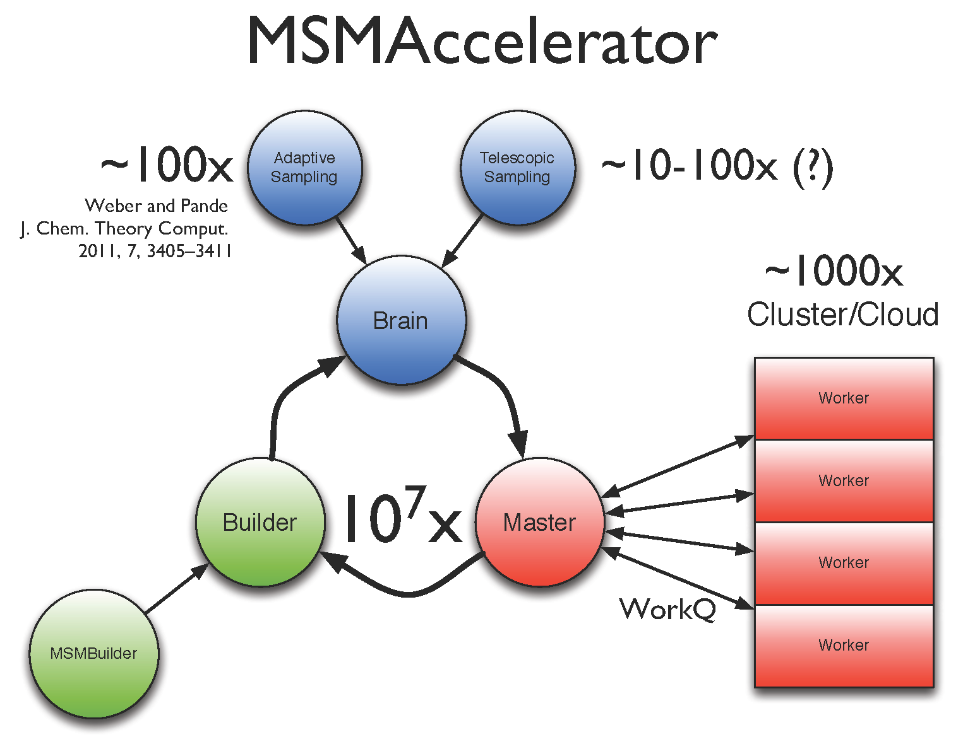
Scalable Computing and Markov State Models
Markov State Models for protein folding and conformational change utilize data from thousands of MD simulations
Adaptive sampling is a strategy to improve MSMs by starting new simulations from rarely visited geometries
“MSMAccelerator” software uses Work Queue to distribute adaptive sampling simulations
TJ Lane and Robert McGibbon,
Pande group, Stanford.

Slide 18

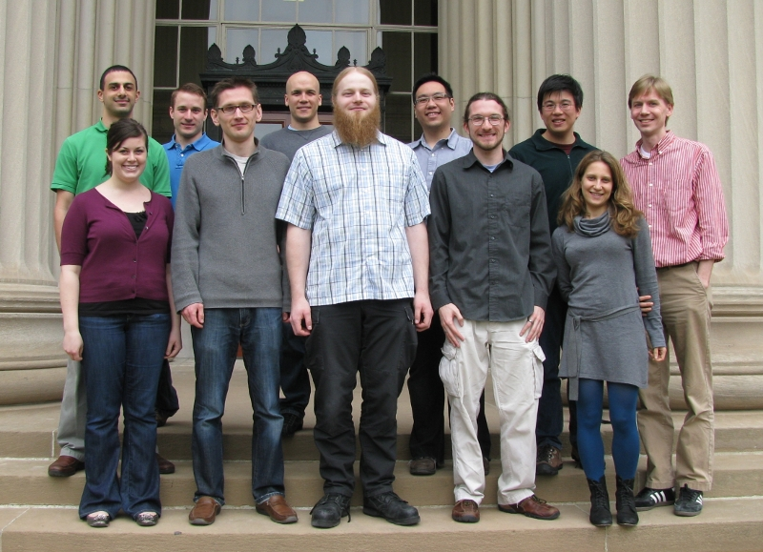


Acknowledgements
Vijay Pande (Stanford)
Todd Martinez (Stanford)
Troy Van Voorhis (MIT)
Teresa Head-Gordon (Berkeley)
Douglas Thain (Notre Dame)
Jesús Izaguirre (Notre Dame)
Simbios Postdoctoral Fellowship
Thank You!

