Slide 1
Introduction to Makeflow and Work Queue
Nate Kremer-Herman
CCL Workshop on Scalable Computing

Slide 2
Makeflow: A Portable Workflow System

Slide 3
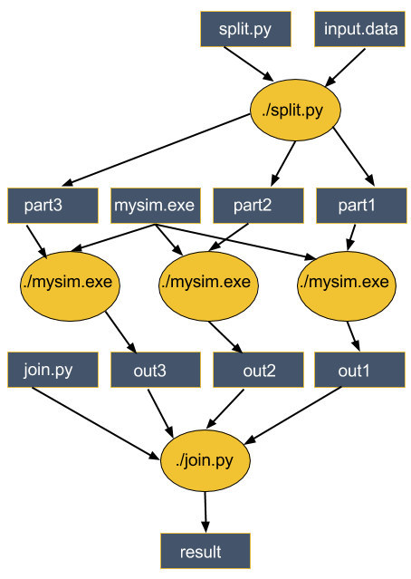
An Old Idea: Makefiles
part1 part2 part3: input.data split.py
./split.py input.data
out1: part1 mysim.exe
./mysim.exe part1 >out1
out2: part2 mysim.exe
./mysim.exe part2 >out2
out3: part3 mysim.exe
./mysim.exe part3 >out3
result: out1 out2 out3 join.py
./join.py out1 out2 out3 > result

Slide 4
Makeflow = Make + Workflow
Provides portability across batch systems.
Enable parallelism (but not too much!)
Trickle out work to batch system.
Fault tolerance at multiple scales.
Data and resource management.
Makeflow
Local
SLURM
TORQUE
Work
Queue

Slide 5
Makeflow Syntax
[output files] : [input files]
[command to run]
One rule
calib.dat
sim.exe
out.txt
in.dat
sim.exe in.dat –p 50 > out.txt
out.txt : in.dat calib.dat sim.exe
sim.exe –p 50 in.data > out.txt
out.txt : in.dat
sim.exe –p 50 in.data > out.txt
Not quite right!

Slide 6
You must state all the files needed by the command.

Slide 7
example.makeflow
out.10 : in.dat calib.dat sim.exe
sim.exe –p 10 in.data > out.10
out.20 : in.dat calib.dat sim.exe
sim.exe –p 20 in.data > out.20
out.30 : in.dat calib.dat sim.exe
sim.exe –p 30 in.data > out.30

Slide 8
Running Makeflow
•Run a workflow locally:
% makeflow example.makeflow
•Clean up the workflow outputs:
% makeflow –c example.makeflow
•Run the workflow on Torque:
% makeflow –T torque example.makeflow
•Run the workflow on Condor:
% makeflow –T condor example.makeflow

Slide 9
Makeflow + Work Queue

Slide 10
Makeflow + Batch System
XSEDE
Torque
Cluster
Private
Cluster
Makefile
makeflow –T torque
???
Makeflow
???
Campus
Condor
Pool
Public
Cloud
Provider
makeflow –T condor
Local Files and Programs

Slide 11
Makeflow + Work Queue
torque_submit_workers
XSEDE
Torque
Cluster
Private
Cluster
Makefile
W
W
Thousands of Workers in a
Personal Cloud
W
submit
tasks
W
W
W
Makeflow
Campus
Condor
Pool
Public
Cloud
Provider
W
W
W
ssh
W
W
W
W
Local Files and Programs
condor_submit_workers

Slide 12
Advantages of Work Queue
Harness multiple resources simultaneously.
Pilot jobs (Work Queue workers) hold on to cluster nodes to execute multiple tasks rapidly.
Scale resources up and down as needed.
Better management of data, with local caching for data intensive tasks.
Matching of tasks to nodes with data.

Slide 13
Running Makeflow with Work Queue
To start the Makeflow:
% makeflow –T wq example.makeflow
Could not create work queue on port 9123.
% makeflow –T wq –p 0 example.makeflow
Listening for workers on port 8374…
To start one worker:
% work_queue_worker master.hostname.org 8374

Slide 14
Project Names
makeflow …
–N myproject
work_queue_worker
–N myproject
Makeflow
(port 9050)
connect to
workflow.iu:9050
Worker
advertise
query
Catalog
work_queue_status
query
“myproject”
is at workflow.iu:9050

Slide 15
Using Project Names
To start Makeflow with a project name:
% makeflow –T wq –N myproject example.makeflow
Listening for workers on port XYZ…
Start one worker:
% work_queue_worker -N myproject
Start many workers:
% work_queue_factory -T condor -N myproject

Slide 16
work_queue_status

Slide 17
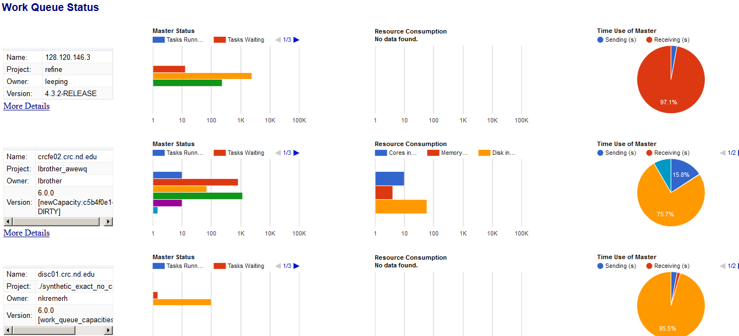
Work Queue Visualization Dashboard
ccl.cse.nd.edu/software/workqueue/status

Slide 18
Work Queue Factory
No need to manually submit workers.
Scales to your workflow automatically (whether up or down).
One-stop worker submission tool.
Supports manual configuration of minimum and maximum workers to maintain if you know your worker needs.
Preferred method of worker submission going forward due to its simplicity.

Slide 19
Resilience and Fault Tolerance
MF +WQ is fault tolerant in many different ways:
If Makeflow crashes (or is killed) at any point, it will recover by reading the transaction log and continue where it left off.
Makeflow keeps statistics on both network and task performance, so that excessively bad workers are avoided.
If a worker crashes, the master will detect the failure and restart the task elsewhere.
Workers can be added and removed at any time during the execution of the workflow.
Multiple masters with the same project name can be added and removed while the workers remain.
If the worker sits idle for too long (default 15m) it will exit, so it does not hold resources while idle.

Slide 20
Visit our website: ccl.cse.nd.edu
Follow us on Twitter: @ProfThain
Check out our blog: cclnd.blogspot.com

